Slide 1
Enhancing Weather Analysis with Data Interpolation and Time Series Forecasting
Master’s Degree in Data Science
Area 5
Author: Alejandro González Barberá
Tutor: Sergio Iserte Agut
Professor: Albert Solé Ribalta

Slide 2
Index
Problem Statement
Workflow and Software
Available Data
Data Understanding
Data Augmentation
  Interpolation Methods Comparison
Time Series Forecasting
  Model Architecture and Hyperparameters
  Validation of the Model
Validation of the Workflow
Final Thoughts and Future Directions

Slide 3

1- Problem Statement
Motivation
Weather analysis has big impact on various industries and sectors.
Large amounts of data from weather stations underutilized.
Complexity of weather patterns and the challenges associated together with the limitations of traditional models.
Enhance data science techniques for effective weather analysis.
Utilization of machine learning and interpolation techniques so as to improve weather analysis.

Slide 4
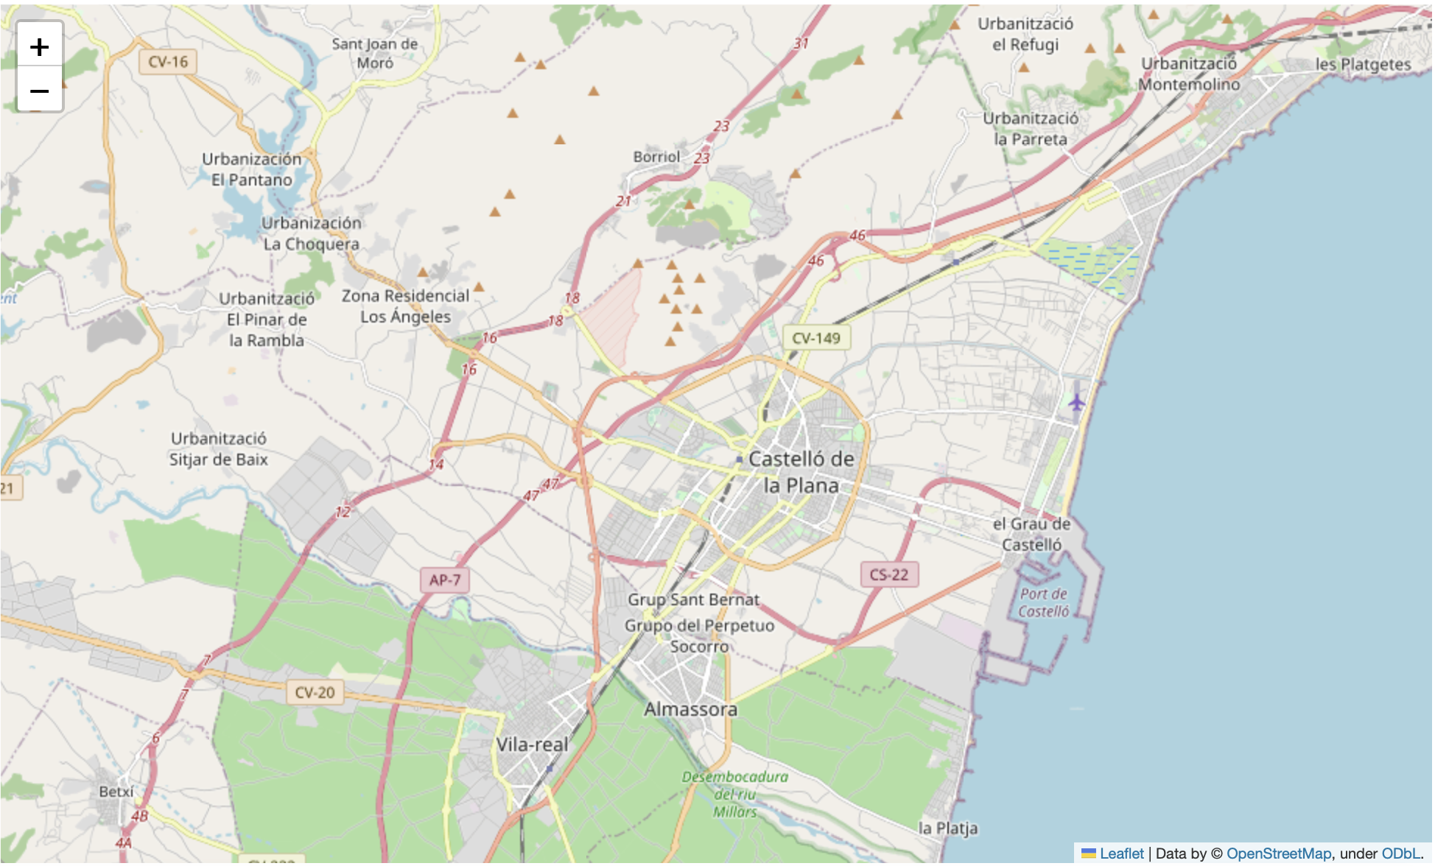
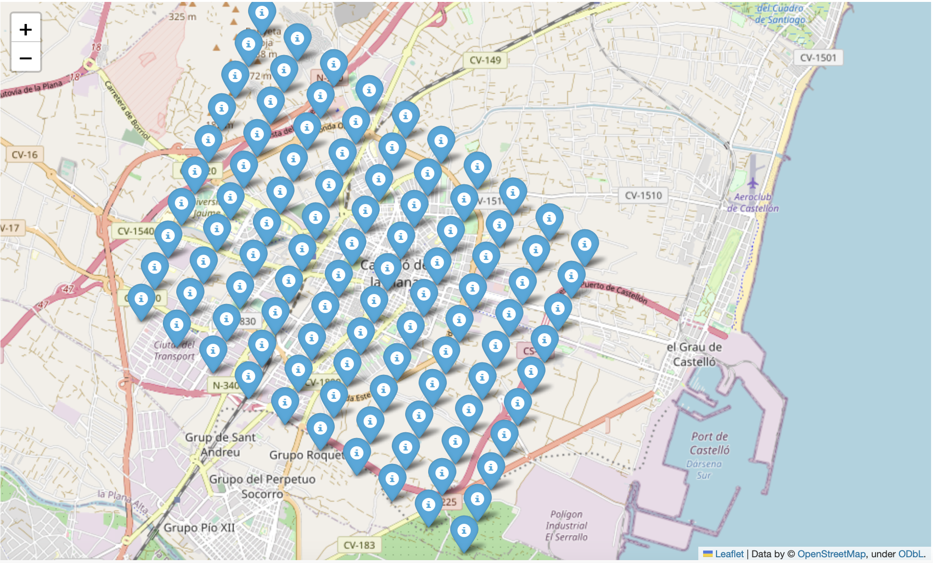
1- Problem Statement
Objectives
Creating a grid of points within the study domain.
Spatial intepolation techniques to fill the gaps in the grid.
Significance of machine learning in leveraging the available weather data.
Enhance weather analysis and time series forecasting.
Optimizing data utilization and improving decision-making processes.
Interpolation

Slide 5
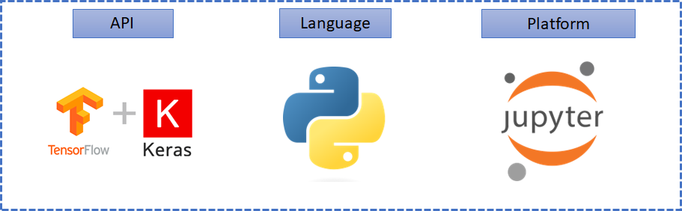
2- Workflow and Software

Slide 6
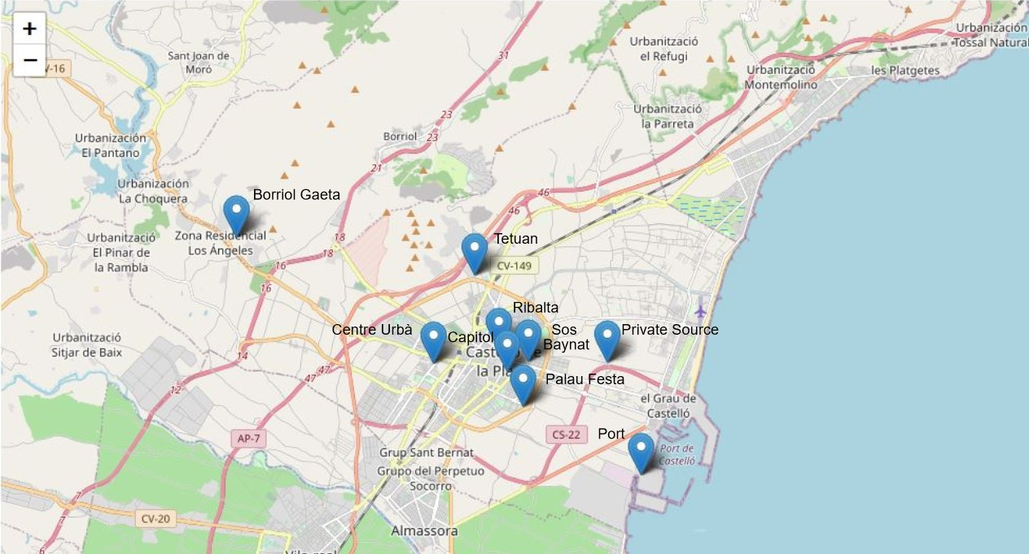
3- Available Data
Temperature
Humidity
Pressure
Wind velocity
Wind direction
Large amount of features
filter

Slide 7
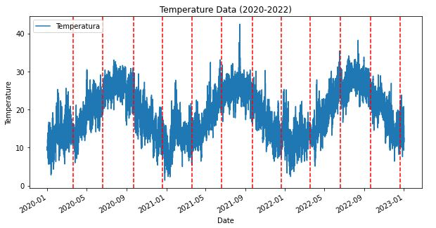
4- Data Understanding
2020
2021
2022
Periodicity

Slide 8
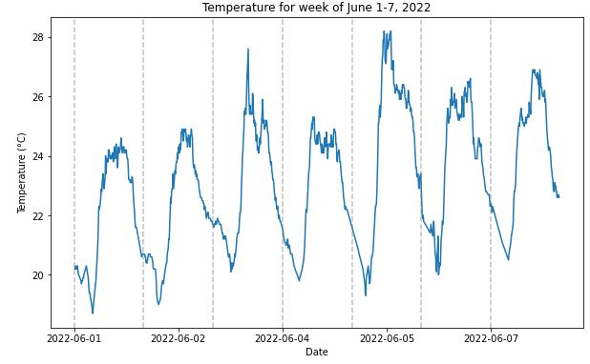
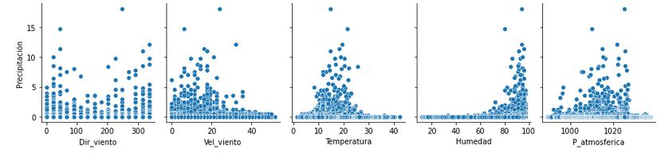
4- Data Understanding

Slide 9
5- Data Augmentation
Cover as much area as possible
Create
Grid within the domain
Filled
Data interpolation

Slide 10

5.1- Interpolation Methods Comparison
RBF
NearestNDInterpolator
Intero2d
Location | RBF | interp2d | Nearest
WWTP | 0.1889 | 0.8601 | 0.1481
Capitol | 0.1288 | 0.1355 | 0.1427
Ribalta | 0.1227 | 0.0474 | 0.1411

Slide 11
6- Time Series Forecasting
Interpolated dataset
Feed
AI Model
Forecast
Time series at any point of the grid
Transformation of the dataset to create a supervised learning needed

Slide 12

6.1- Model Architecture and Hyperparameters
Convolutional
Extract relevant features
Downsample and reduce the spatial dimensions
Capture higher-level representations
Architecture
MaxPooling
Dense
Hyperparameters

Slide 13
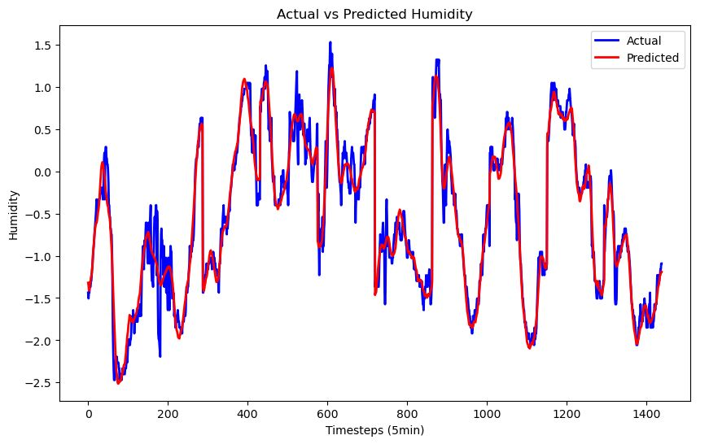
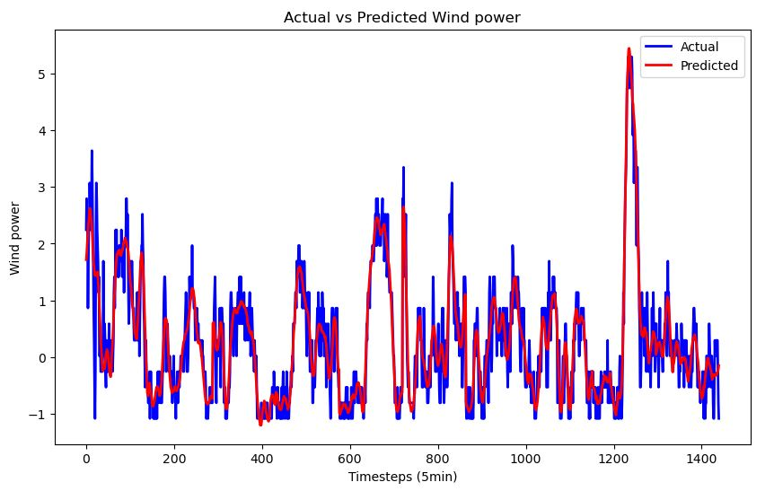
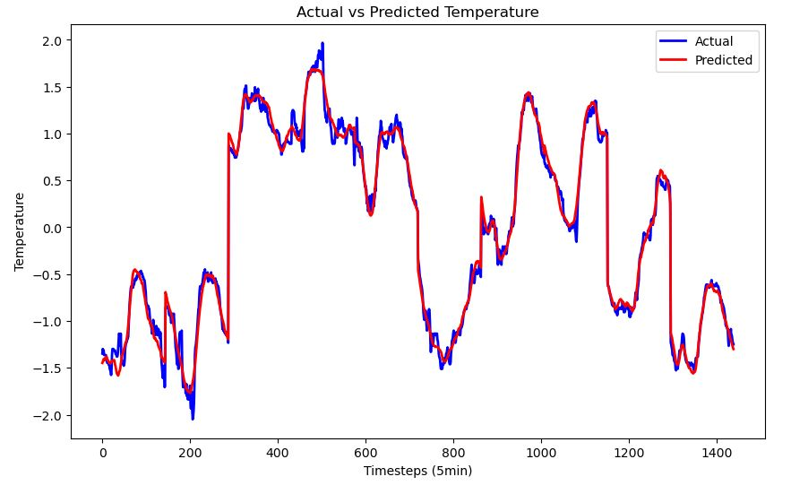
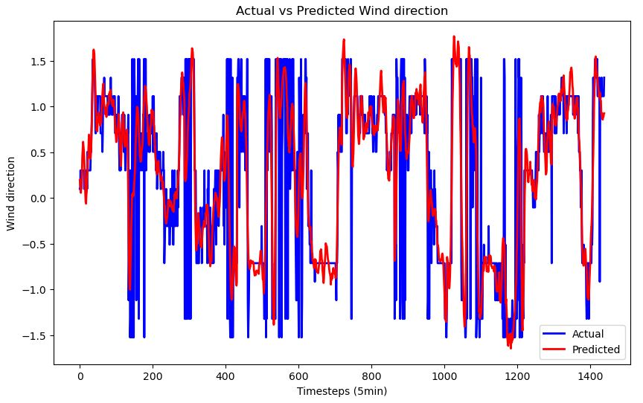
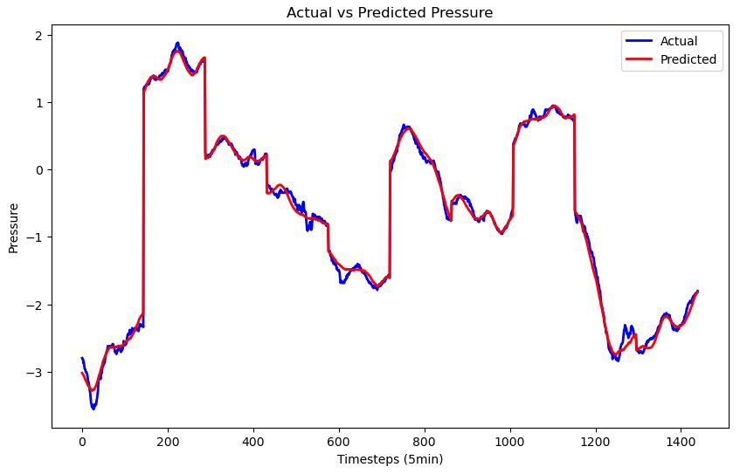
6.2- Validation of the Model
Variable | MSE
Temperature | 0.0096
Humidity | 0.0064
Pressure | 0.0348
wind velocity | 0.2639
Wind Direction | 0.1530

Slide 14
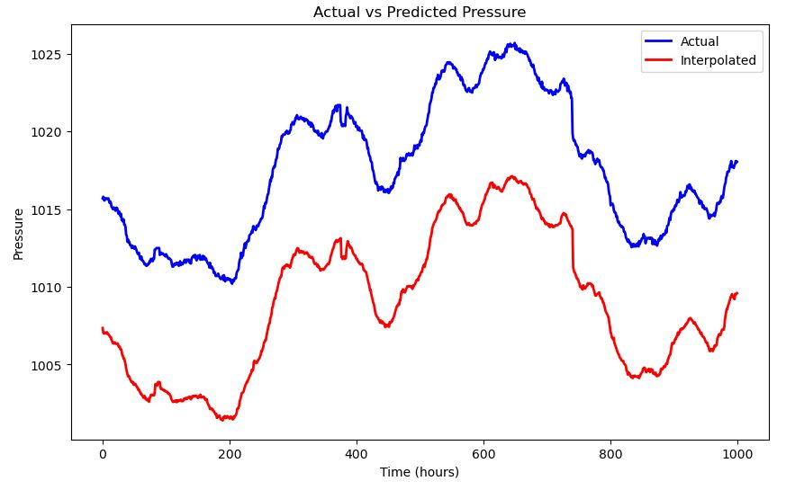
7- Validation of the Workflow
Encounter a vertical bias on pressure interpolation in all three validation scenarios
Add a constant value to the whole interpolation

Slide 15
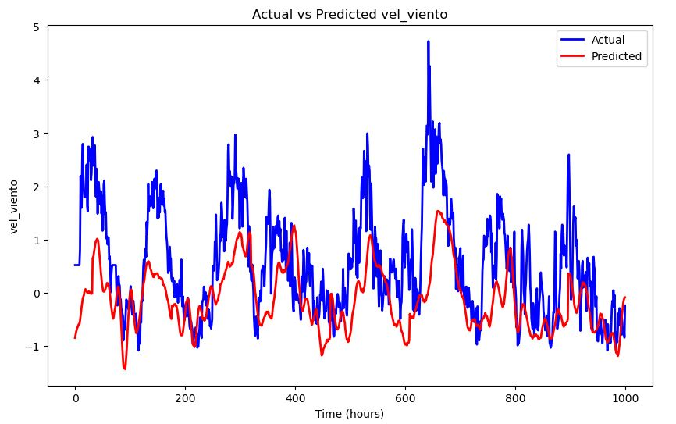
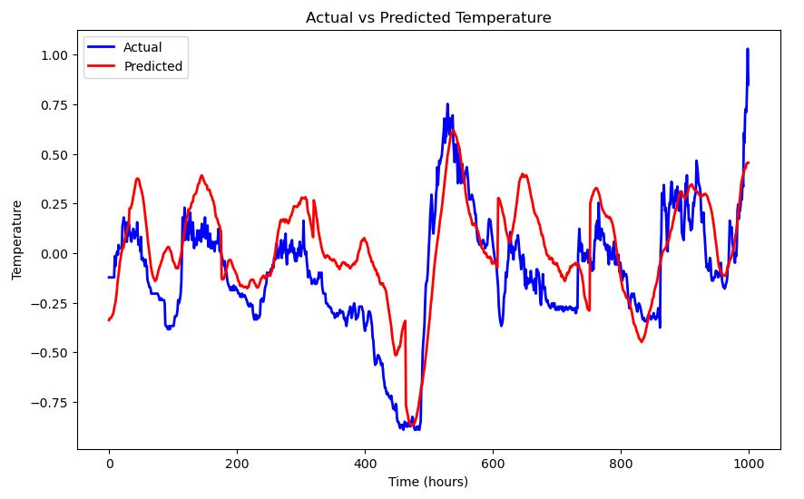
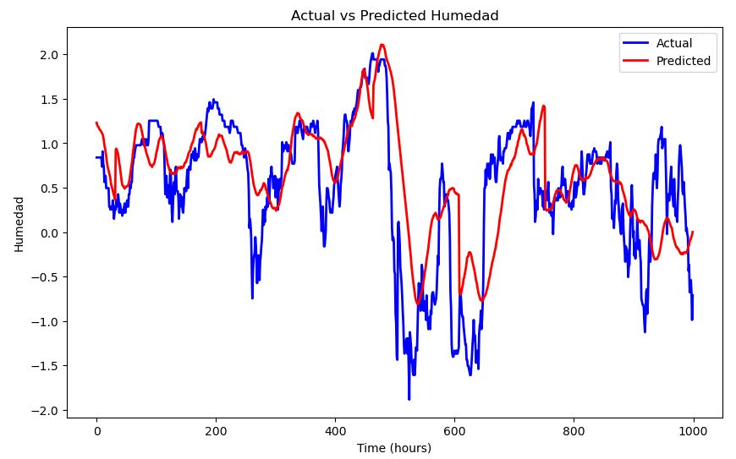
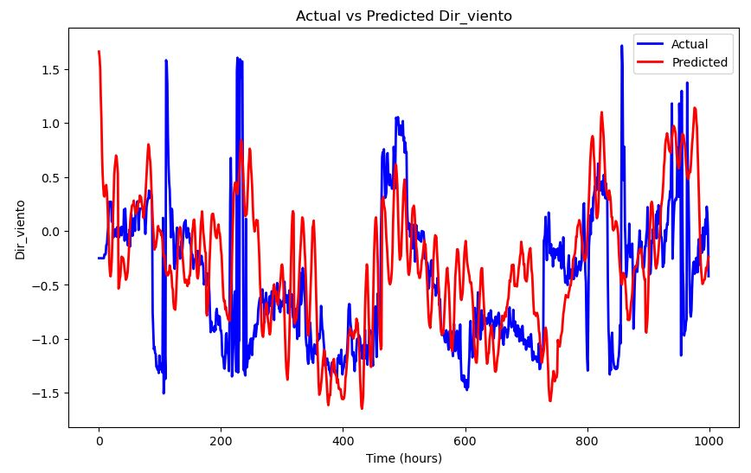
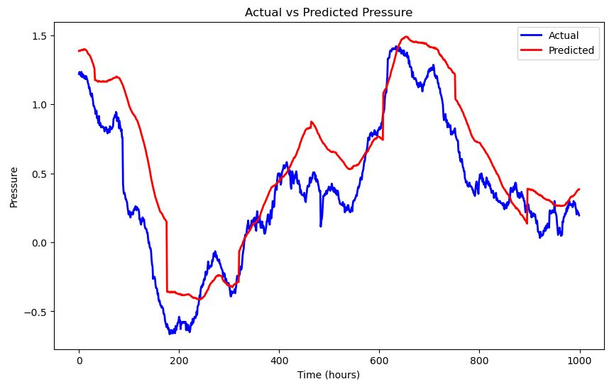
7- Validation of the Workflow
Variable | MSE
Temperature | 0.052
Humidity | 0.09
Pressure | 0.37
wind velocity | 1.08
Wind Direction | 0.45

Slide 16
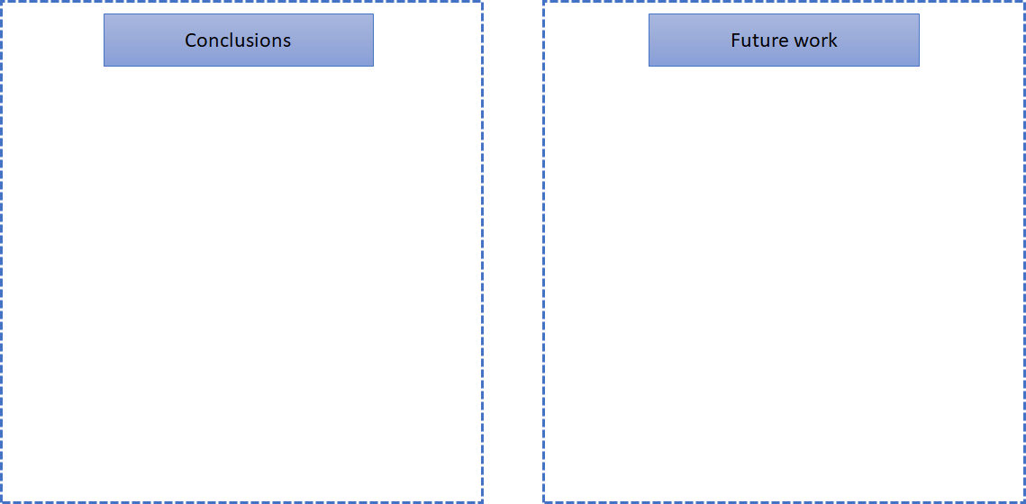
8- Final Thoughts and Future Directions
Testing new models
Incorporating more external data sources
Exploring ML based interpolations
Integration of Real-Time Data Streams
Generalizations to different regions
Comprehensive framework for weather analysis and time series forecasting
Integration of dot rain coverage, interpolation techniques and machine learning models.
Best interpolation method is RBF
Fine tuned Deep learning for time series forecasting
Applicability accross different weather stations

Slide 17



Enhancing weather analysis with data interpolation and time series forecasting
Thank you for your time!
facebook
@twitter
instagram

