Slide 1
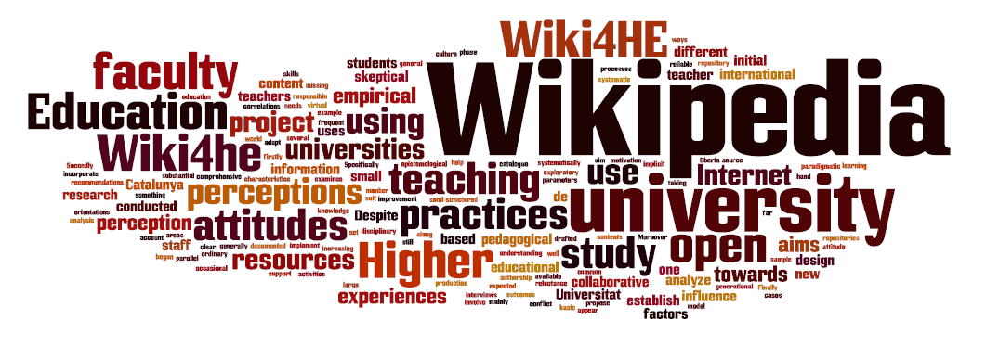
Lay Scientific Expertise in Wikipedia
Eduard Aibar
eaibar@uoc.edu
Open Science & Innovation Research Group
http://osi.blogs.uoc.edu/
Internet Interdisciplinary Institute
Universitat Oberta de Catalunya
Experts, expertise and scientific authority:
historical and sociological approaches
Centre d’Història de la Ciència (CEHIC), UAB
Bellaterra, April 30, 2015.

Slide 2
Research aim: Exploring the interactions between Peer production and Science
Peer production = mass online commons-based peer production
Free software: Linux, GNU, Apache, Sendmail, Firefox, …
Wikipedia, Slashdot, OpenStreetMap,…
Some trends in present science:
open science / open research / citizen science / open-source technology
Against neoliberal trends: commoditisation of scientific knowledge, emphasis on competition, ...
Increasing distance between citizens and science / pleas for more participation in S&T issues

Slide 3
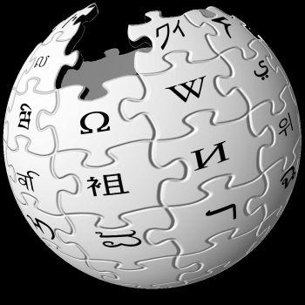
Why Wikipedia?
6th most visited website
The only one in the first 74 that is not private property
It’s literally a commons (everything on a CC license)
English version: 4M articles (Spanish 1.15M and Catalan 450k)
There are more than 250 language versions
22M of registered users – 300k making more than 10 edits/month

Slide 4
(1) what scientists do and think about Wikipedia (2) what Wikipedia does to science
Project 1: Perception and practices of academic faculty [online survey with 50 questions to all faculty members of two Spanish universities (913 valid responses) and 12 interviews]
Most faculty members are regular users (both for personal and professional matters: 60%) though few of them edit (5.5%).
Quality is mostly positively considered (updated, reliable)
Private use though public silence: Wikipedia as academic porn
Most think the use of Wikipedia is not well considered by colleagues; they think colleagues don’t use it much
Colleagues as strong role models: even quality perception depends heavily on peers
Different cultures within academia/science: disciplines matter!

Slide 5
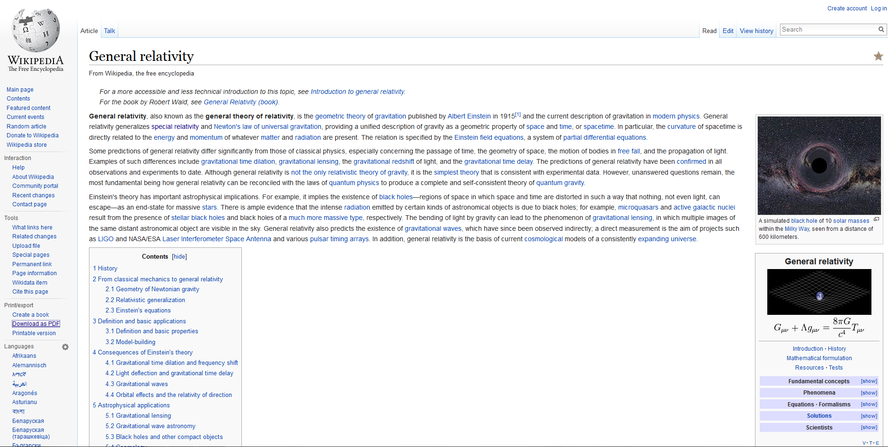
(2) What Wikipedia does to science
Analysis of the science & technology contents of Wikipedia
Between 10% and 15 % of the 1.15 million articles of the Spanish version are about Science & Technology
Recent studies show that Internet surpasses TV and other media as main source of scientific information
Spain: 21.7% say they use Wikipedia as their main source
Wikipedia as the most important channel for the public communication of science
About 20 pages long
Lots of figures and formulae
High quality
More than 300 refs.
More than 1,400 authors!!!

Slide 6
Research question: Is the non-expert character of editors shaping the way S&T issues are depicted at Wikipedia?
Selecting the corpus of S&T articles: UNESCO 6-digit + algorithm for internal links
340 clusters = 60,108 articles (5%)
Sub-questions:
Are Wikipedia articles more sensible to social issues?
Do they reflect standard scientific consensus or give some room to minority positions in science?
Are the more controversial issues in Wikipedia (in science and technology) also those more controversial in society at large?
Are controversies between editors in Wikipedia similar to scientific controversies?
How is the expert/lay divide managed in Wikipedia?

Slide 7
Most controversial articles on S&T
Efecto_invernadero
Sigmund_Freud
Tecnología
Capitalismo
Primera_Guerra_Mundial
Célula
Ciencia
Psicología
Internet
Albert_Einstein
Evolución_humana
Homo_sapiens
Tierra
Método_científico
Agua
Esquizofrenia
Sensibilidad_química_múltiple
Cambio_climático
Teoría_del_Big_Bang
Alimento_orgánico

Slide 8
Some preliminary conclusions
Standard /mainstream scientific consensus is usually reflected
Too strong commitment for not letting “pseudo-science” inside
Lots of boundary work and even some scientism – very rationalist view of science
Lay Wikipedia editors seem more Catholic than the Pope
Credit and reputation in Wikipedia are internally built (external credentials don’t matter)
Large debate inside the community
Similar to other peer production initiatives like free software
The burden of truth is translated into reliability of sources
Trust in people is translated into trust in procedures
Lots of norms and policies in Wikipedia: 1,200 docs; 150,000 words; 50 basic norms. Example: “If a rule prevents you from improving or maintaining Wikipedia, ignore it.”
Expertise on procedures can be crucial = bureaucrats!!!

