Slide 1
Micro #OAMOOC, fomenting literacy on Open Access through social media
6th July 2018
Clara Riera Quintero
Rosa Padrós Cuxart

Slide 2
A crash course on Open Access via Twitter
Teaching from 12 a.m. every day for 15 minutes, via @moocmicro under the hashtag #OAMOOC
01.1
What is a micro-MOOC on Open Acces?

Slide 3
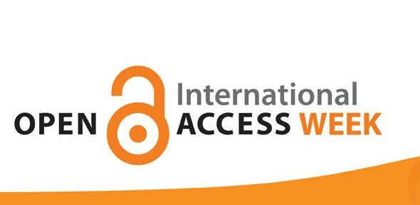
01.1
micro-MOOC on open access
An open initiative for
A collaborative work:
- 10 Catalan universities + UJI
Support of:
- CSUC
- LIBER
- SPARC
- EUA
Inspired on
Opportunity to engage large number of researchers
Opportunity to reuse the open access content of each university and the existing content on open access landscape
Micro-MOOC
Microbiology

Slide 4
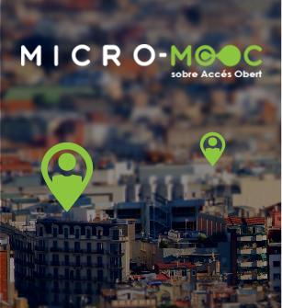
01.1
micro-MOOC content and target
Target
Researchers
PhD and Master students
and anyone else with an interest in this area
Content
23/10/2017
Introduction to Open Access. RRI and Open Science
24/10/2017
Publishing on Open Access
25/10/2018
Research data
26/10/2018
Publishing licences and Authors’ rights
27/10/2018
Visibility and impact
#OAMOOC
Catalan as course language to direct engagement

Slide 5
01.1
micro-MOOC team
External collaborators
Coordinator
Community manager
Content creators
Institutional support
Role
- Content coordinator
- Collaborators coordination
- Assure tweets consistence
- Comunication plan
- Create specific Twitter account
- New graphic image
- Align story
- Schedule the tweets
- Analyse impact
Reuse of European and contents of each university
Resources in their Original language
- Dissemination
- Fomenting engagement
- Dissemination
- Reuse their open access resources
Tasks
Catalan Universities and UJI Libraries
Catalan Universities and UJI
Who

Slide 6
microMOOC impact
#OAMOOC
@moocmicro
504 participants
3.191 tweets
740.492 reach
674 followers
166 tweets
1.900 retweets
295.000 impressions
number of times the reached people may have seen your content
number of people who may have seen your content

Slide 7
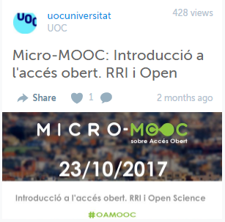
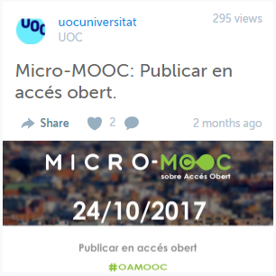
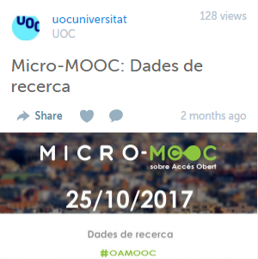
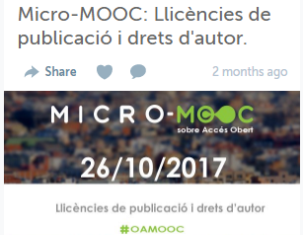
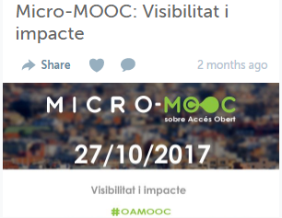
01.1
micro-MOOC impact and reuse
Training material for universities

Slide 8
01.1
micro-MOOC Next steps
New edition of Micro-MOOC 2018 because ...
Easy to update
Great way to raise awareness on open access with researchers
100% satisfaction of participants and collaborators
High impact
Benefits of a collaborative work

Slide 9
UOC.universitat
@UOCuniversitat
@uocuniversitat
Thank you for your attention !
Notes:
Thank you for your attention

