Slide 1
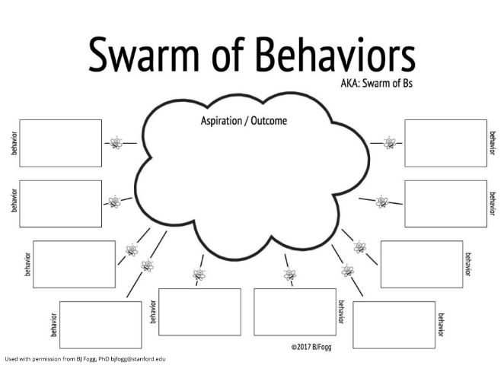
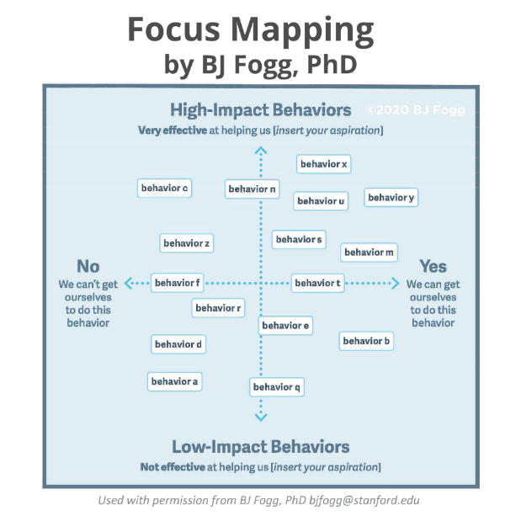
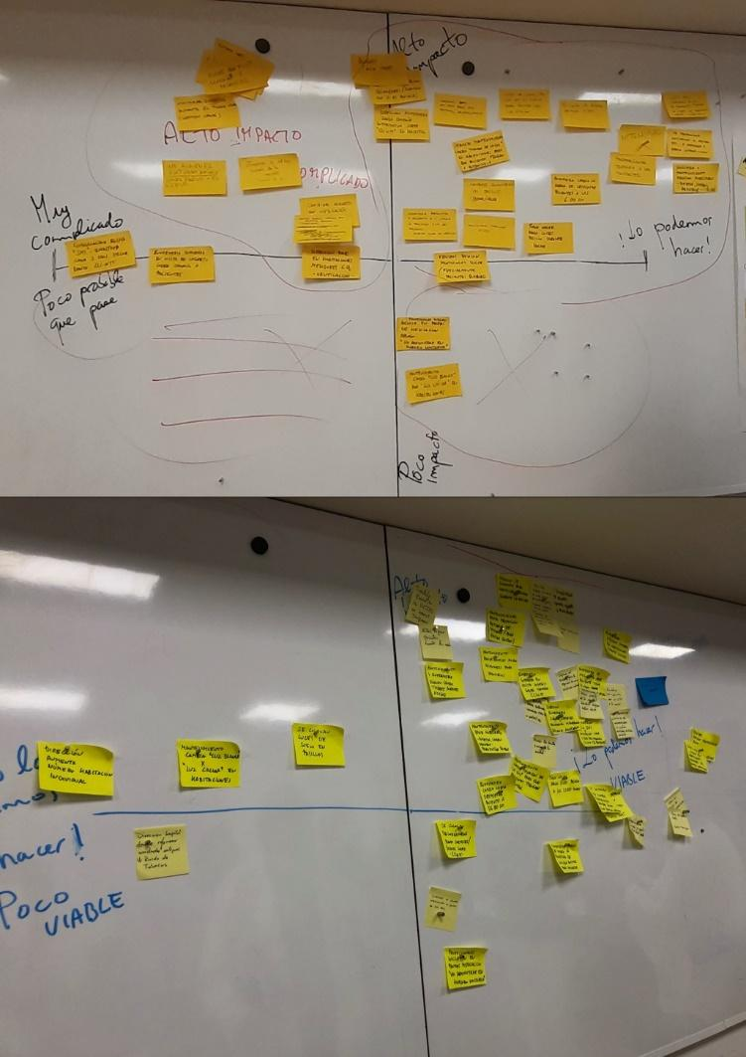
Using the Focus Mapping technique to identify
activities to promote sleep
in hospitalised patients in Hospital Clinic
Manuel Armayones ruiz¹, noemi robles¹, Iolanda Graupera Ten², Raimon Camps Salat³,
Joan Escarrabill Sanglas³, Elena Salas Marco²
1.eHealth Center, Universitat Oberta de Catalunya, 2. Nurse Supervisor. Clinical Hospital of Barcelona, 3. Patient Experience Unit. Barcelona Clinic Hospital
46 shares
identified
AI
Introduction
Methods: Behavior Fogg Model Techniques
Sleep during a period of hospitalisation is an essential element for recovery in admitted patients. Hospital Clínic de Barcelona has developed the ClíNit project with the aim of promoting patients’ sleep to identify elements that affect the quality of sleep and implement actions to improve rest at night.
To prioritise specific actions in a collaborative way with nurses from Clinic Hospital we have been use two techniques from the Fogg Model:
Swarm of behaviors
Focus Mapping.
This study aims to provide results on two levels: firstly, in relation to the usefulness of the Fogg methodology itself. Secondly, showing the results of the techniques used with a sample of healthcare professionals in a real-life situation.
Our hypothesis was that The Fogg model could be a useful methodology applicable in the clinical setting for process prioritization.
Those actions proposed and prioritized by the clinical staff themselves who must execute them would be more realistic and adjusted to the actual possibilities of implementing them.
With the start point of our common aspiration to find out our ”Golden Behavior” (such combining “high impact” & “easy to do”
We start with Swarm of Behaviors (SoB) Techniques with the following statement:
“If you had a magic wand to force someone to do something that would allow patients to sleep better in hospitals, what would you do?”
4-5 proposed actions was proposed per participant in SoB and we start to create the Focus Mapping (FM) following the Fogg Technique. We ask nurses to classify the previous actions identified in SoB, putting it in FM
Vertical axis (higher-lower impact), no discussion
Vertical axis adjustments, no discussion
Horizontal axis (feasible-not feasible), no discussion
Horizontal axis adjustments, no discussion
Position changes, justifying and voting
Completion when no further changes are proposed and identification of Golden Behaviors (yellow area).
Analysis:
Classification of actions in according to impact-difficulty axes.
Identification of repeated actions.
Assignment of those responsible for the implementation of the actions:
Nursing
Hospital address
Medical Equipment
Disclosure
Hospital management
ClíNit team meeting to select actions, prioritizing Golden Behaviors (yellow area) and specifically that nurses consider that has high impact and depends of themselves.
Methods: Sessions and participants
We organized two focus group & design sessions. At these sessions the common aspiration to start the design process was:
“How to promote good sleep for hospitalized patients during admission nights to the Clinic Hospital
Sessions: 2 behavioral design sessions (one per unit). 60 min each
Participants: Pulmonology (8) and Neurosurgery (6) units night shift nurses (nurses, nurse assistants). Mean age: 49 years. 11 females, 3 males. Average professional experience: 22 years.
Location: Patient Experience Unit of the Clinical Hospital
Sessions Guided: Led by a senior expert on the Fogg model and a junior expert to document the session. Two observers
Reports: photo-documented sessions and memorandum to CliNit project staff
Results
Prioritized Actions (GOLDEN BEHAVIORS)
Explain the ClíNit project at entry
Ensure patient has light device on hand
Change the standard of waking patients at 6 am
In the medication protocols, indicate “Do not administer during the night”
Action Owner:
44% Nursing (14/32)
41% Hospital management (12/32)
9% Medical equipment (4/32)
6% Communication (2/32)
Conclusions
Fogg’s behavior design methodology and specifically swarm of behaviours and focus mapping techniques helped to efficiently identify the actions that the nurses considered relevant and that the ClíNit project managers considered easier and more effective to carry out.
We recommend the use of these types of techniques in the field of Health due to their ease, potential for co-creation of solutions and identification of viable and positively impacting actions on the objective
REFERENCES
Fogg B, Ngo D. How to Do Behavior Design. Expert Guide Series. Stanford; 2018.

