Slide 1
Spiral Antenna Design with MATLAB
Final Master’s Project
Marcos Fioravante Buccella Espinoza
Consultants: Dr. Jaume Anguera Pros
Dr. Aurora Andújar Linares
Universitat Oberta de Catalunya
Antenna technologies
January 2023

Slide 2
Agenda
1. Introduction
2. The research project
3. Conclusion and future research

Slide 3
Introduction
1.
What is this about and why is it important?

Slide 4
1
Introduction • Break Down
Break down of
the topic
This project presents a quantitative analysis of spiral antennas based on designs and simulations performed in the MATLAB software suite.
Spiral antennas are a type of planar antenna with diverse applications and ongoing research. MATLAB is a computer suite based on the application of numerical computation with many integrated applications.
At the end of the project, results have been obtained in graphical form that have served to determine how the application works in the study area.
Key words: Spiral, frequency-independent, simulation.

Slide 5
1
Introduction • Overview
Overview of
the topic
Bibliographic research
It is essential to understand how spiral antennas work and knowing their applications.
Parameterization and simulation
Preliminary calculations of the antenna generator parameters have been performed for subsequent simulation.
Like any research project, certain phases must be fulfilled for its successful development. To determine whether spiral antennas are useful and can be simulated in MATLAB, these three phases have been followed:
Analysis of the results
The results obtained must be analyzed to determine the feasibility of the hypothesis.

Slide 6
1
Introduction • Justification
Why is this important?
Spiral antennas have numerous applications especially due to their frequency-independent behavior, so having a simulation software that allows easy modeling of them becomes necessary.
The simulation process can be complex since the time and computational requirements are significantly increased based on the frequency range under study. This project was born out of this need.

Slide 7
1
Introduction • Topic & Objectives
Topic
Question
Spiral antenna design, analysis and simulation
Can spiral antennas be designed and simulated in MATLAB?
Answer
Objectives
Yes. Different tests carried out satisfactorily prove this.
To understand how spiral antennas work.
To simulate different configurations of spiral antennas in MATLAB.
To determine if the chosen tool is suitable for this type of simulations.

Slide 8
1
Introduction • Project History
Project History
09/15/2022
Begin of scientific bibliography review and training.
10/15/2022
Started simulating spiral antennas.
12/15/2022
Finished the simulation and analysis, which included:
First simulation of an equiangular spiral with a frequency range set.
Simulation of a rectangular spiral antenna and comparison with the equiangular one.
Analysis of the effect of the number of turns of the spiral.
Effect of including a reflector plane under the antenna.
Start of the project drafting process.
01/15/2023
Completed research project

Slide 9
1
Introduction • Products obtained
Products obtained
Literature review:
Basic functionality of spiral antennas.
Frequency independency.
Applications of spiral antennas.
Graphical results:
Corresponding to each simulation.
Detailed analysis.
Adjusted to each simulated parameter.
Simulation’s code:
To generate every simulation carried out.
Explanation of its usage.
Easy adaptability.
Thesis memory:
Reflection of results.
Based on the UOC standard.
Basis for future developments.

Slide 10
The research project
2.
What happened.

Slide 11
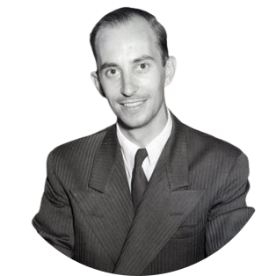
2
The research project • Definition
“
What are spiral antennas?
If an antenna is self-scalable, its properties will be independent of frequency.
”
They are planar antennas with arms coiled in a spiral shape. Numerous geometries have been studied with different results. They acquire importance because if their geometry meets certain parameters, they behave as frequency-independent elements.
Victor H. Rumsey
English electrical engineer

Slide 12
2
The research project • Definition
What makes a structure self-scalable?
Truncable
They must be able to have a finite size and not grow to infinity.
Self-complementary
A structure is self-complementary when it and its complement have the same shape.
Defined by angles
They are defined by a polar coordinates equation: $r=e^{aφ}f(θ)$.
𝜏=1.55

Slide 13
2
The research project • Research procedure
Scientific articles review
In-depth analysis:
Operation basics and parameters review.
Feeding structures.
Electromagnetic analysis (Green function).
Research and development:
Usage of shallow cavities with resonant material to obtain unidirectional radiation.
Application of SMD resistors to generate unidirectional radiation.
Usage of parasitic elements (metallic posts) to increase bandwidth.
Use of a resonant element as a notch filter.
Aplication of dielectric lenses to increase the directivity of the antenna.
Non-uniform structures that allow miniaturization.
Applications:
Space launcher communication.
DF systems based in the angle of arrival (AoA) estimation.

Slide 14
2
The research project • Design parameters
Equiangular spiral antenna parameters
Inner radius
Distance from the center to the center of the innermost turn. Sets the maximum operating frequency of the antenna.
Outer radius
Distance from the center to the center of outermost turn. Sets the minimum operating frequency of the antenna.
1
2
Growth rate
Defines how fast the antenna is wound up. This is directly related to the number of turns the spiral will have.

Slide 15
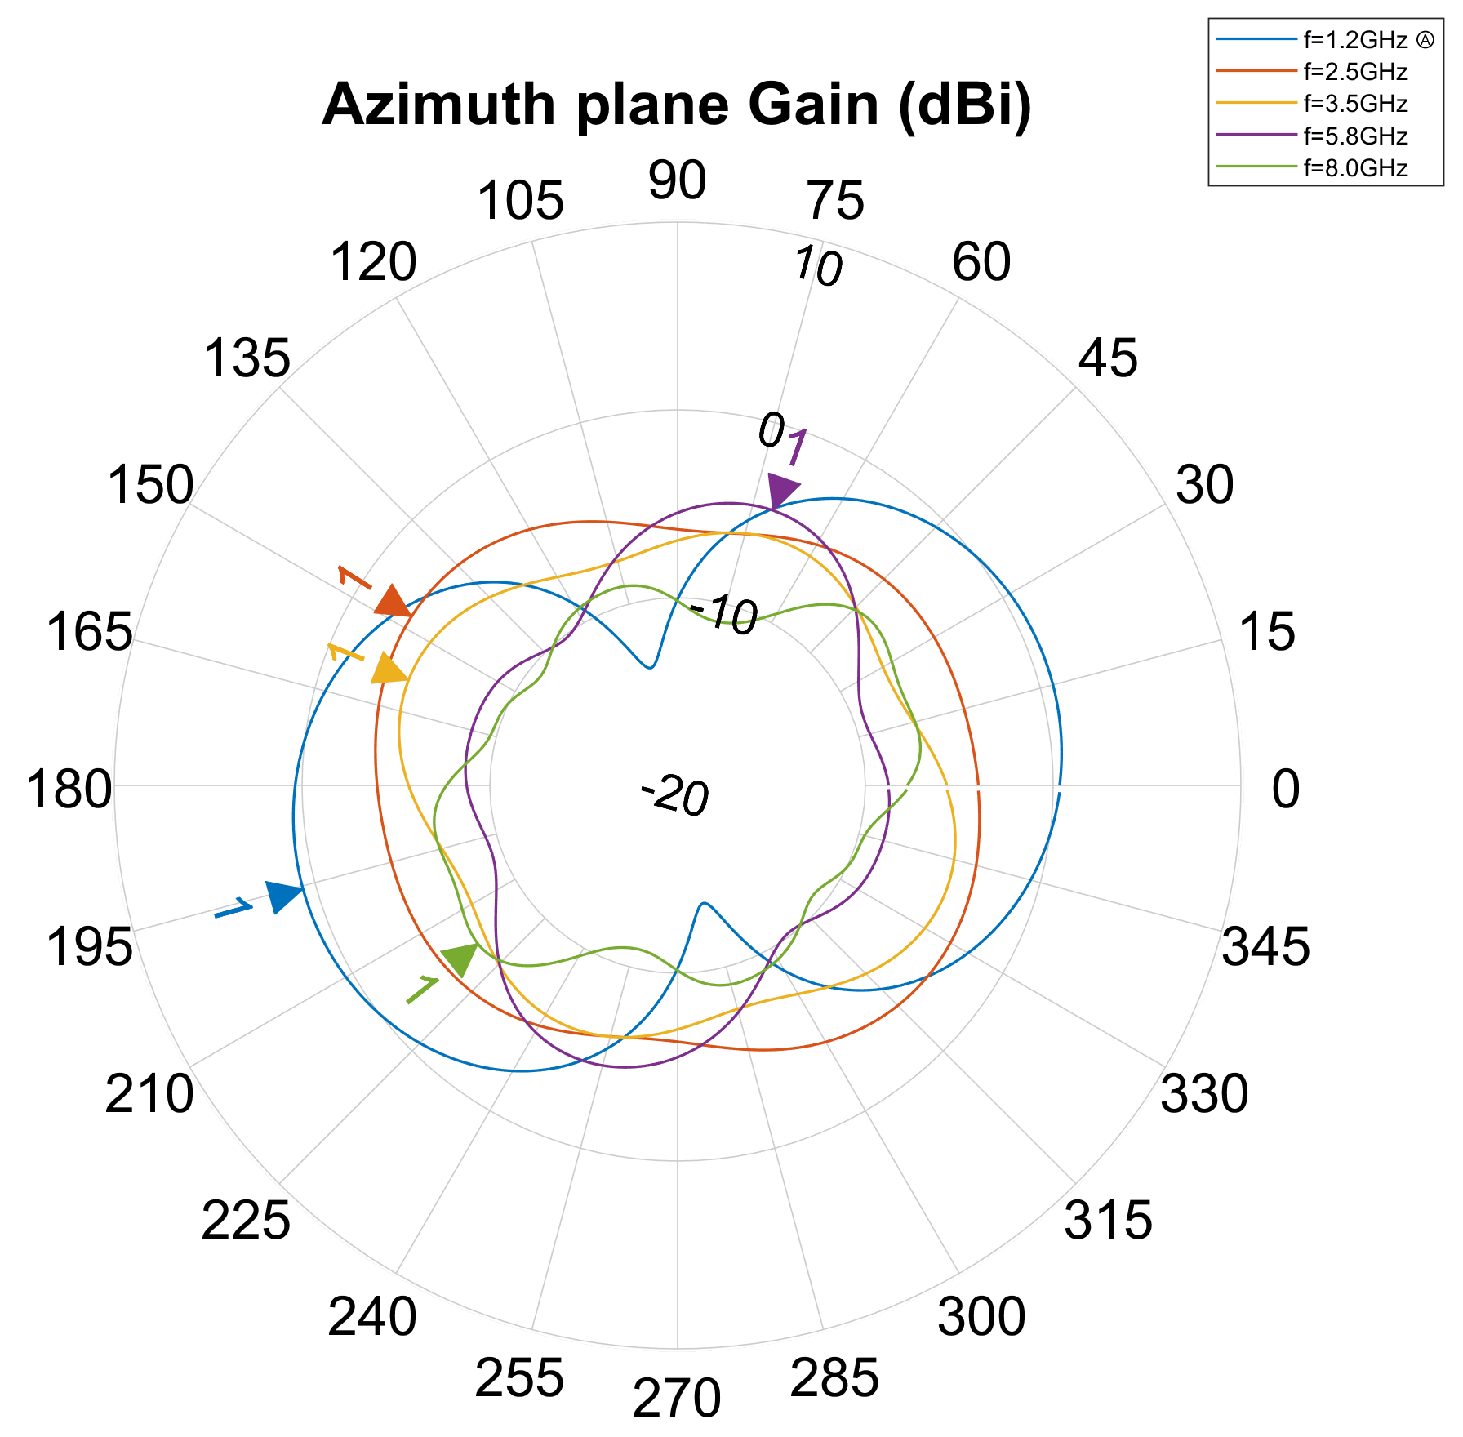
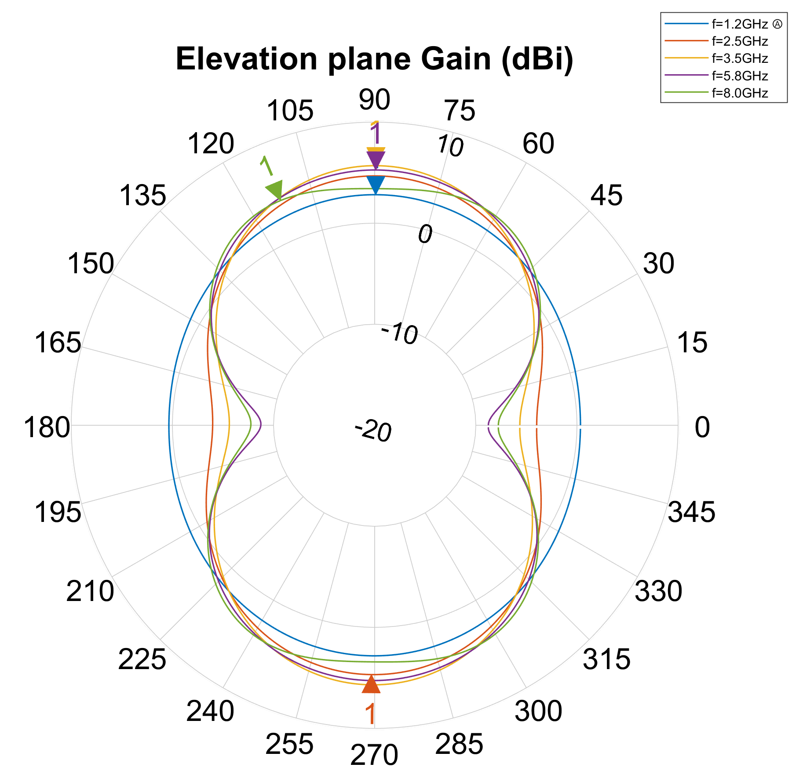
2
The research project • Trial Results
First simulation set
Equiangular spiral antenna to operate in the 1GHz-6GHz band.
Default growth rate (0.35).
2D Radiation diagrams
Results according to the expected:
Almost no radiation to the sides of the antenna.
Bidirectional radiation pattern.
Extremely consistent results, aside from the lowest frequency.

Slide 16
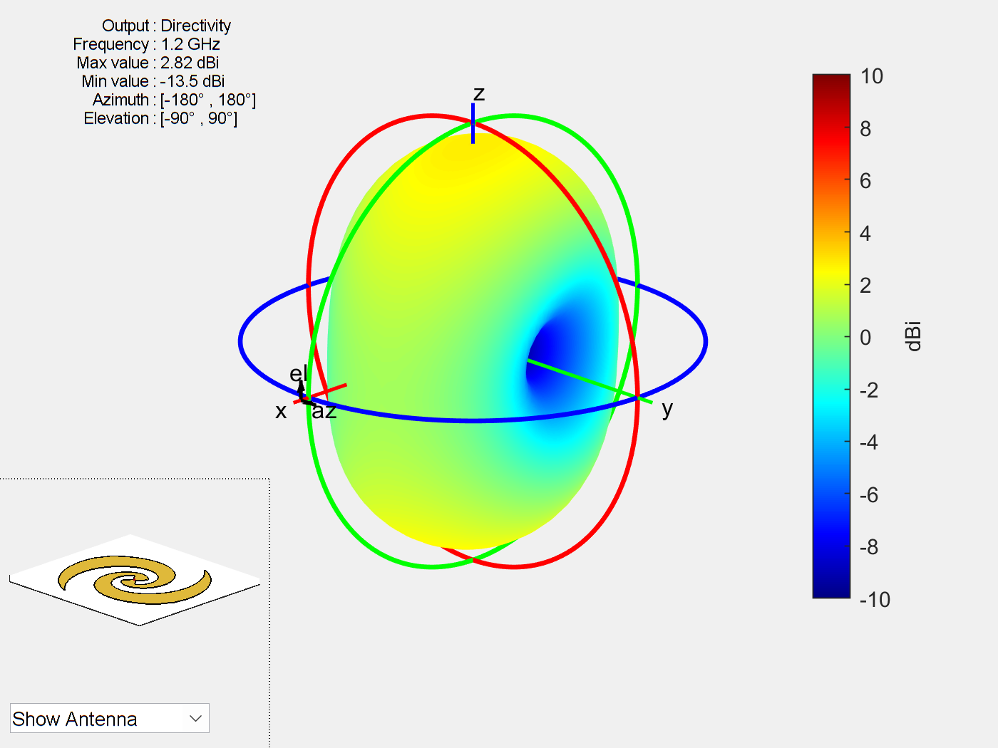
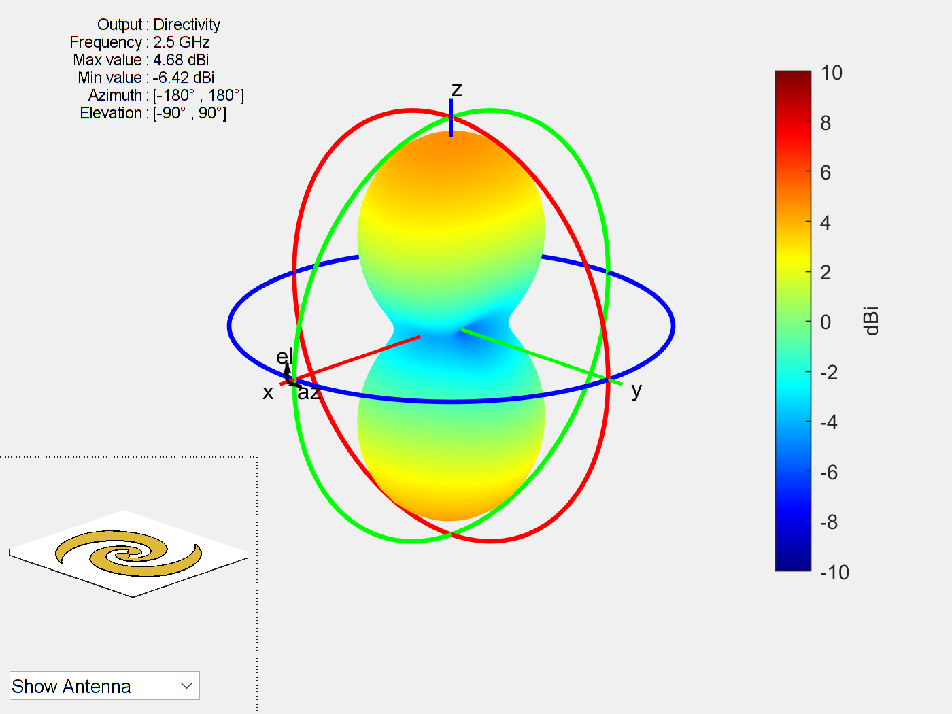
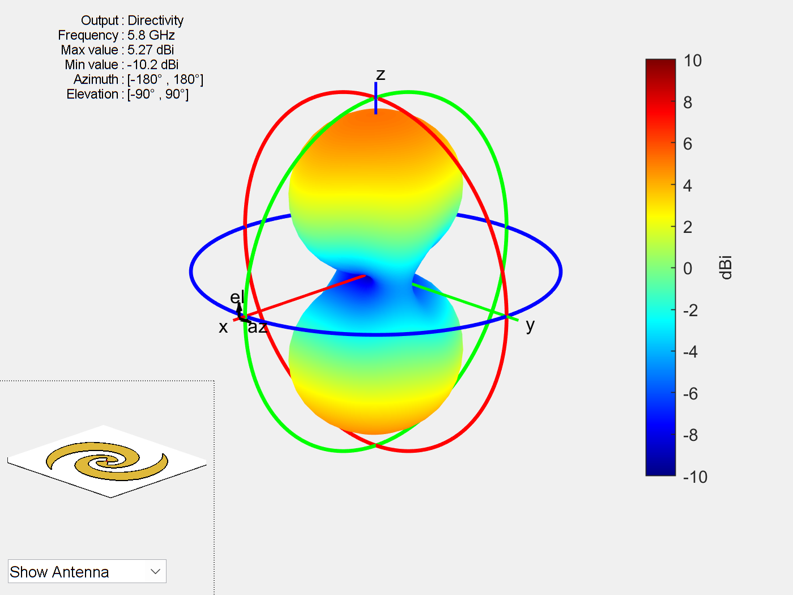
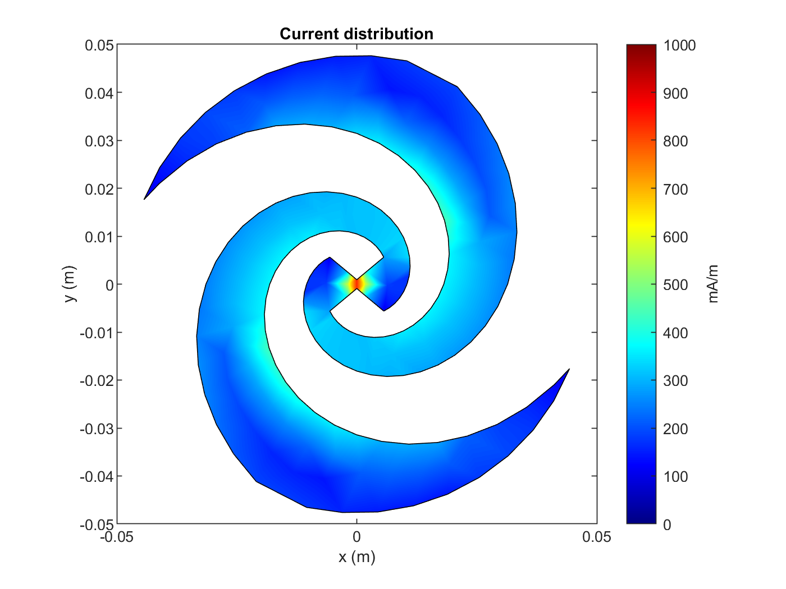
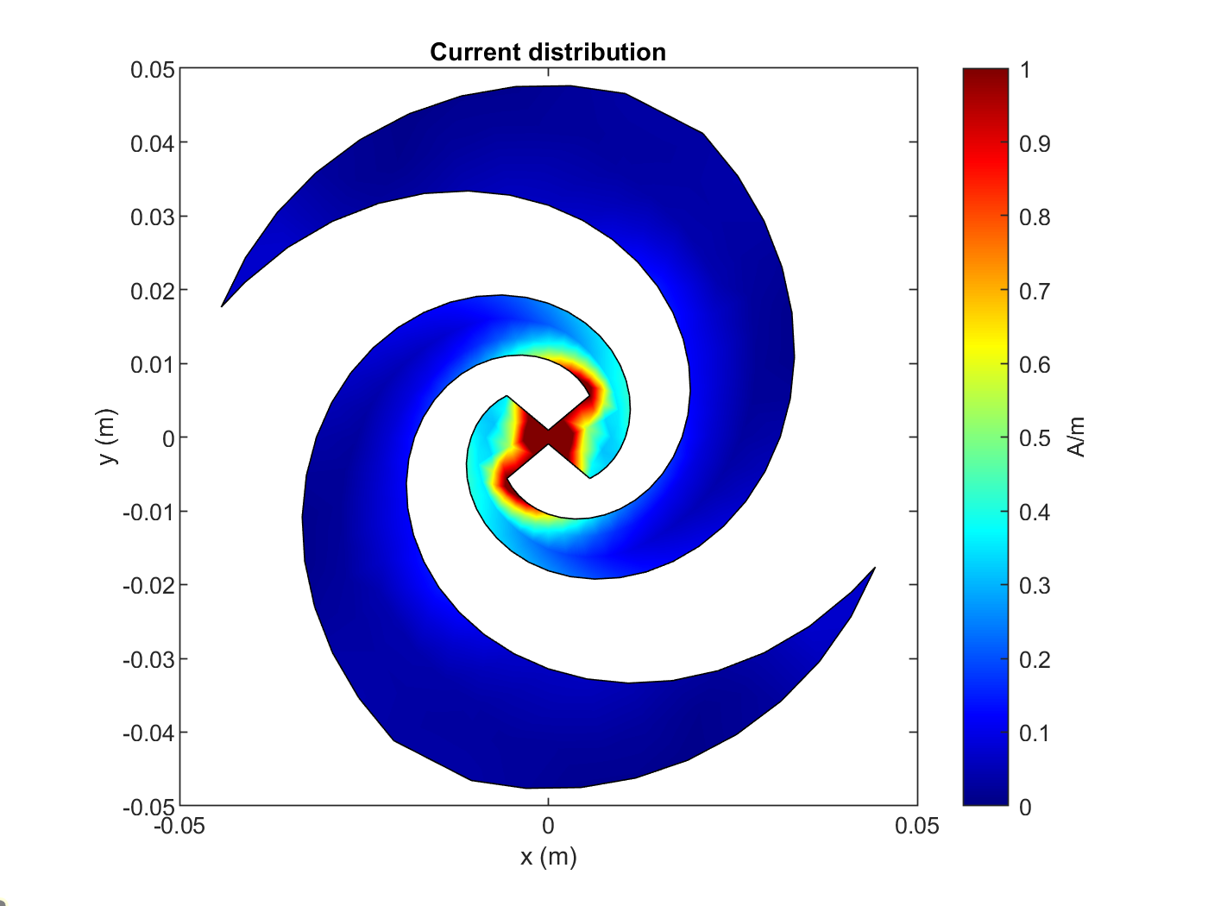
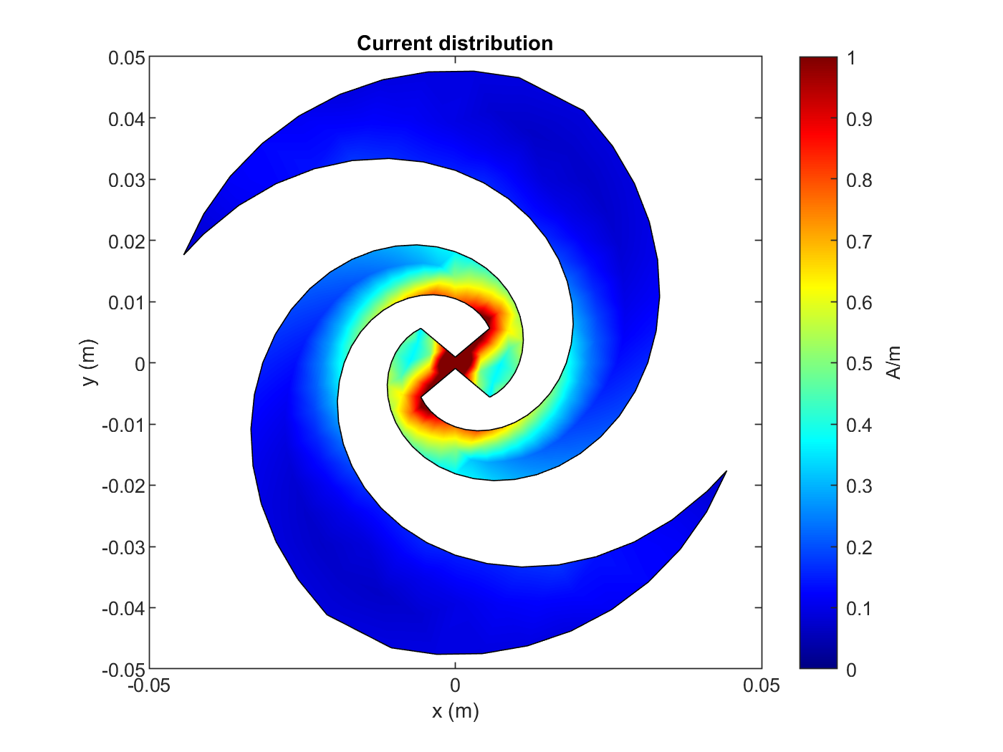
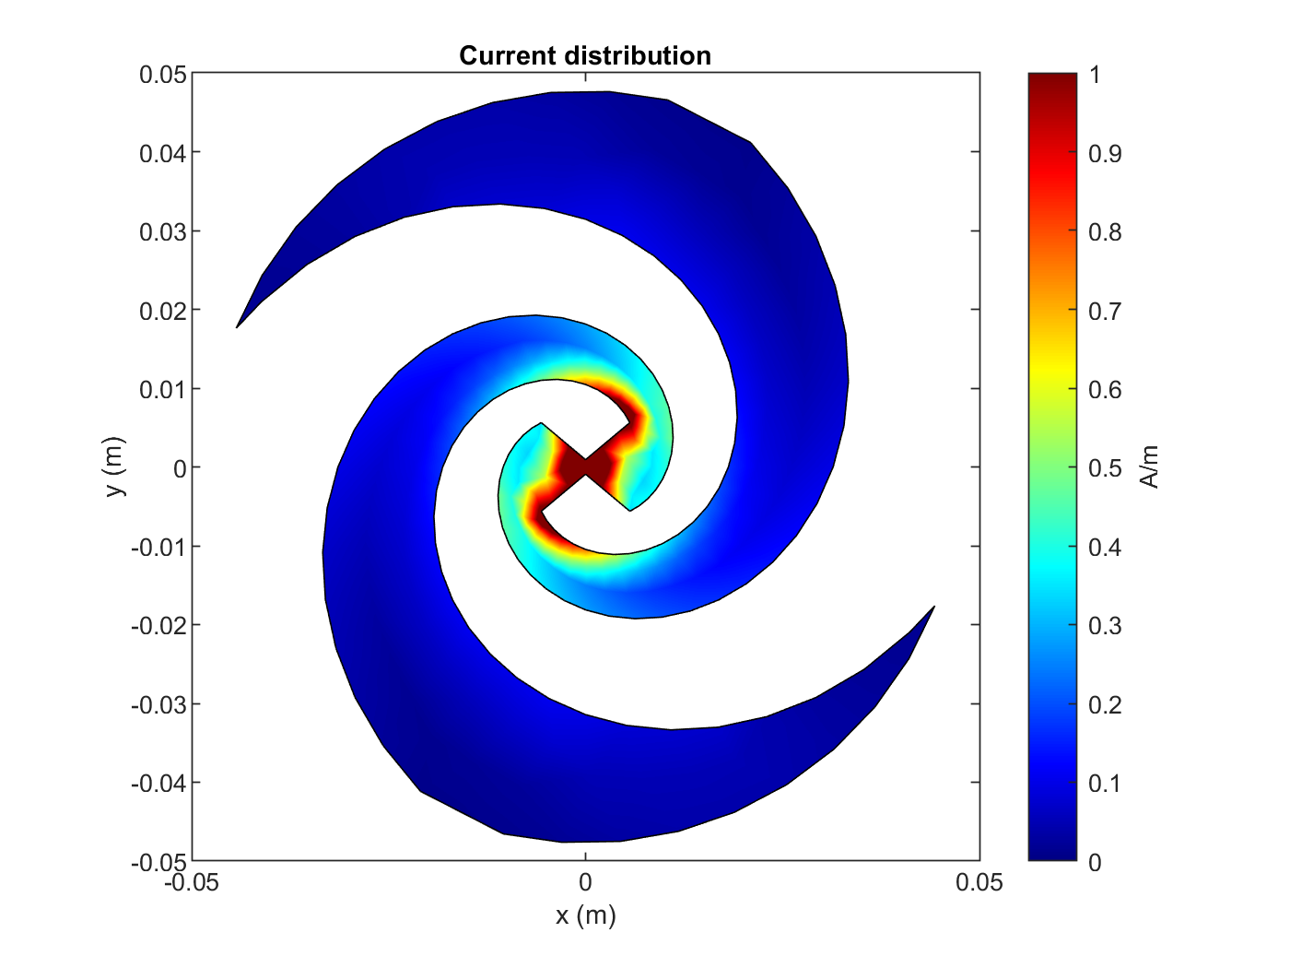
2
The research project • Trial Results
1.2 GHz
2.5 GHz
3.5 GHz
5.8 GHz
8 GHz
3D Radiation diagrams: Again, the results are extremely consistent, aside from the first frequency studied which shows radiation in the X coordinate direction.
1.2 GHz
2.5 GHz
5.8 GHz
1.2 GHz
3.5 GHz
8 GHz
Surface currents distribution: The currents remain near the source. The lowest frequency had currents more evenly distributed over the arms.

Slide 17
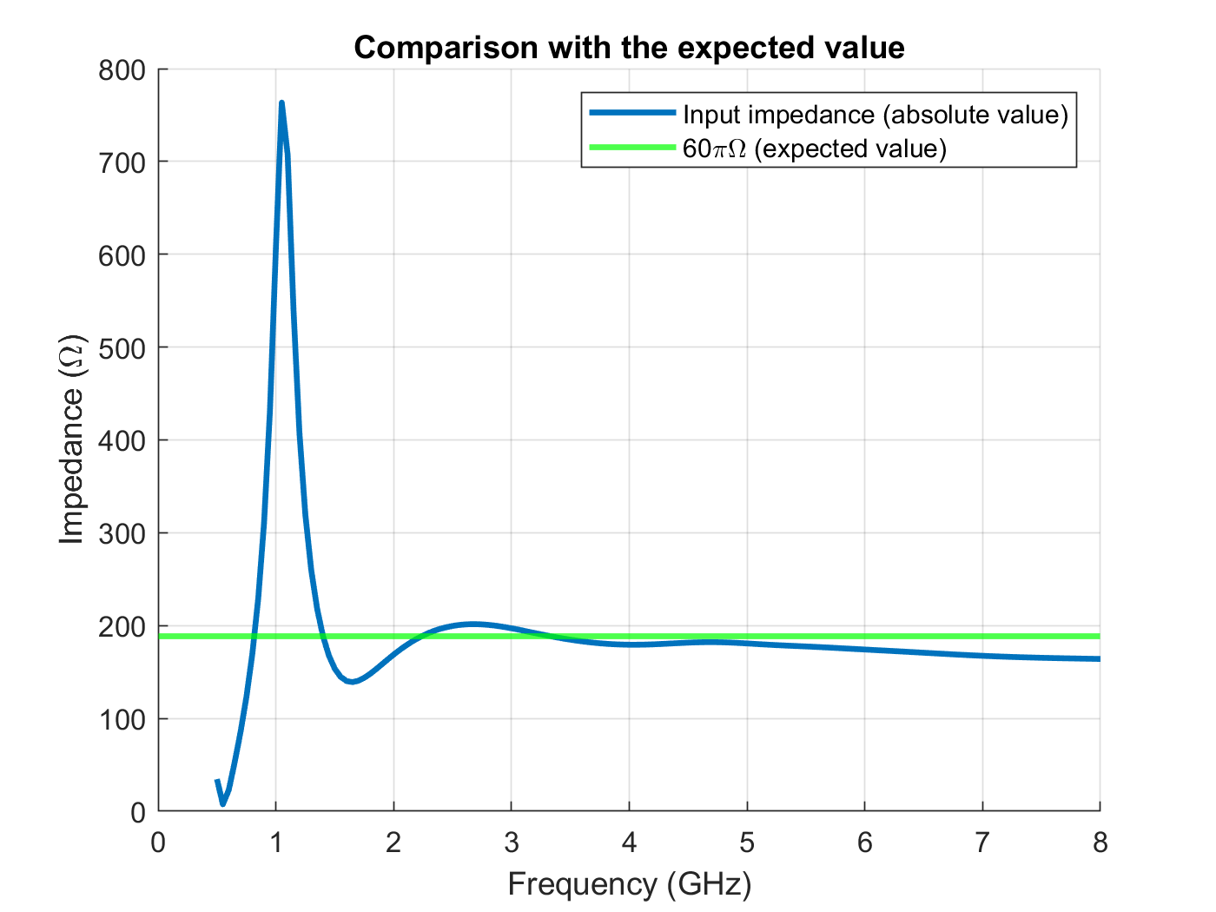
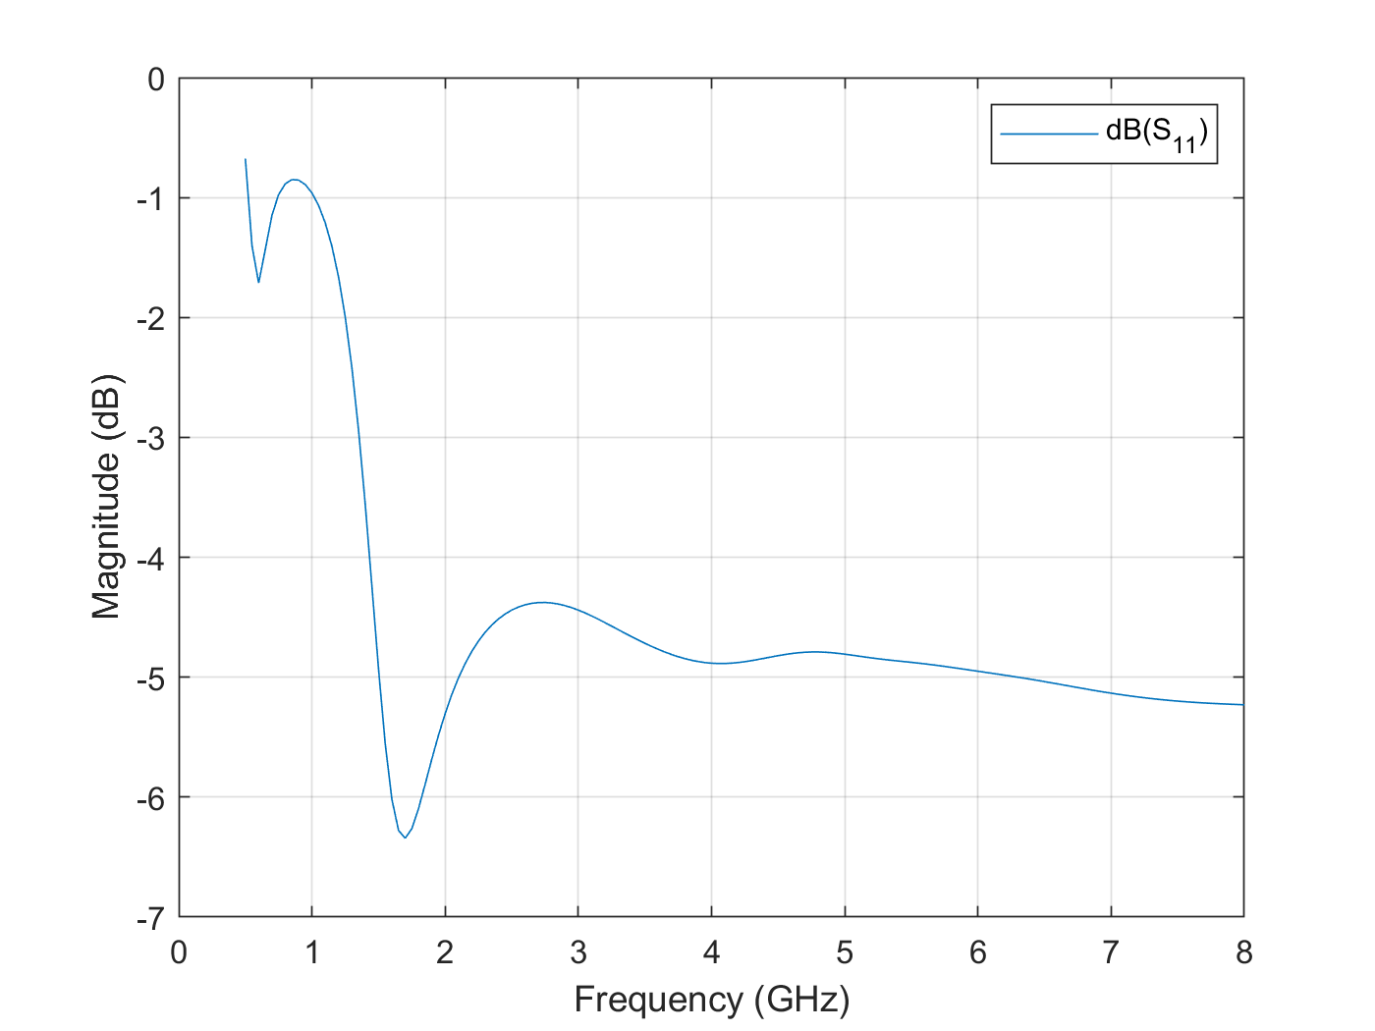
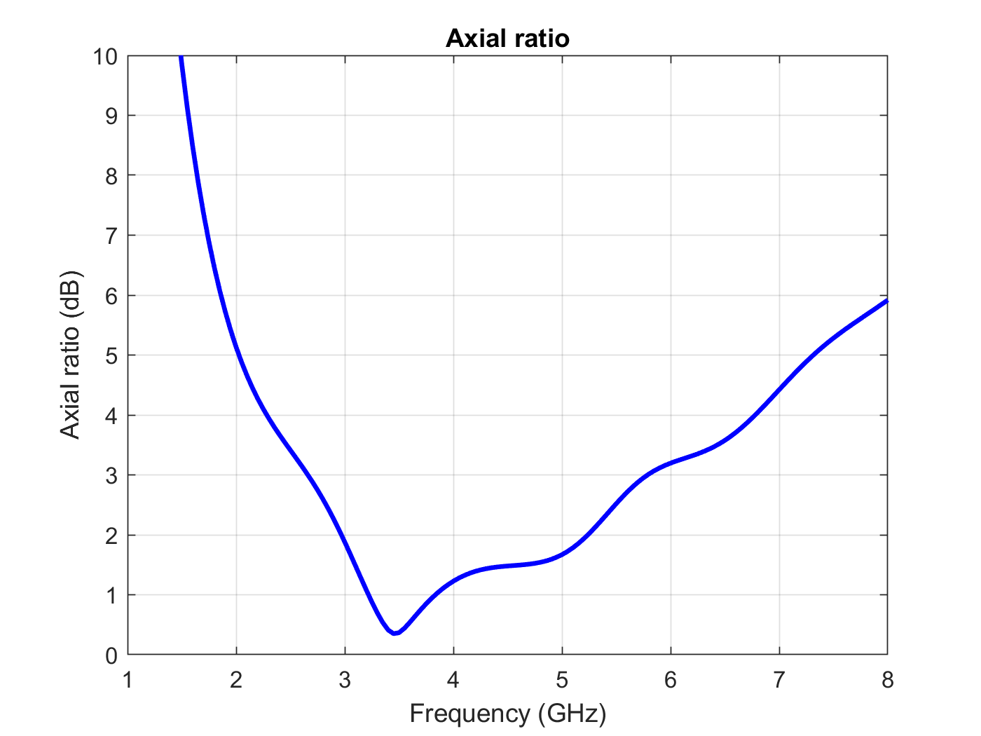
2
The research project • Trial Results
Input impedance: The input impedance remained somewhat constant beyond 2GHz and consistent with the expected value for self-complementary structures. A spike appears around the lowest frequency selected.
S11 parameter: The results are the expected as seen in the input impedance plot. The value of the parameter remains below -5dB beyond 1.5GHz.
Axial ratio: The antenna shows an axial ratio below 2dB in the range of 3 to 5.2GHz, indicating a very good circular polarization in that range. The best value is obtained exactly in the center frequency (3.5GHz)

Slide 18
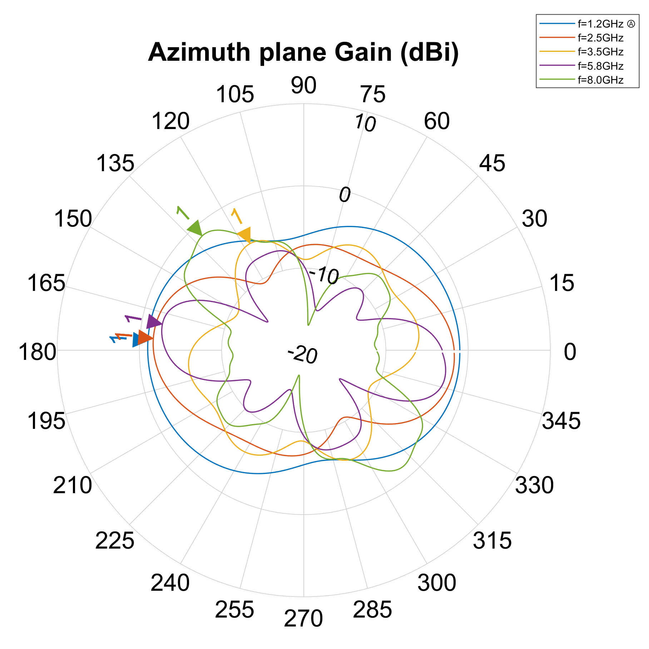
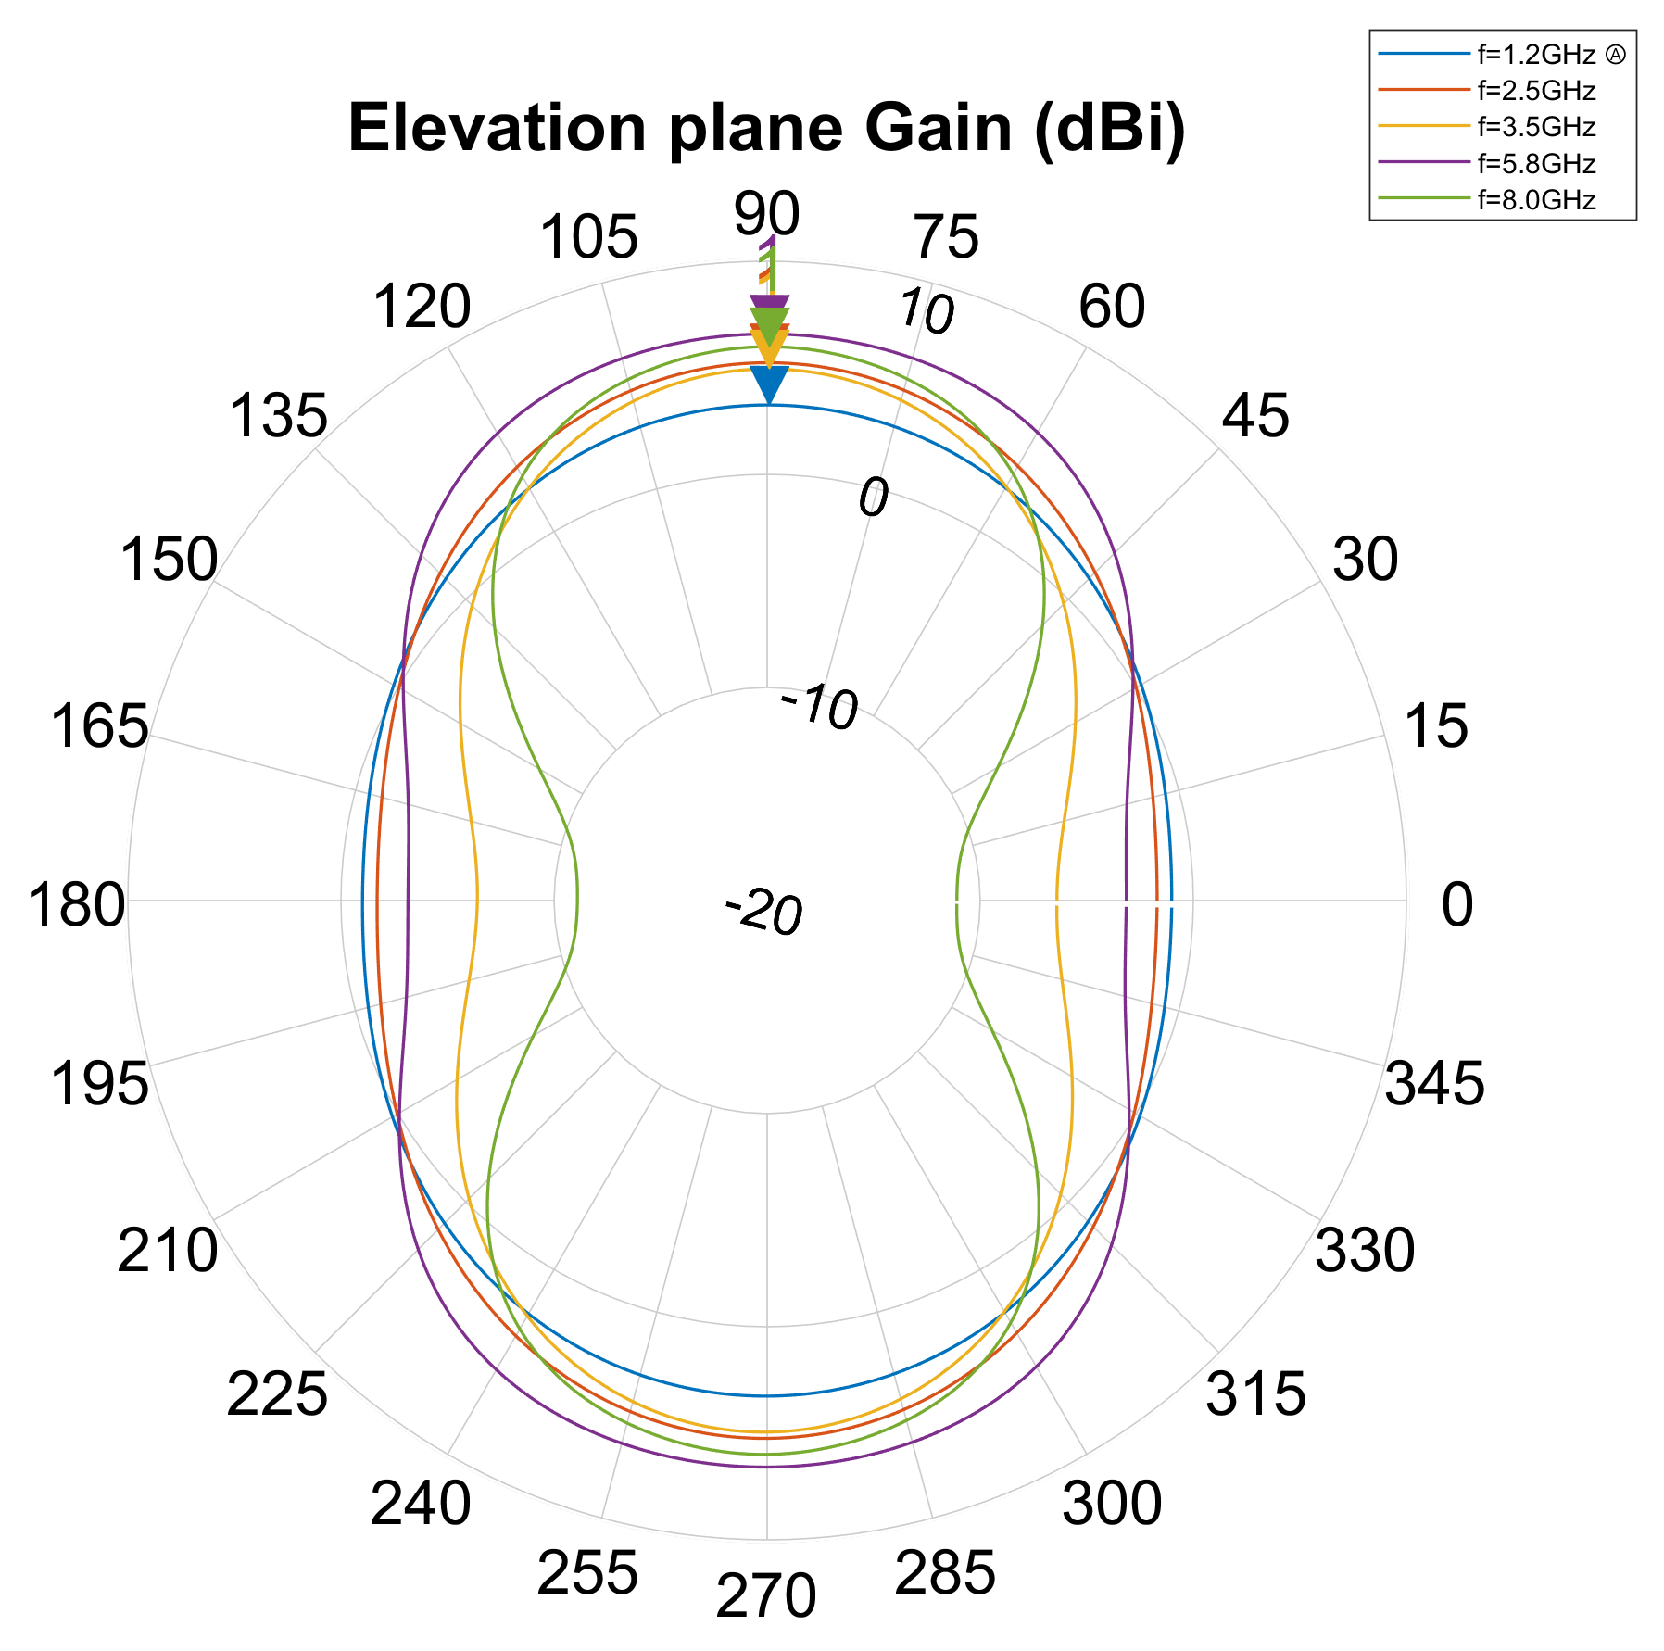
2
The research project • Trial Results
Second simulation set
Rectangular spiral antenna with matching dimensions of the previously simulated equiangular spiral.
2D Radiation diagrams
Comparable (very little) radiation to the sides of the antenna.
Again, a bidirectional radiation pattern in obtained. Gains are comparable, but better than those of the equiangular antenna.
Apparent good stability, but not as good as the equiangular spiral.

Slide 19
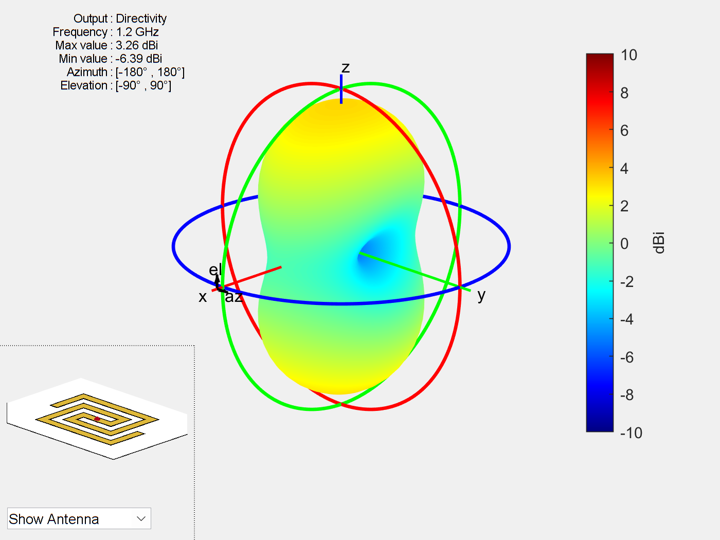
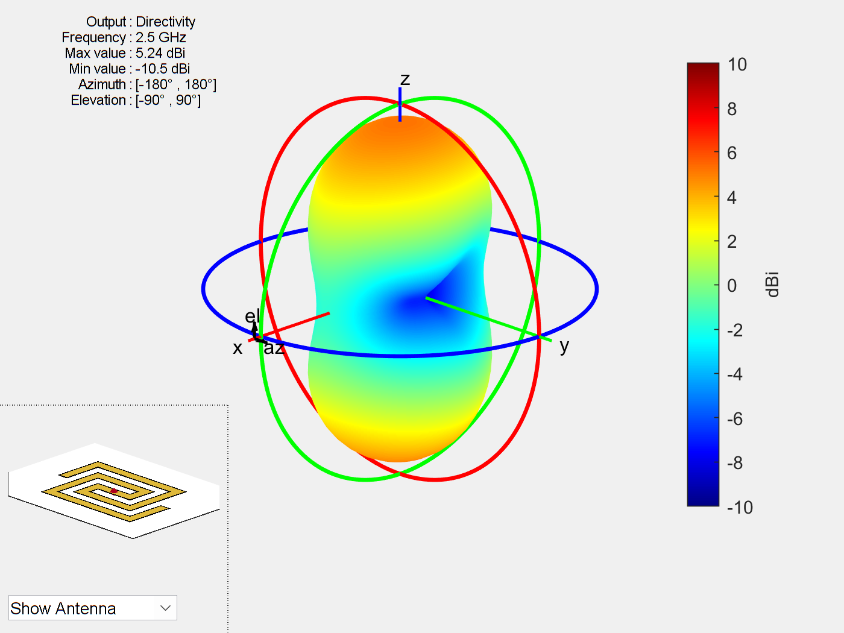
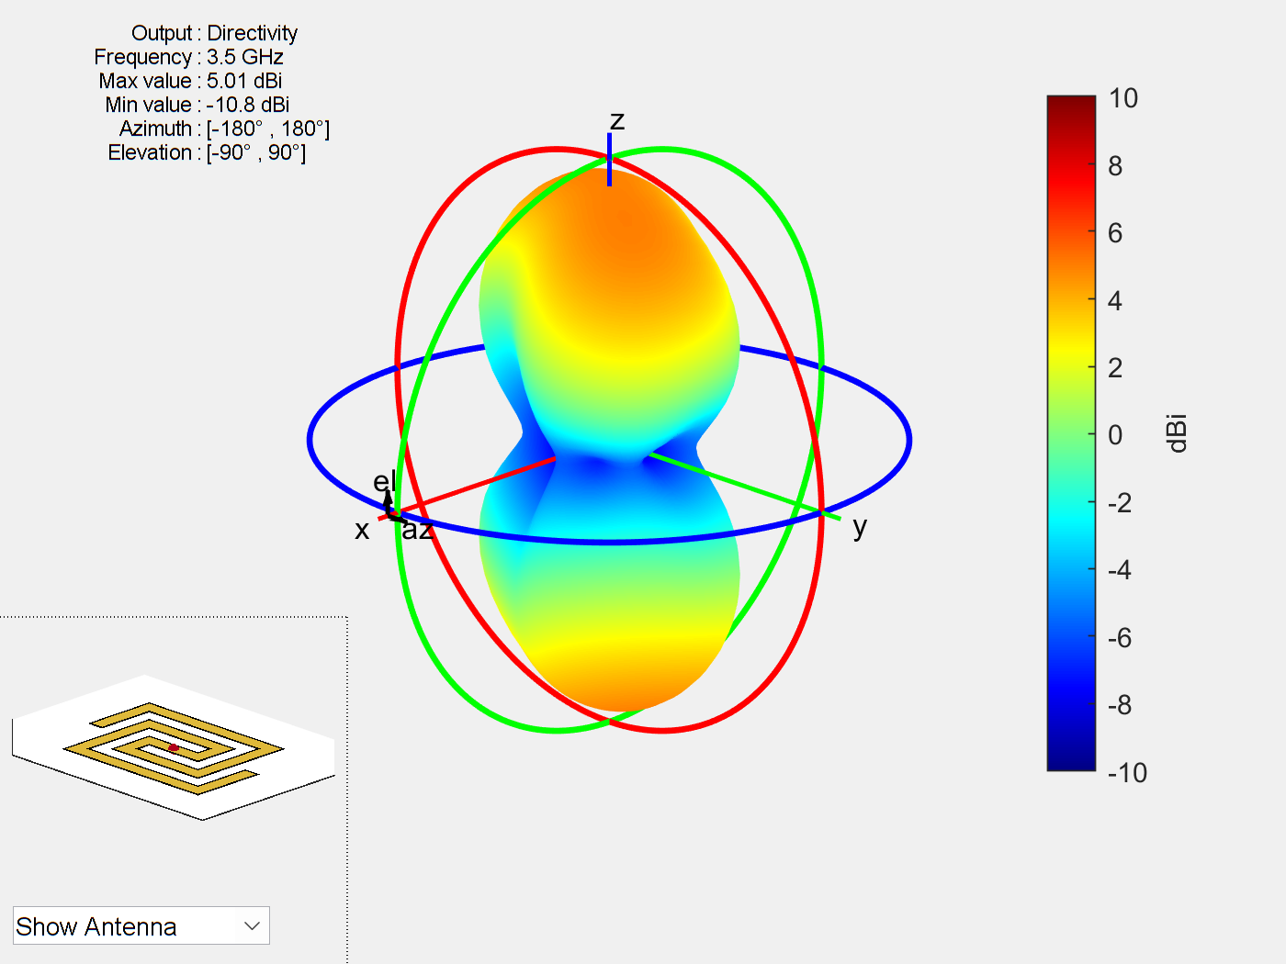
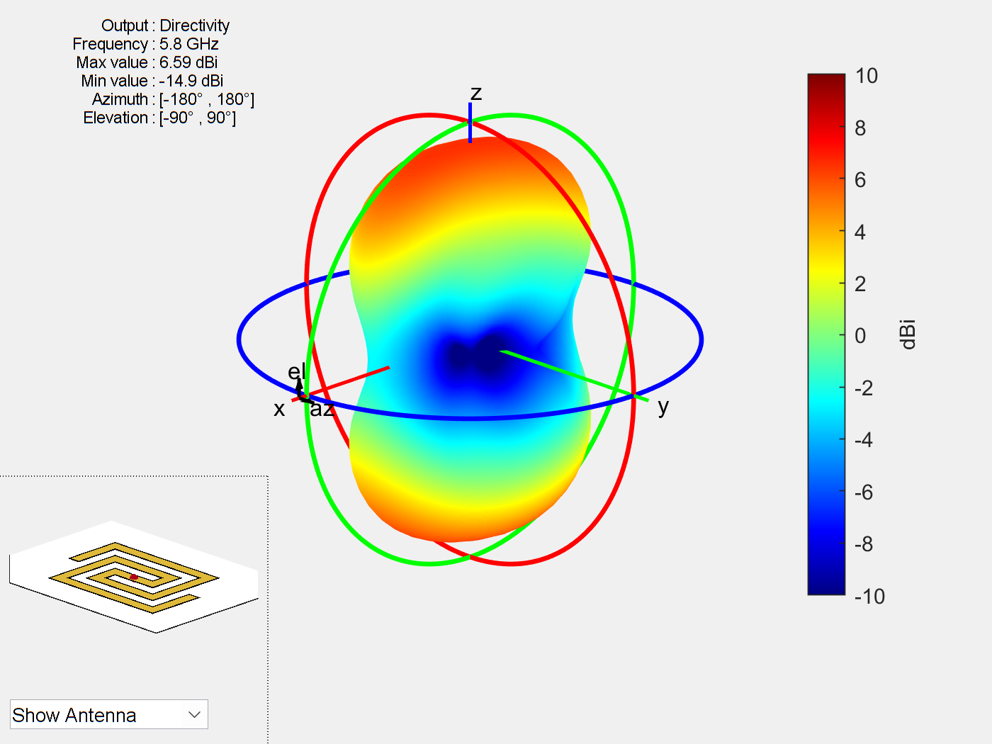
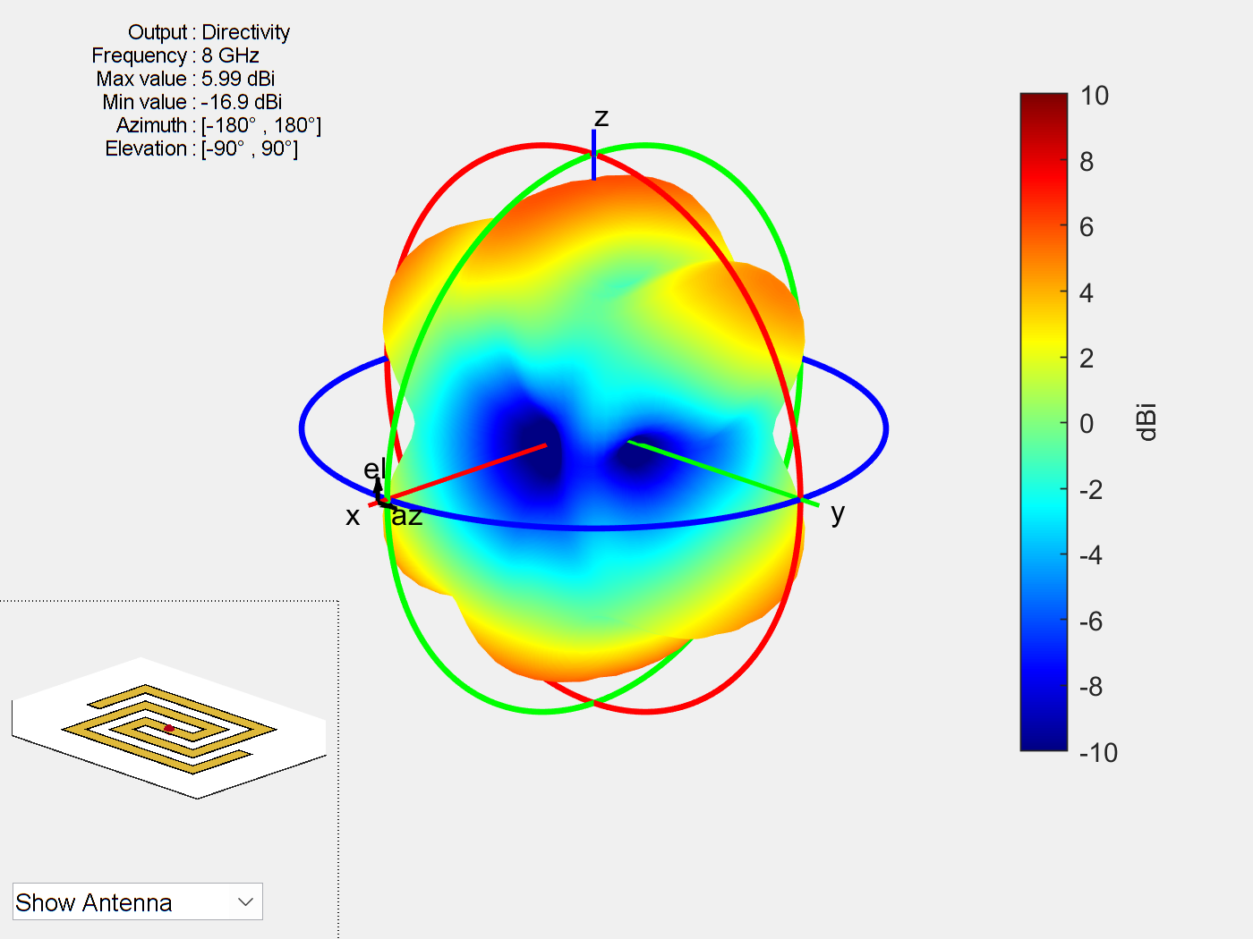
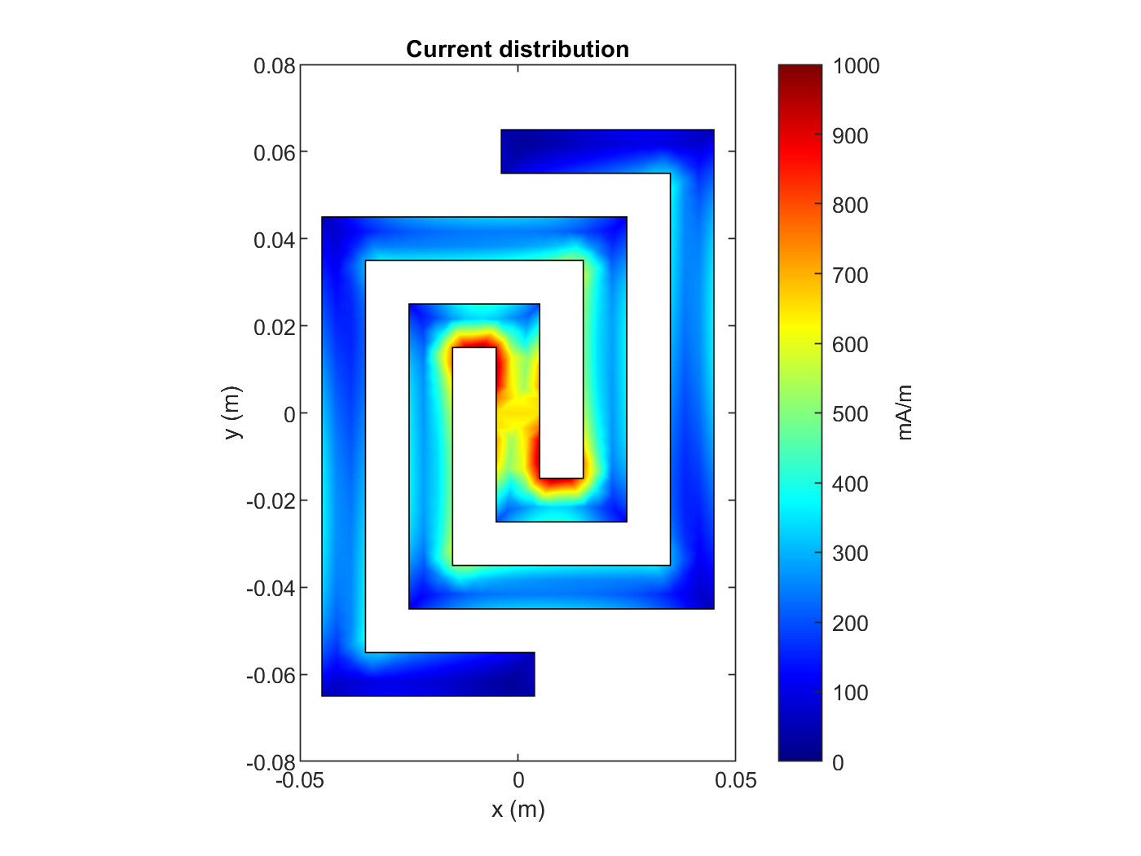
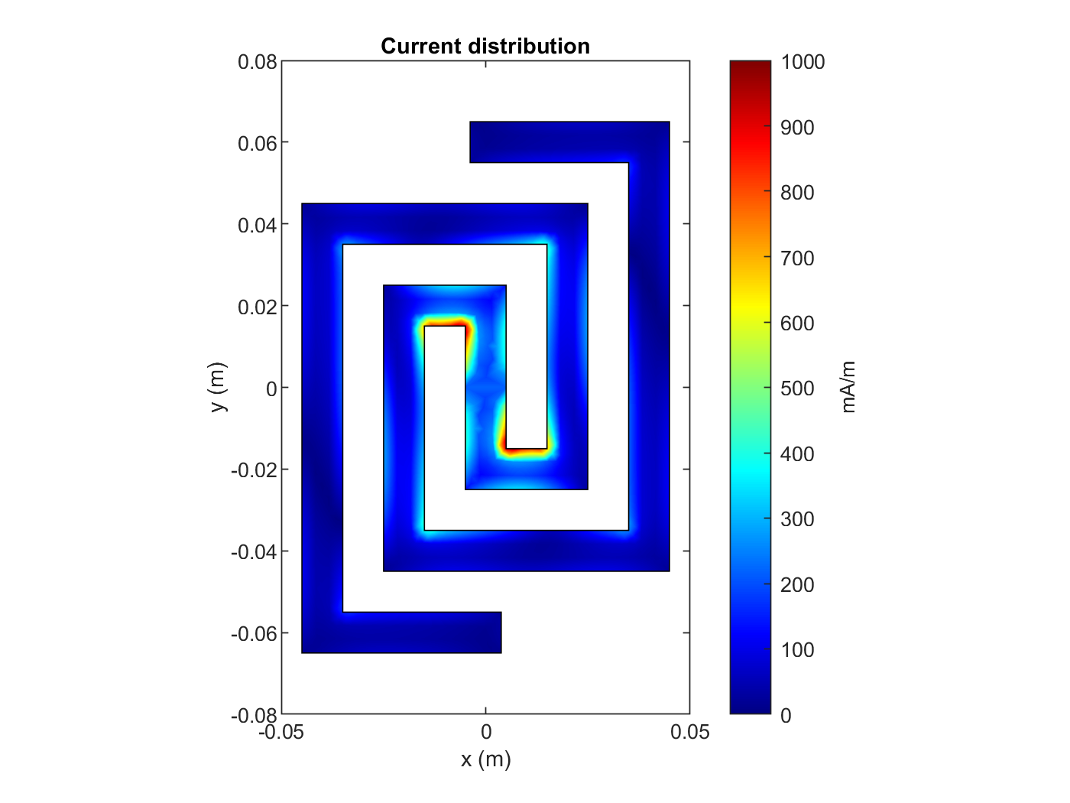
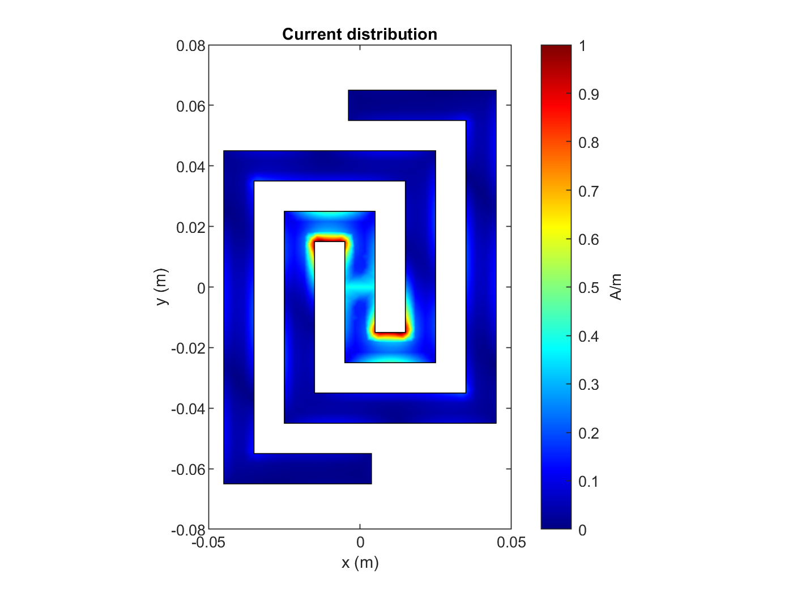
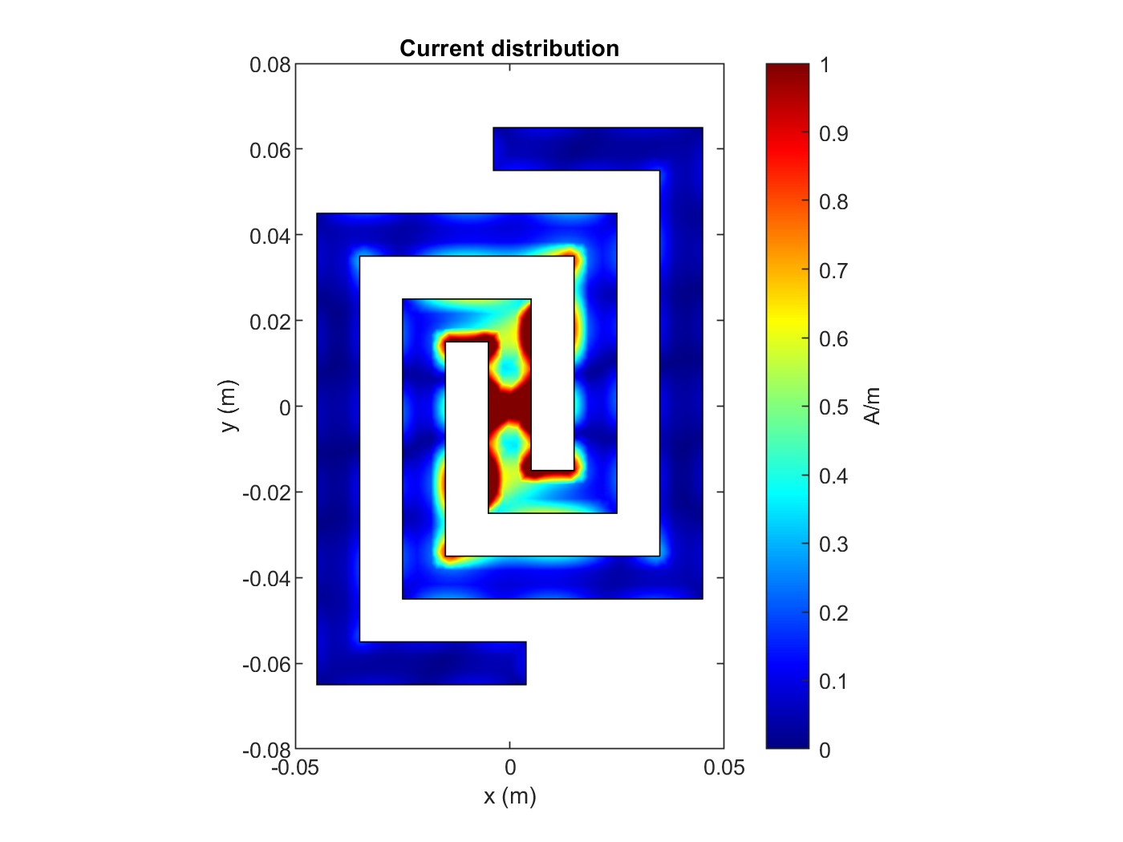
2
The research project • Trial Results
1.2 GHz
2.5 GHz
3.5 GHz
5.8 GHz
8 GHz
3D Radiation diagrams: The antenna performs better than the equiangular one at lower frequencies but significantly worse at the higher. The diagram is not as stable either.
1.2 GHz
2.5 GHz
5.8 GHz
1.2 GHz
3.5 GHz
8 GHz
Surface currents distribution: The currents remain near the first turns when the antenna appears to perform better. At the higher frequency, large densities appear around the source.

Slide 20
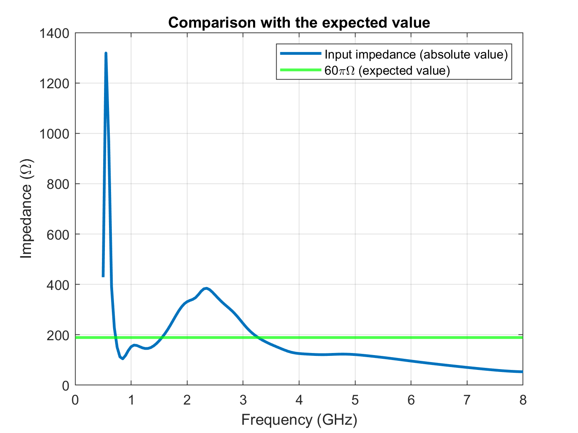
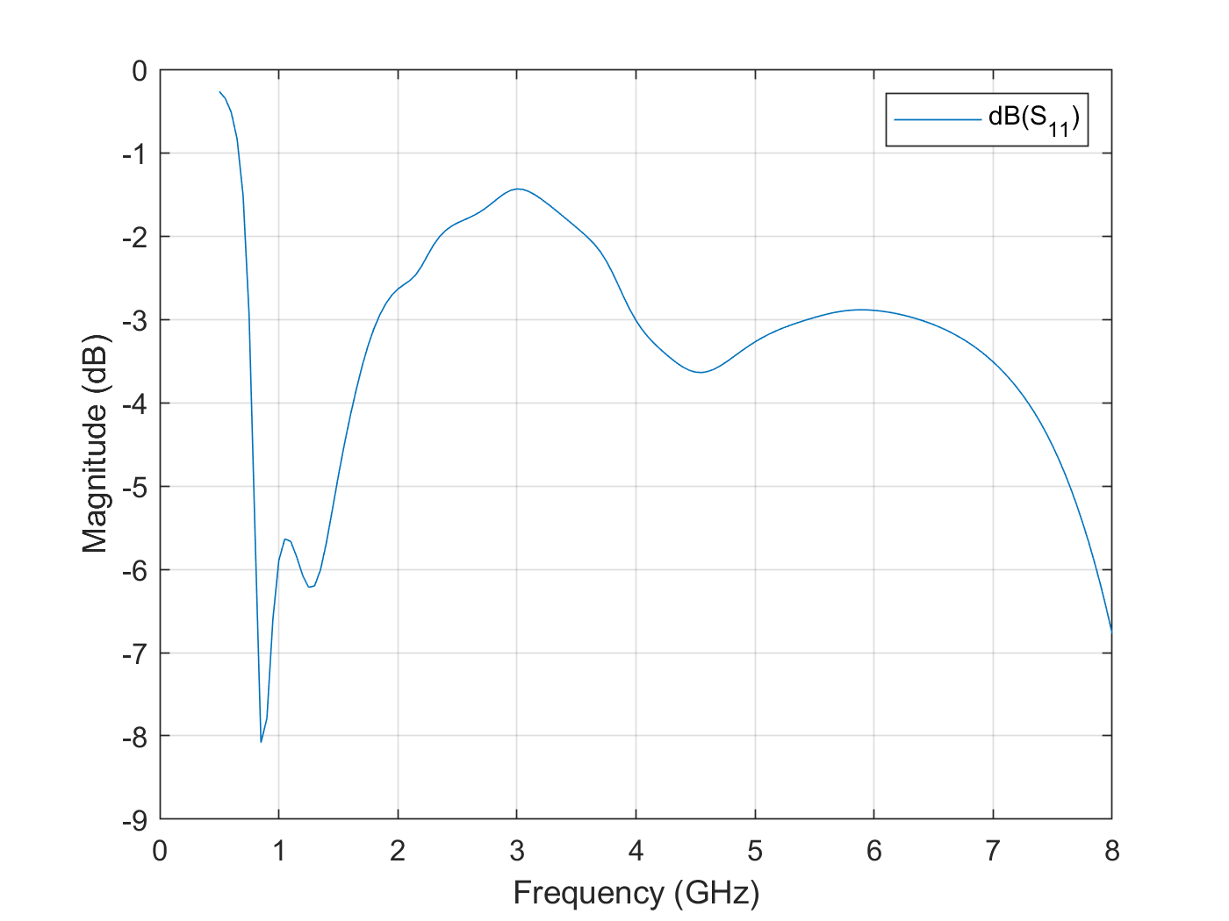
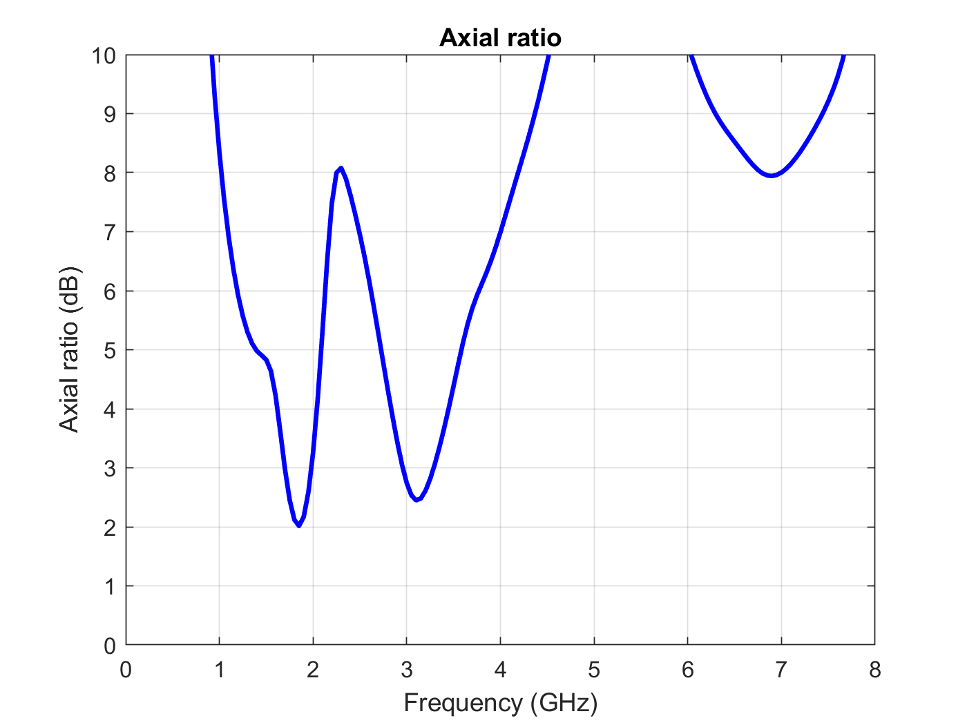
2
The research project • Trial Results
Input impedance: The input impedance is extremely variable in the range under study, performing much worse than the equiangular spiral.
S11 parameter: The voltage reflection coefficient is also very unstable, keeping over the -5dB mark for good part of the frequency range.
Axial ratio: Aside from a single frequency just under the 2GHz mark, the antenna fails to reach the 2dB mark that is acceptable for having a good circular polarization, representing again a clear disadvantage over the equiangular antenna.

Slide 21
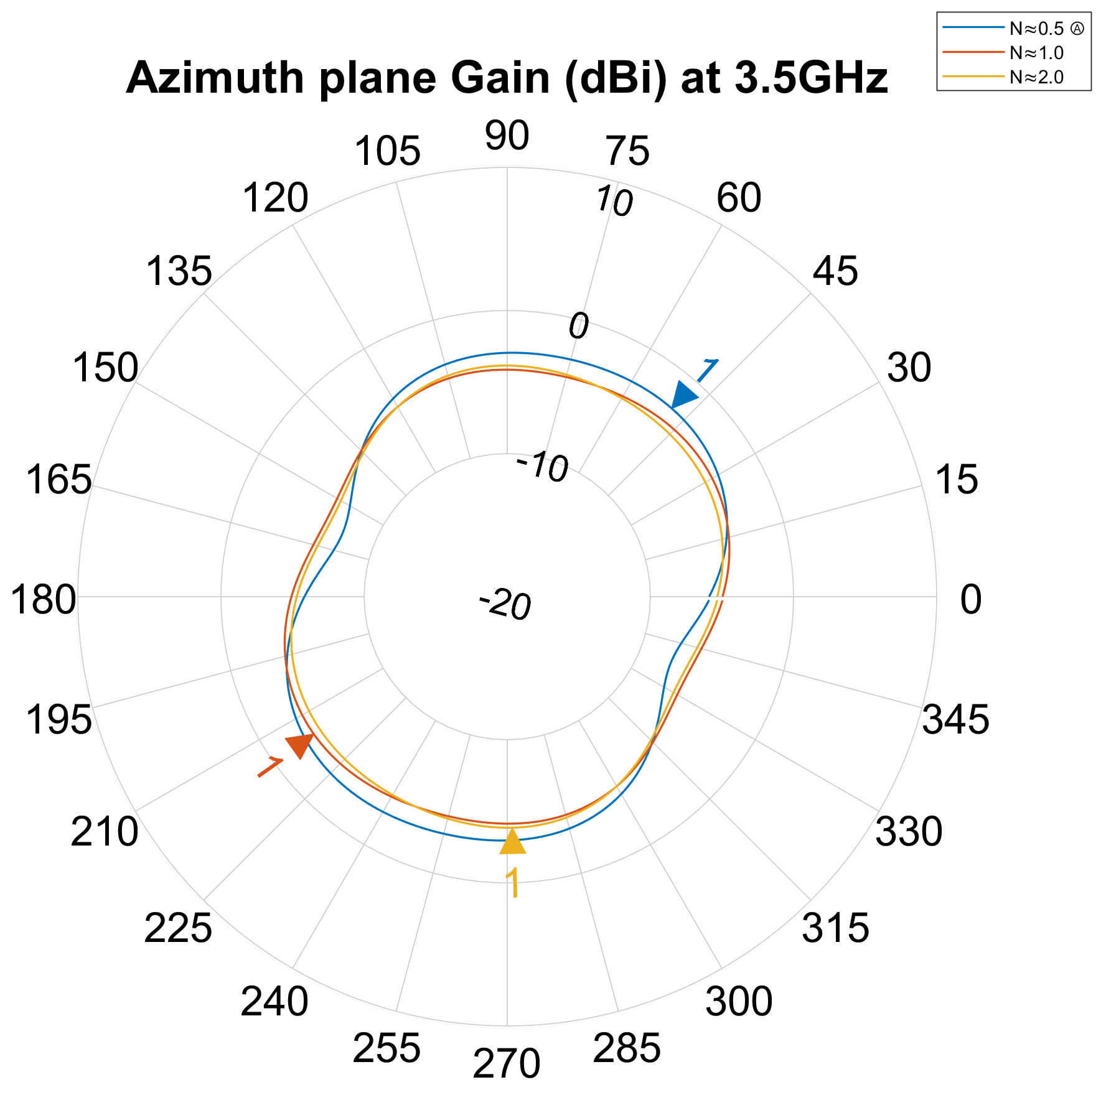
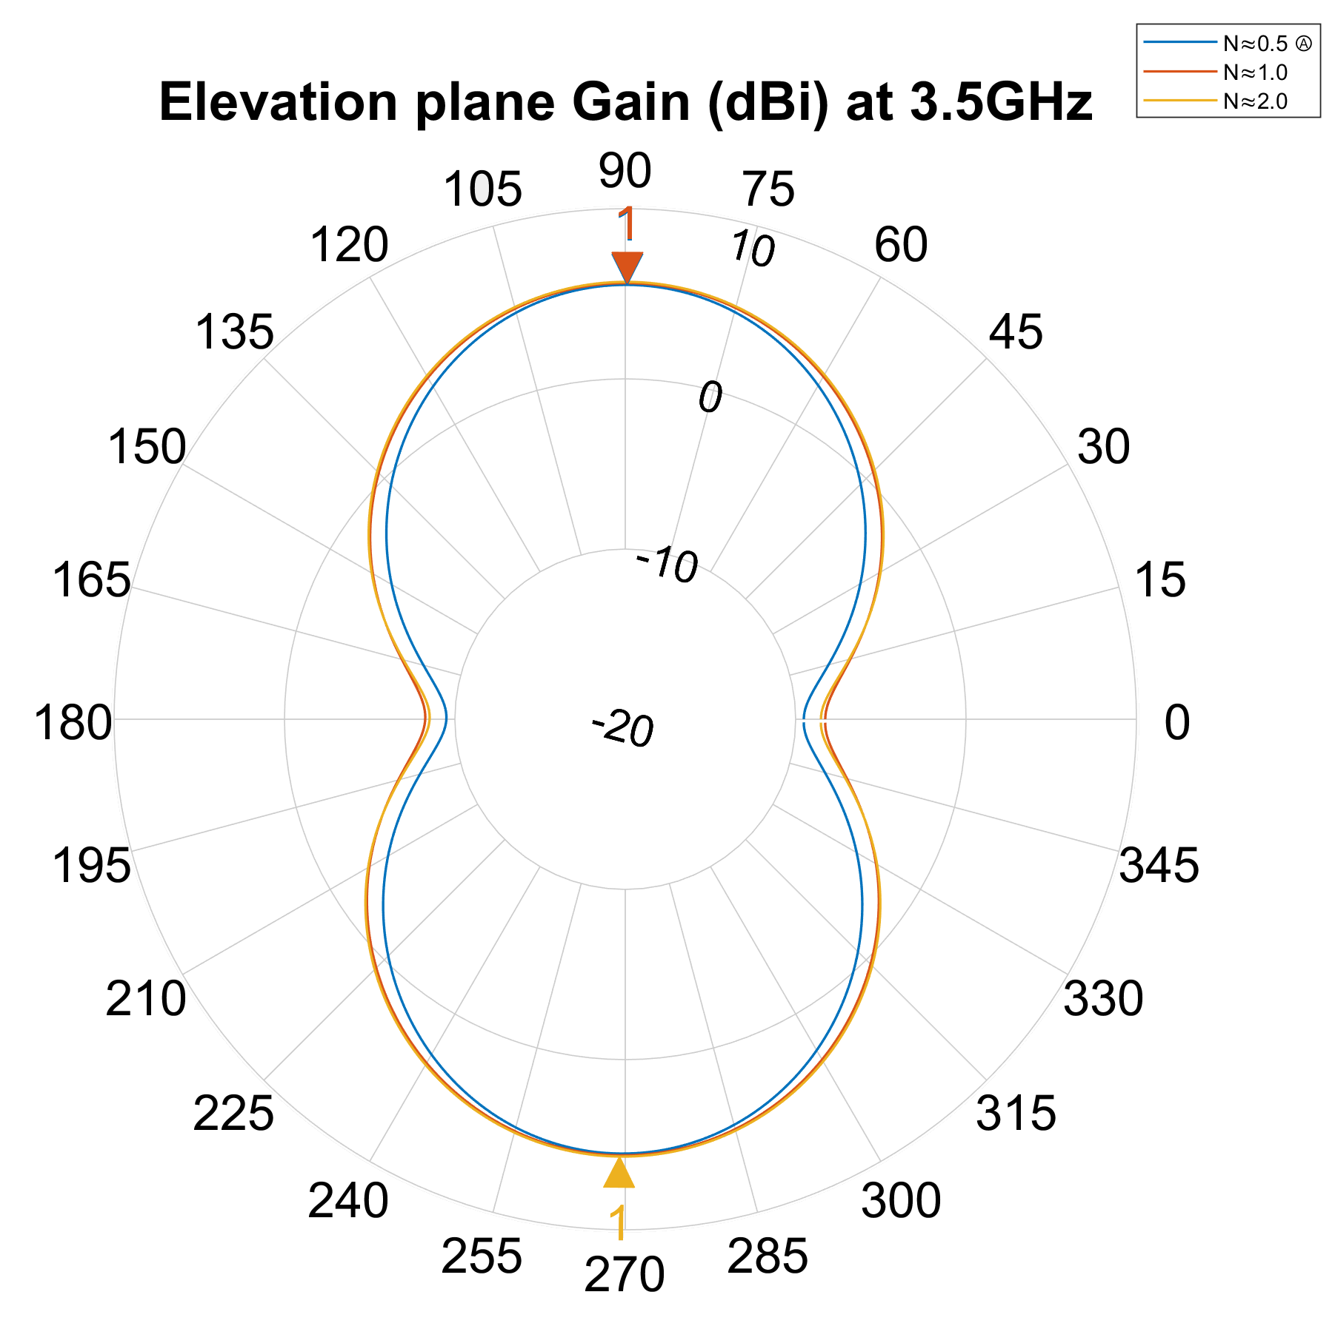
2
The research project • Trial Results
Third simulation set
The number of turns of the equiangular antenna was changed varying the growth rate parameter in order to analyze its influence.
2D Radiation diagrams
Extremely consistent values obtained for the three configurations tested. The number of turns does not seem to affect significantly the gain of the antenna. The lower number of turns produced more radiation in the azimuth plane, but the values are almost insignificant (always below the 0dBi mark).

Slide 22
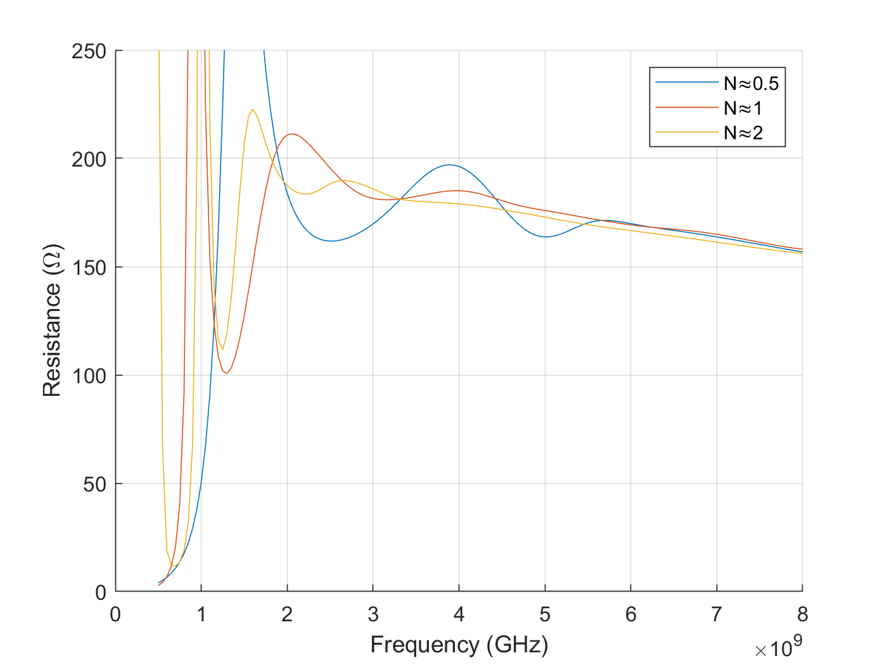
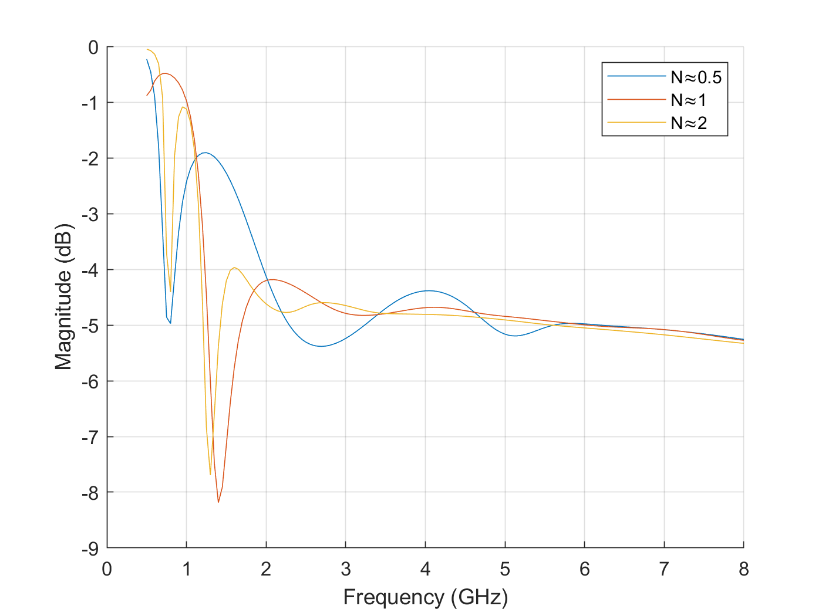
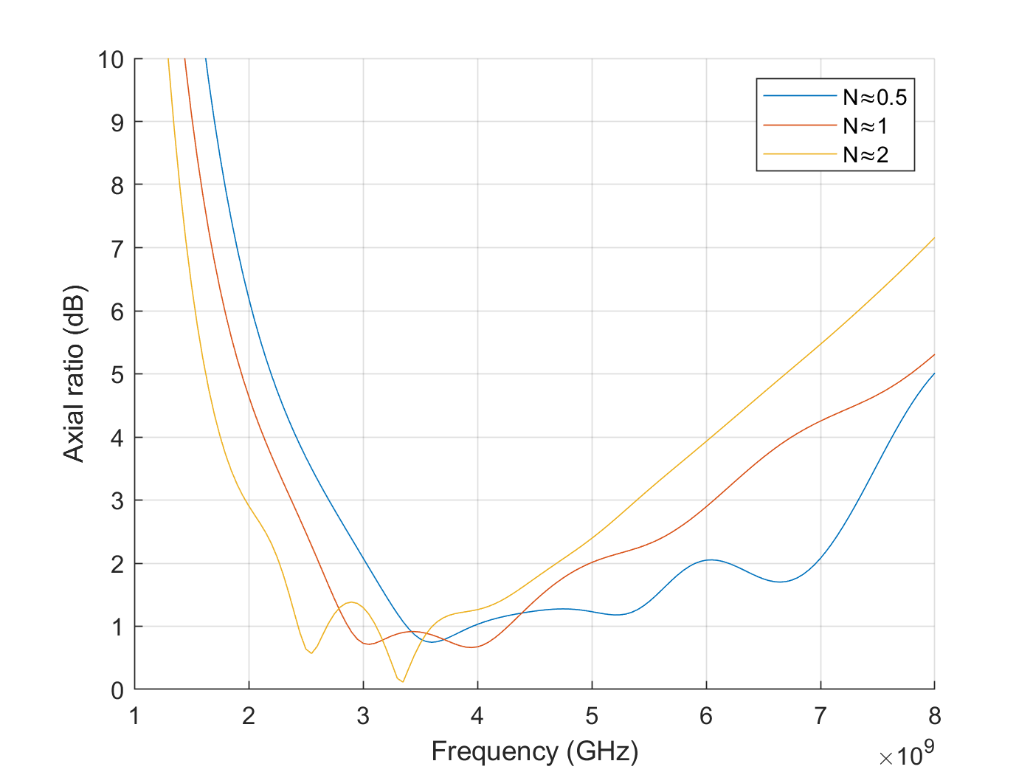
2
The research project • Trial Results
Input impedance: As the number of turns the antenna made increased, an improvement to the input impedance performance was seen. The curve became more stable, and the last peak moved down in the frequency range.
S11 parameter: Again, the input voltage reflection coefficient showed better results as the number of turns was higher. The curve became stable at a faster rate.
Axial ratio: While plot with two turns reaches the 2dB mark faster than the others, it was the 0.5 turns one that showed a higher bandwidth of circular polarization, going from 2.5GHz to 4GHz, a significant variation.

Slide 23
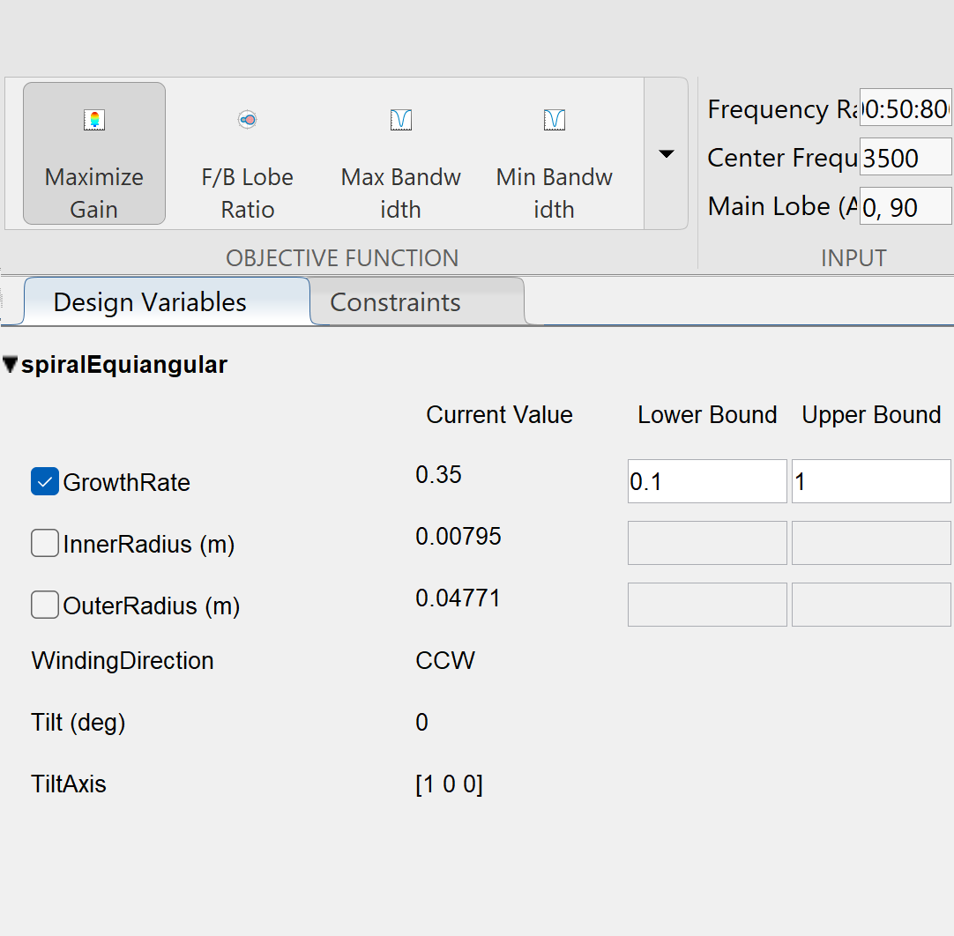
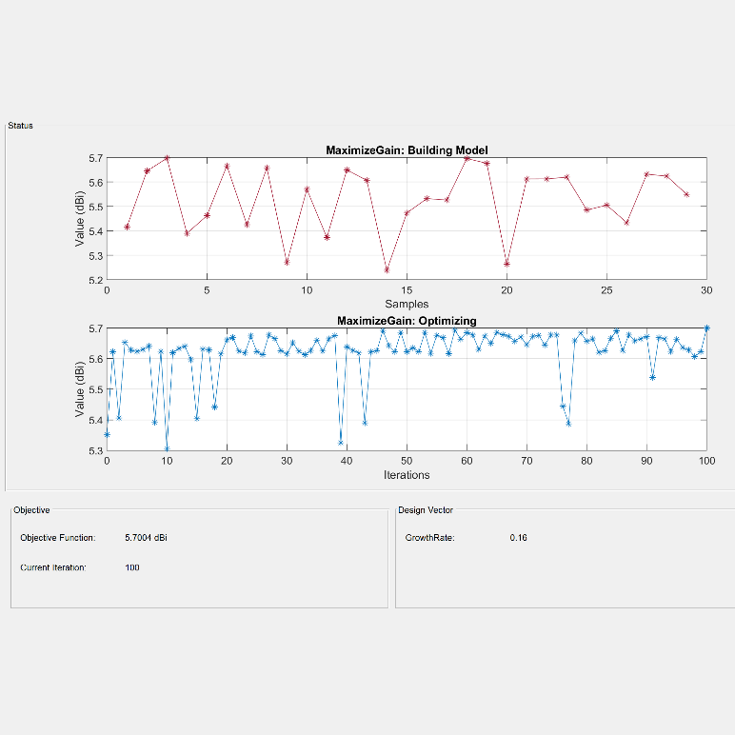
2
The research project • Trial Results
Optimization
The growth rate parameter was then optimized to obtain the highest possible gain using the built-in MATLAB Antenna Toolbox.
The parameter was iterated 100 times around the values of 0.1 and 1. After a short while, the optimization tool obtained an optimal value for the growth rate of 0.16, which produced a gain of 5.7dBi at the center frequency (3.5GHz). This result was used in the next section.
A manual for the usage of this tool is included in the memory of the project as an appendix.

Slide 24
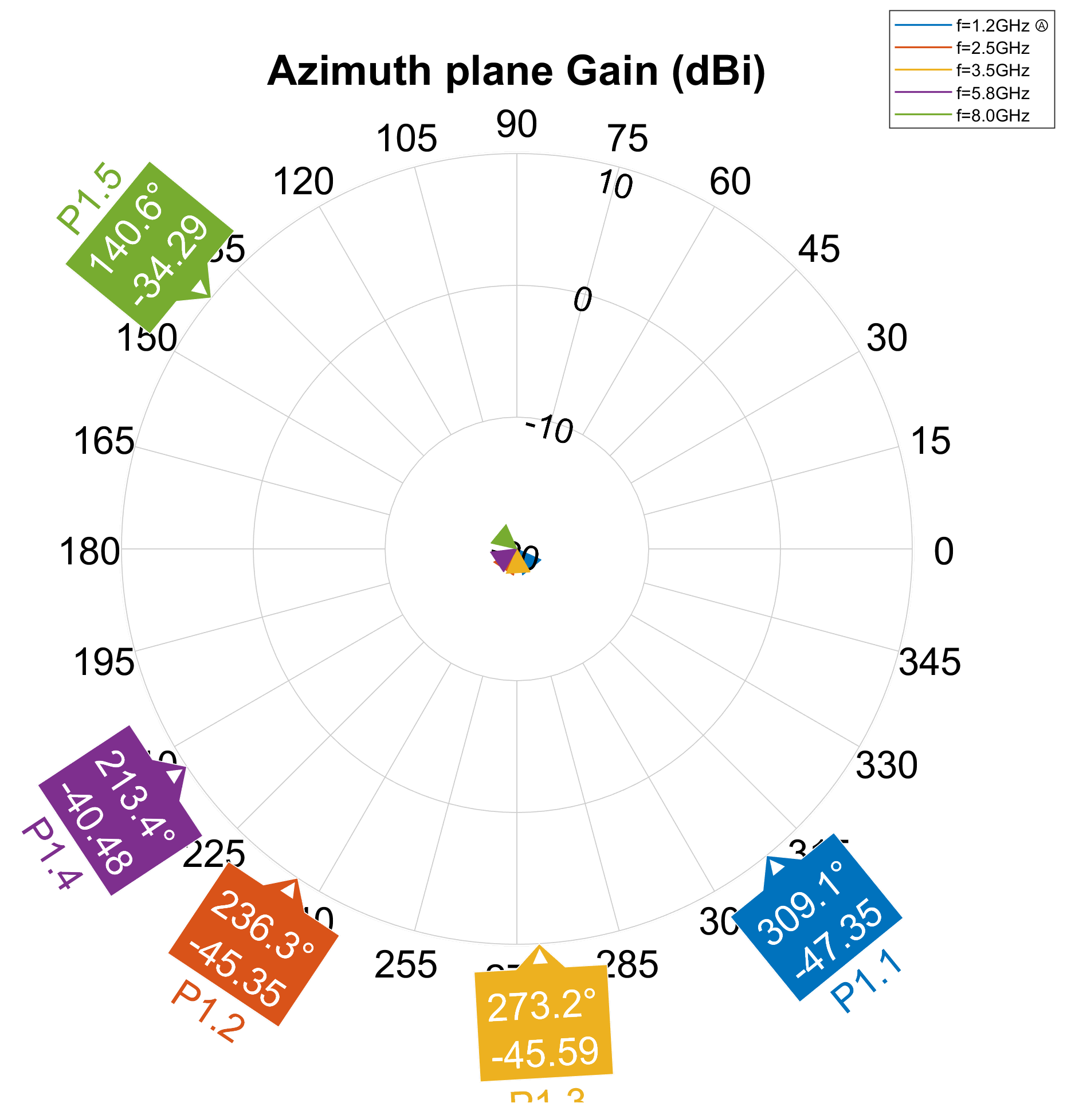
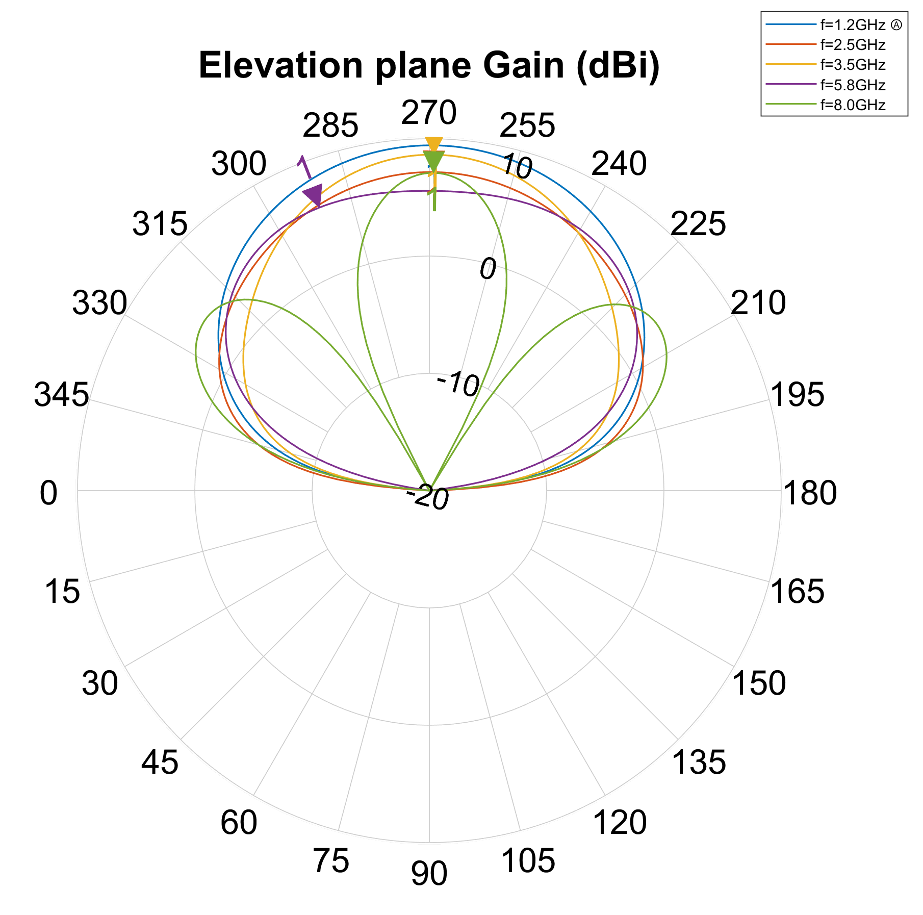
2
The research project • Trial Results
Fourth simulation set
An infinite PEC reflector plane element was added to the antenna to obtain a unidirectional radiation pattern. Its effect on the radiation was studied.
2D Radiation diagrams
Gain in the azimuth plane was exceedingly small, always below -34dBi, which is expected, as the reflector plane further concentrates the radiation perpendicularly to this plane.
The elevation plane diagram shows the desired unidirectional diagram with improved gains. However, the higher frequency (outside of the design limits) shows undesirable lobes.

Slide 25
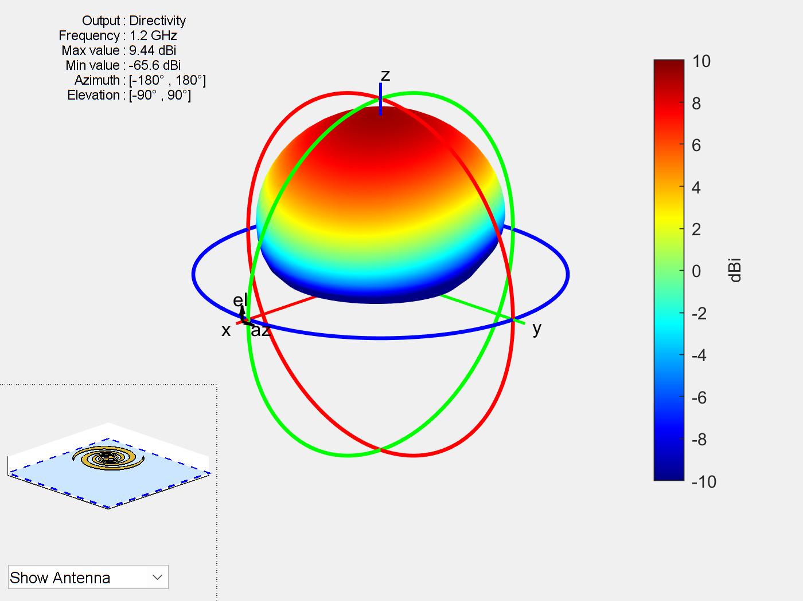
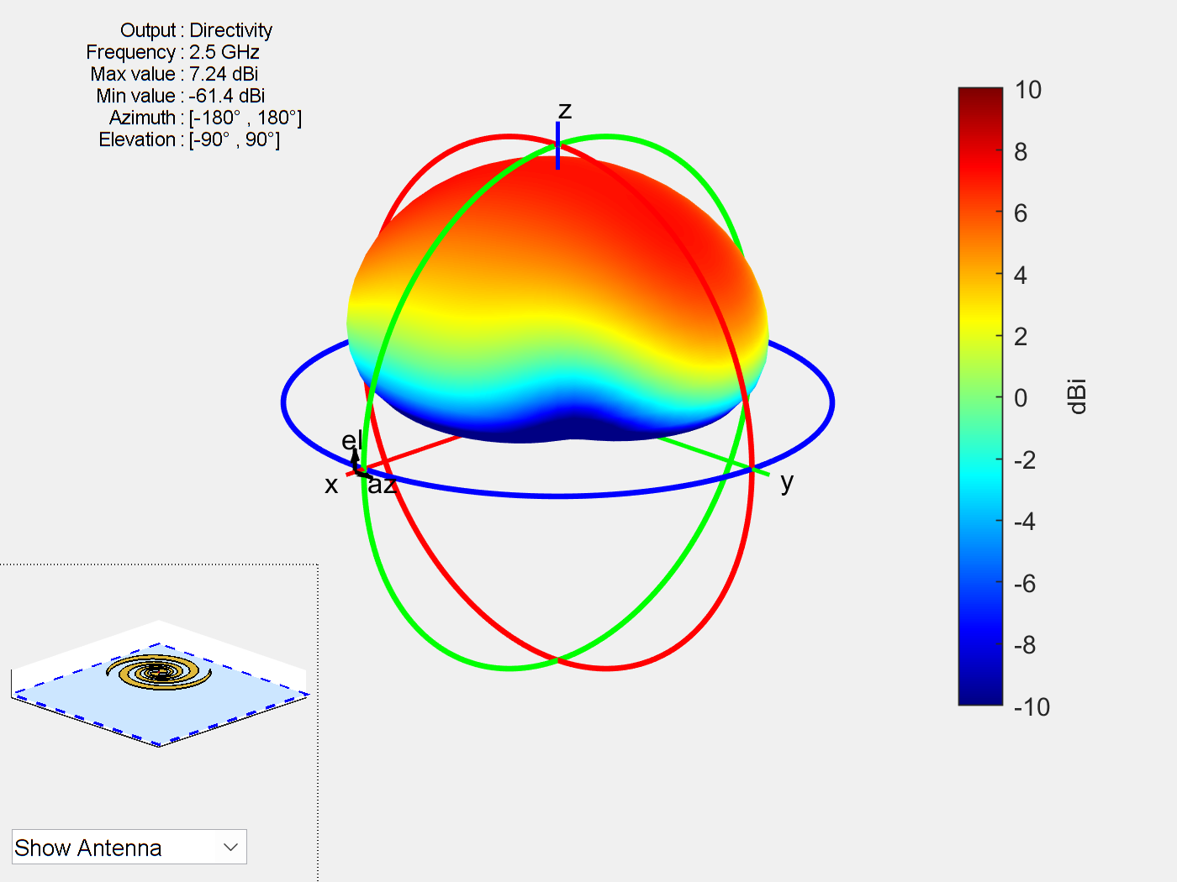
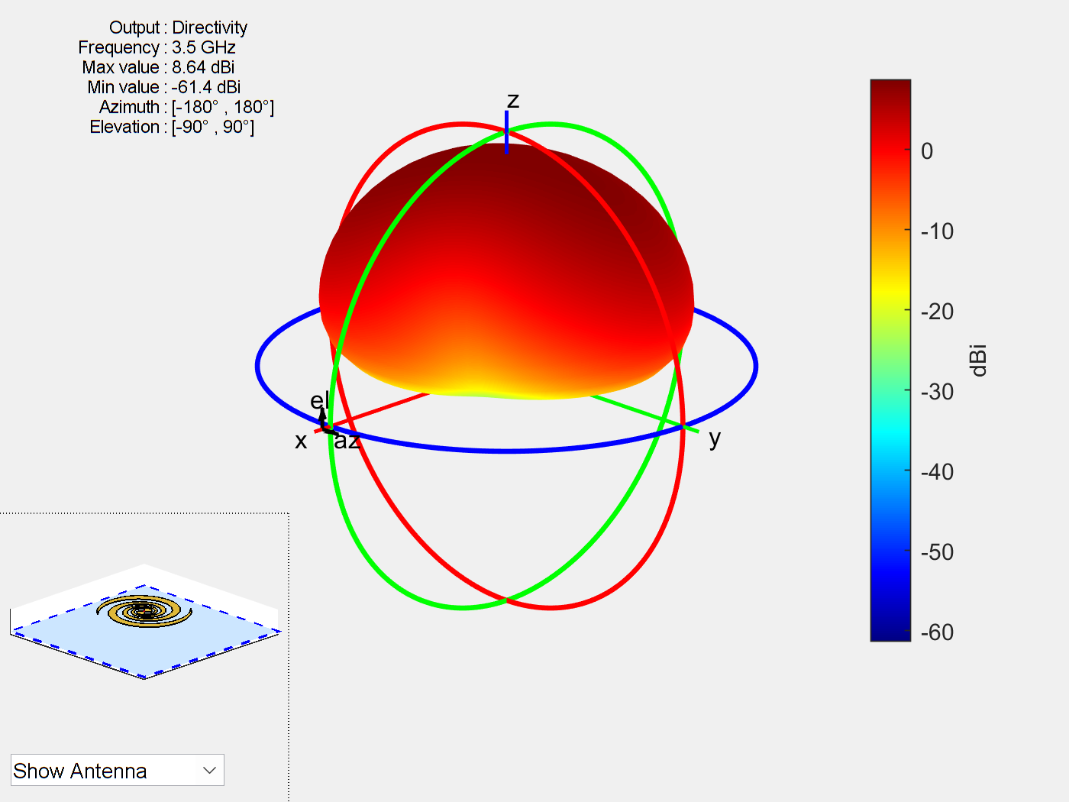
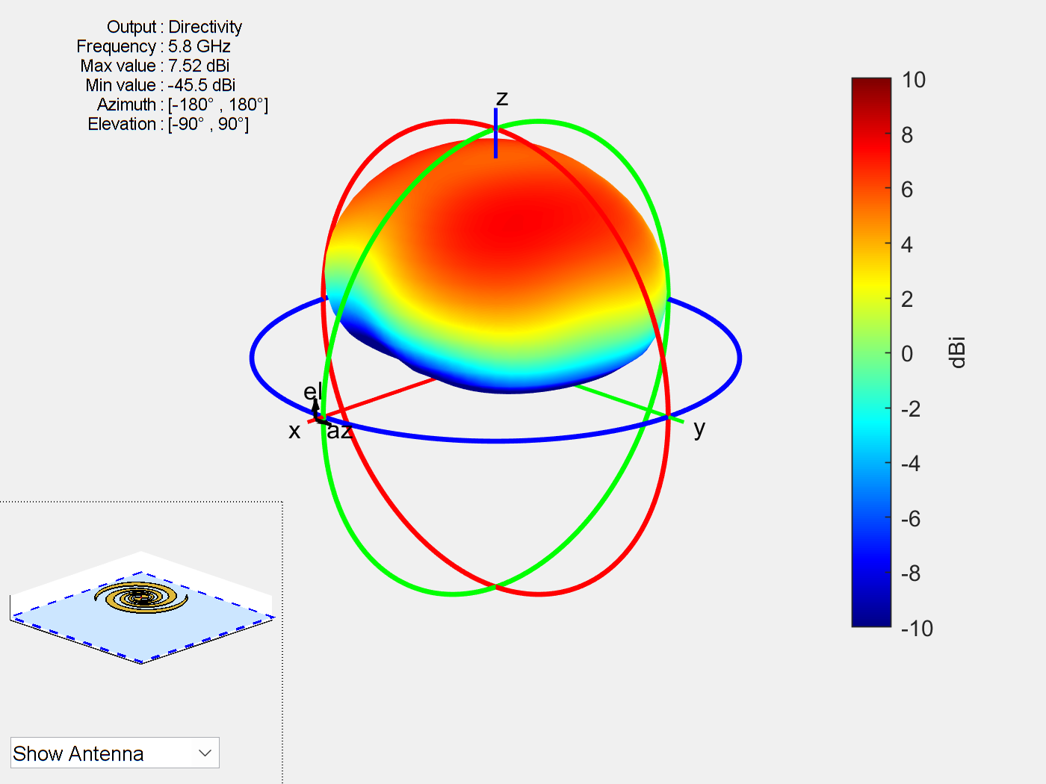
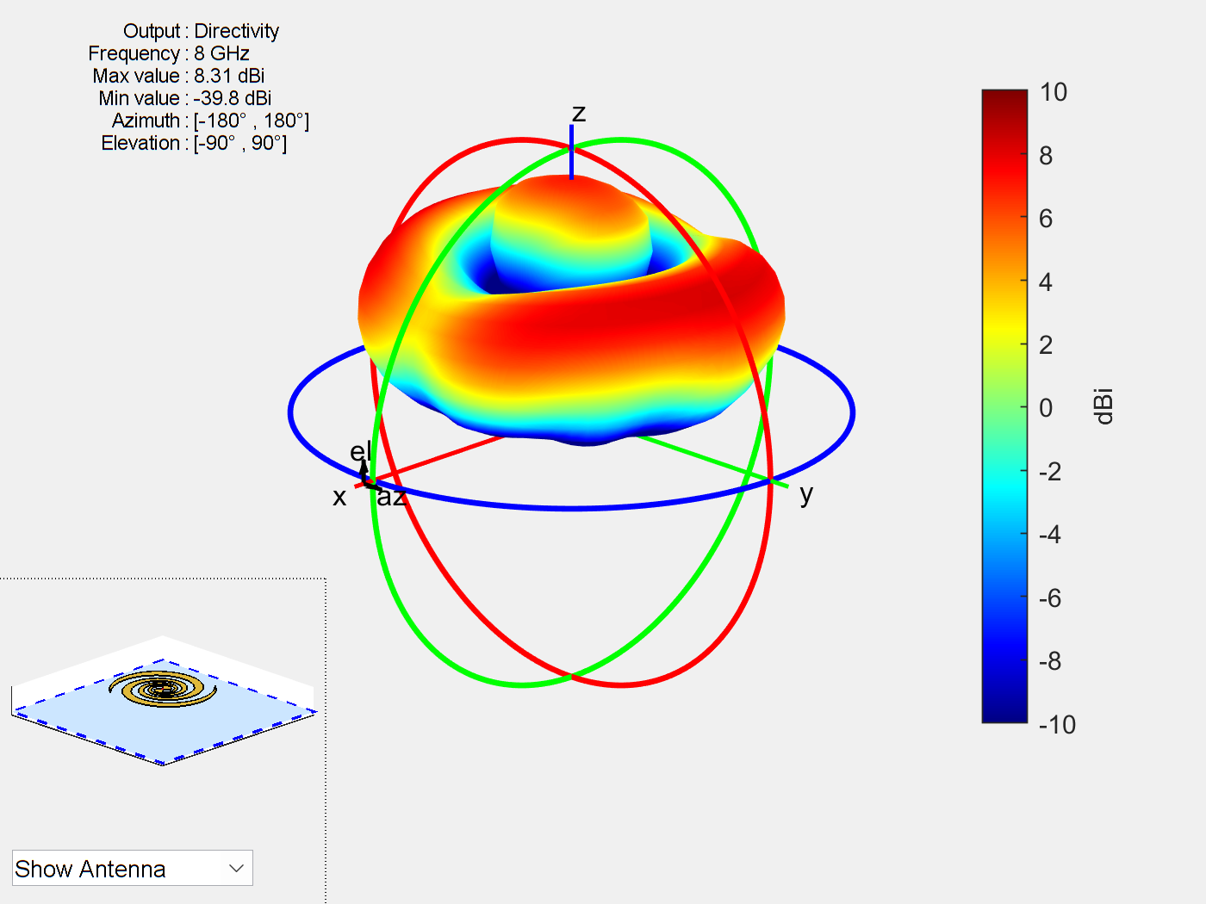
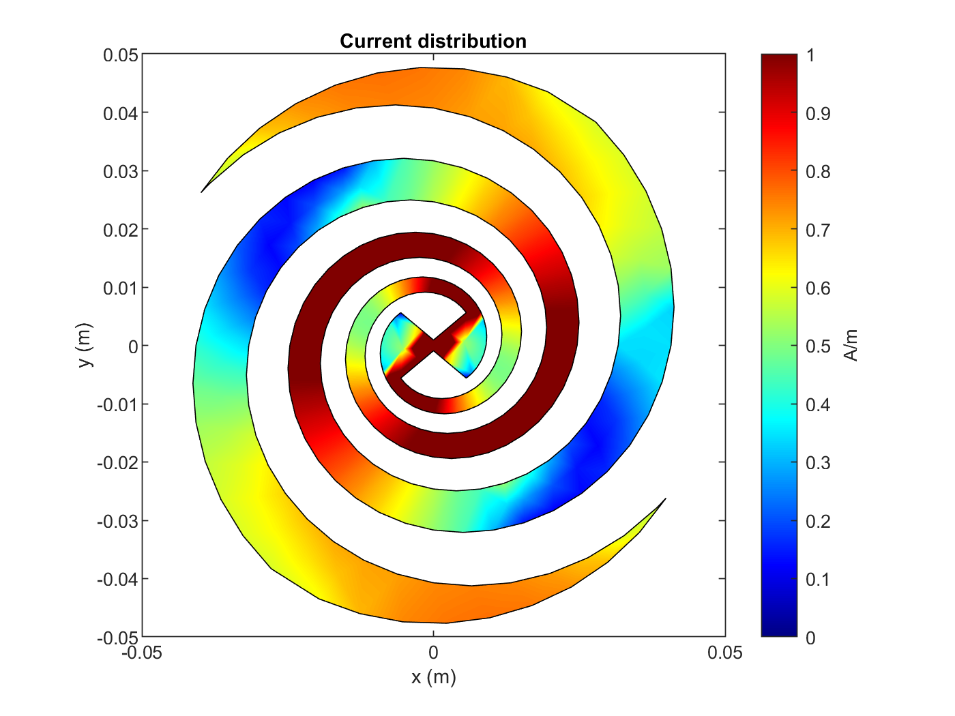
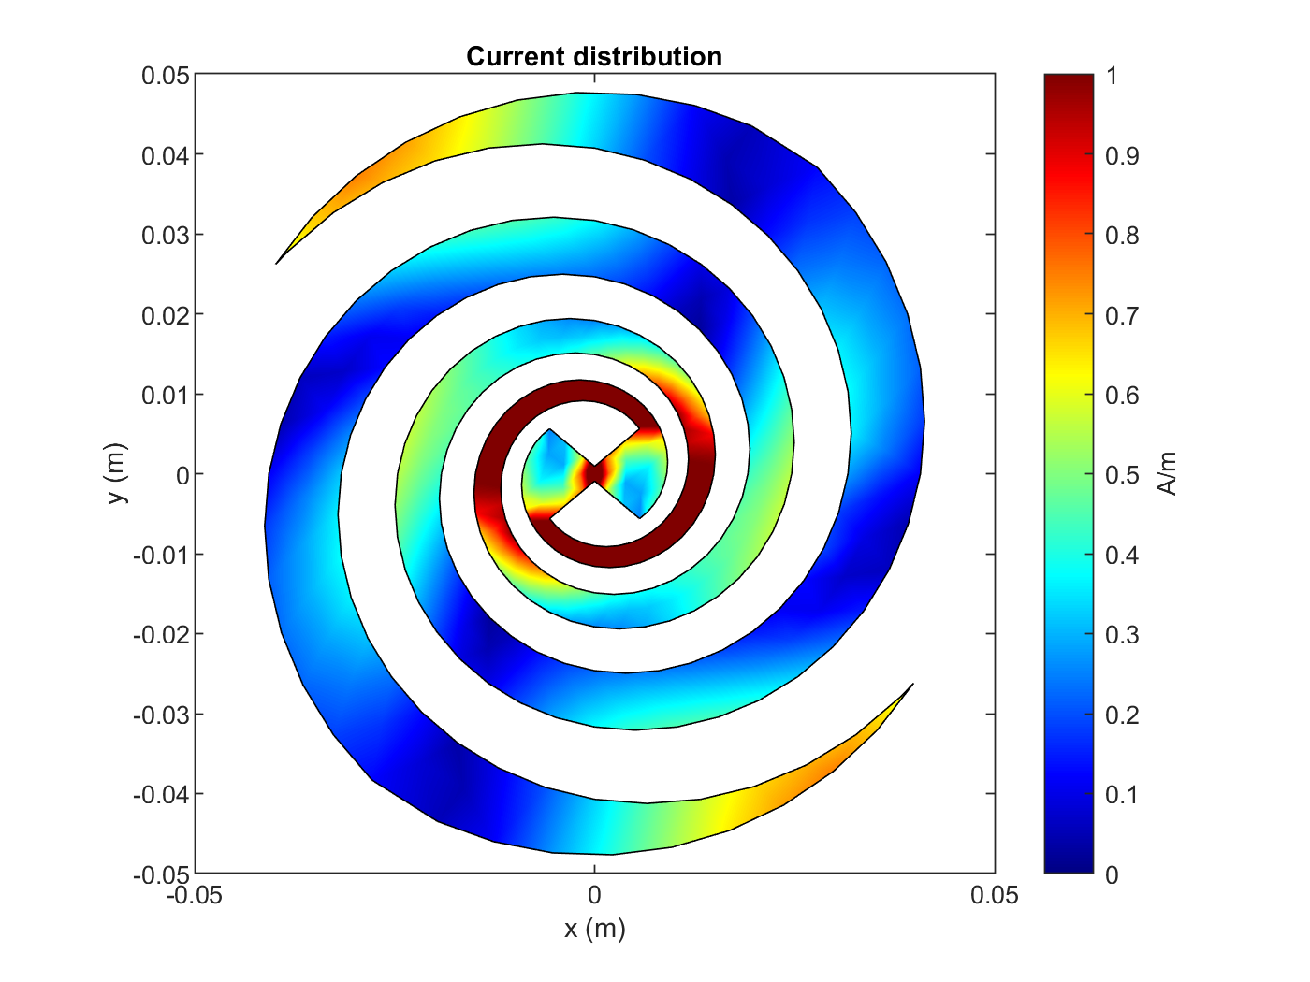
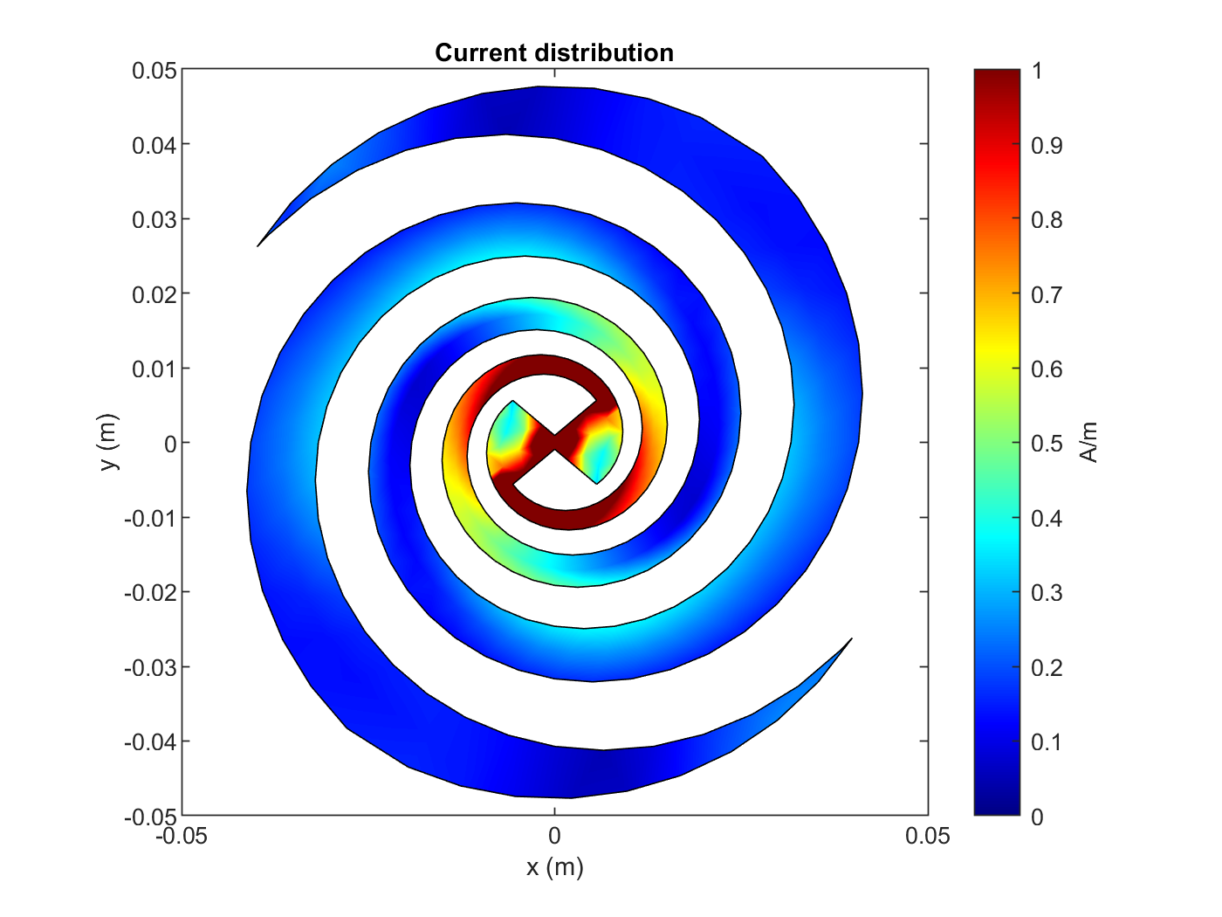
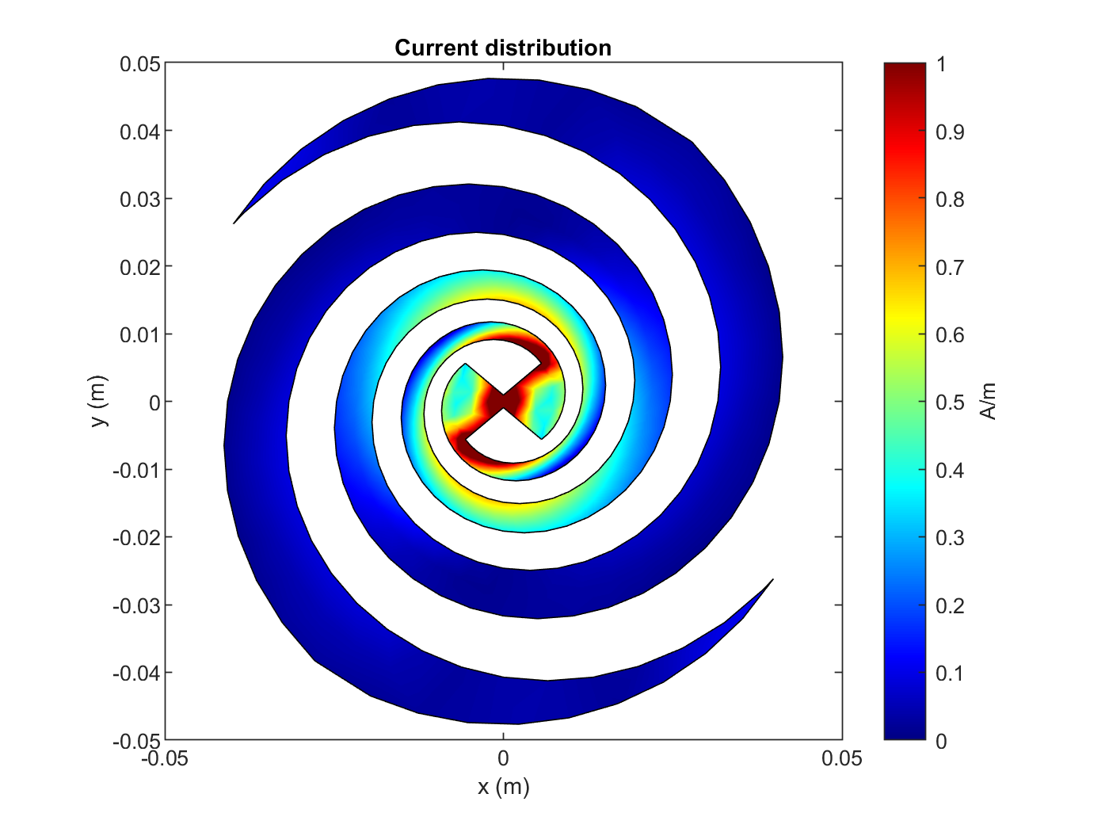
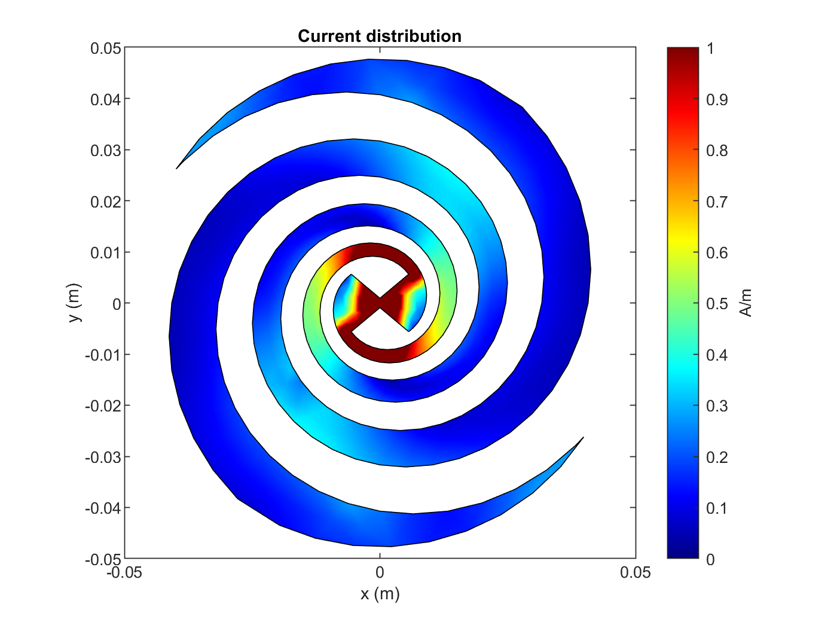
2
The research project • Trial Results
1.2 GHz
2.5 GHz
3.5 GHz
5.8 GHz
8 GHz
3D Radiation diagrams: The radiation diagram is consistent in the operating frequency range. However, the diagram from the highest frequency shows lobes, making it perform worse.
1.2 GHz
2.5 GHz
5.8 GHz
1.2 GHz
3.5 GHz
8 GHz
Surface currents distribution: The reflector caused high current densities around the arms in the lower frequencies. This means that the antenna is not behaving as a self-scaling structure.

Slide 26
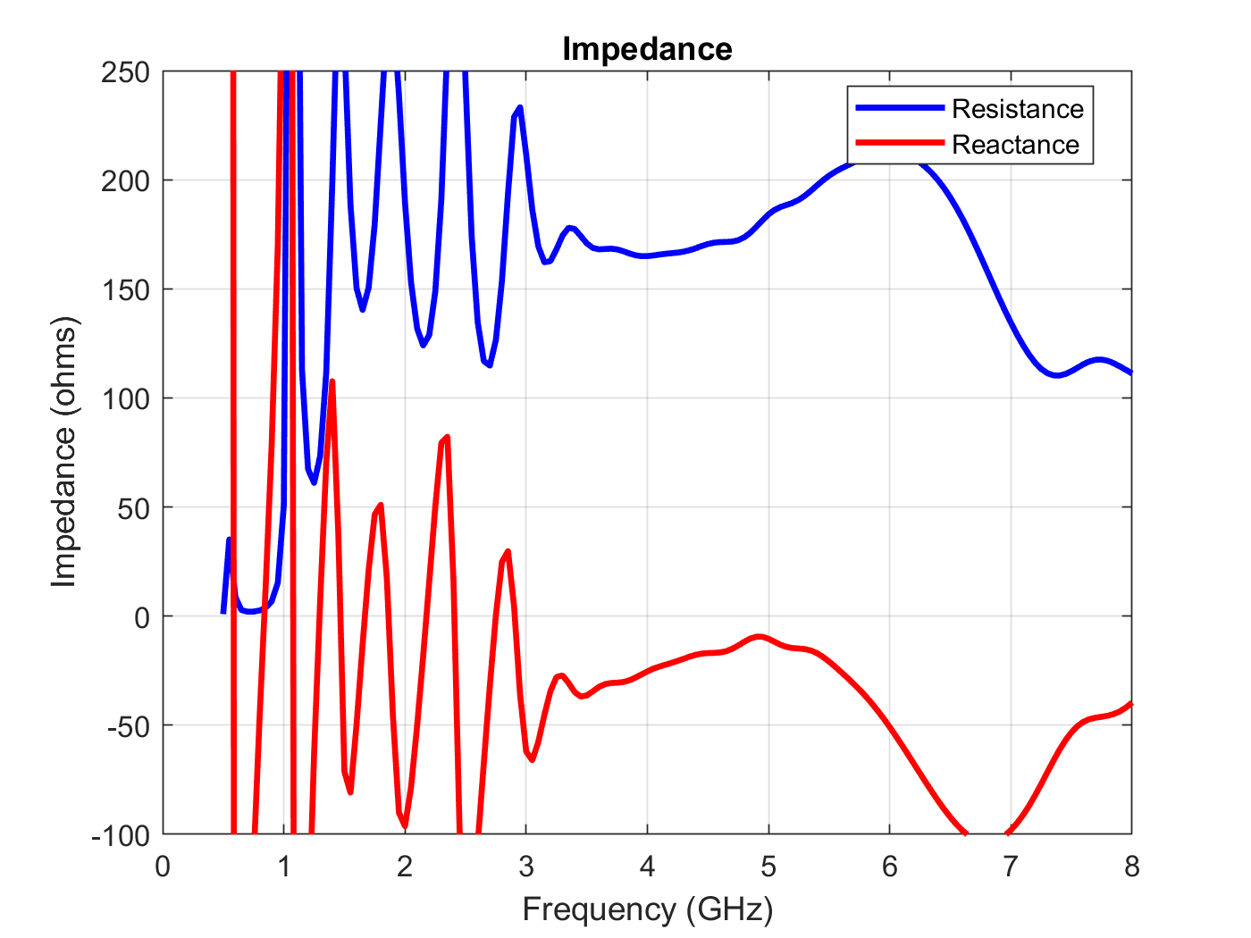
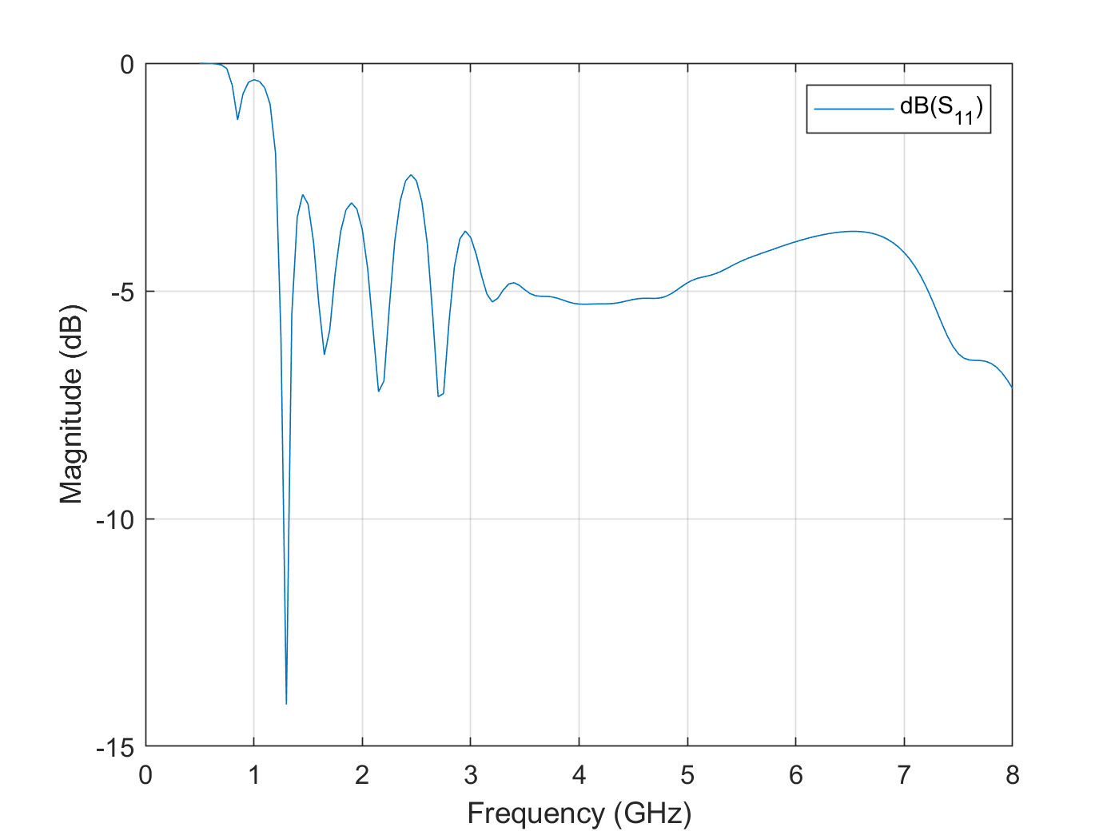
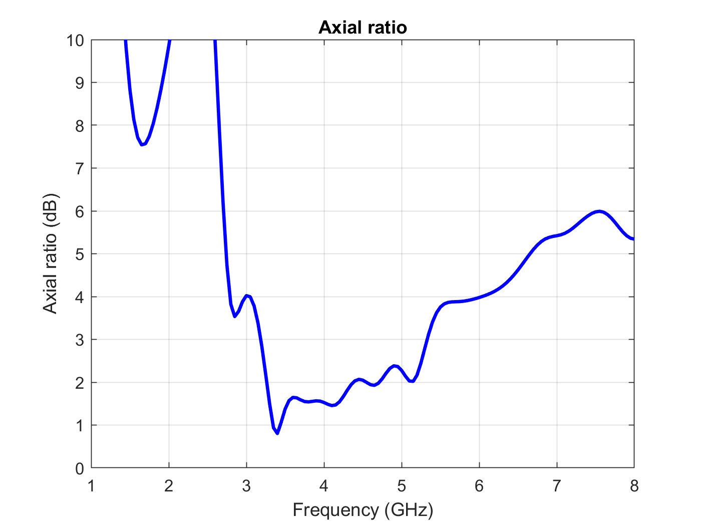
2
The research project • Trial Results
Input impedance: The lower frequencies display an erratic behavior, with many oscillations. The only relatively stable frequencies are found in the 3-6GHz range. This is consistent with the surface currents results.
S11 parameter: The system shows good impedance matching past the 3GHz mark, near -5dB. Before that, the oscillations make it extremely unstable.
Axial ratio: The circular polarization range, where the axial ratio keeps below 2dB is also reduced with the use of the reflector plane. Now, it is seen only consistently around 3.2GHz to about 4.8GHz.

Slide 27
Conclusion and proposed future research
3.
What have we learned.

Slide 28
3
Conclusion
Conclusion
Conclusion 1
Conclusion 2
Conclusion 3
Equiangular spiral antennas are frequency independent.
They show very good stability in all parameters.
Its characteristics can be easily adjusted.
Other types of spiral antennas do not work as well in any sense.
Reflector planes can be used to obtain unidirectional radiation.
The radiation diagrams maintained their behavior.
The antenna bandwidth is reduced with its use.
The gain greatly improves.
MATLAB is a viable option to simulate spiral antennas.
It allows simulations to be performed using both code and a graphical interface.
It generates results both in graphical form and in data tables.
Allows parametric optimizations to be performed.

Slide 29
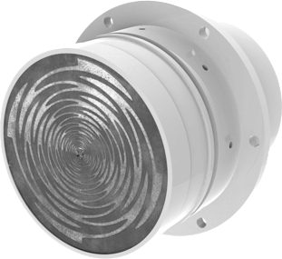
3
Proposed future research
Future research
Some proposed future research topics include:
Feasibility and sustainability studies for the use of equiangular spiral antennas in integrated applications.
Exploration of the use of other geometries for frequency-independent antenna design.
Continue the work developed by the authors cited in this paper in areas of research and development to create improvements to spiral antennas.

Slide 30
Thank you.
?
Questions?

