Slide 1
Astronuts
Esboços

Slide 2
0. Splash screen
Astronuts: Esboços

Slide 3
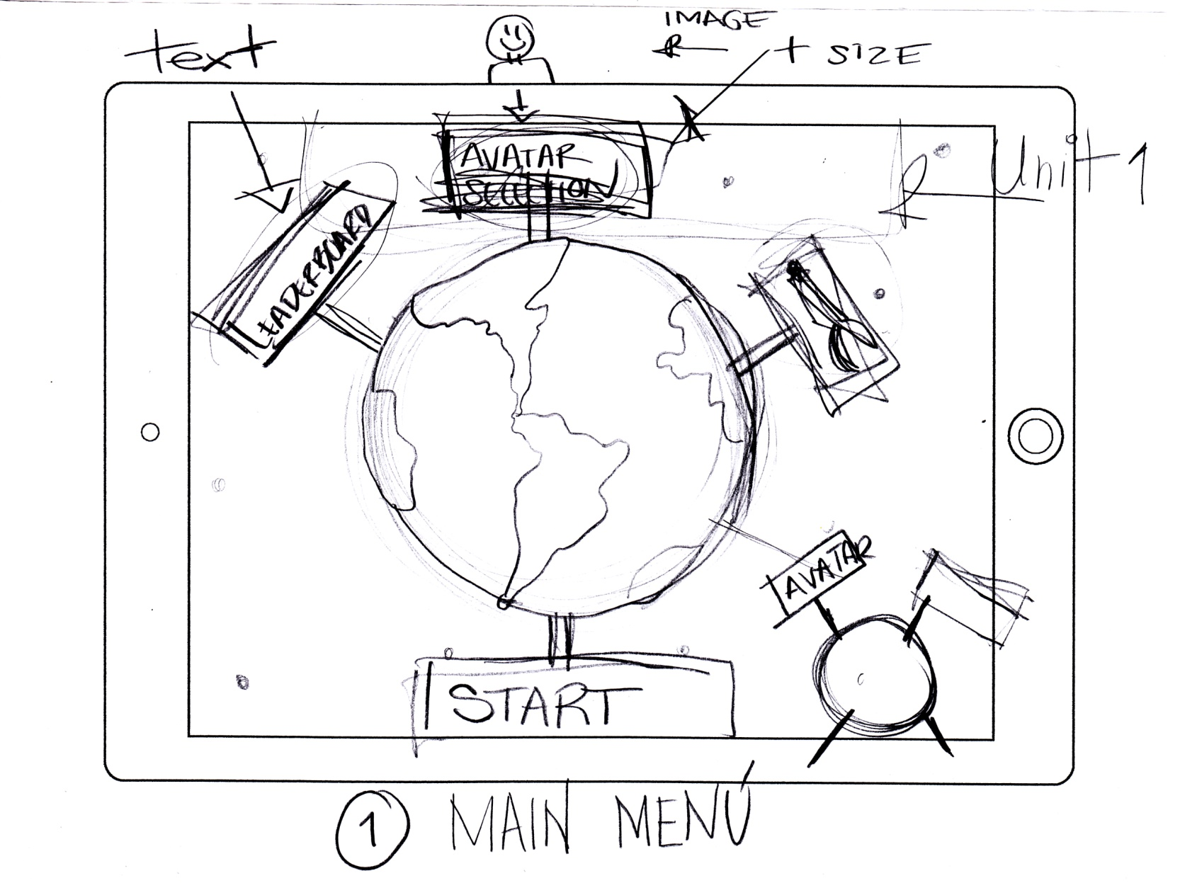
1. Main menu
Astronuts: Esboços

Slide 4
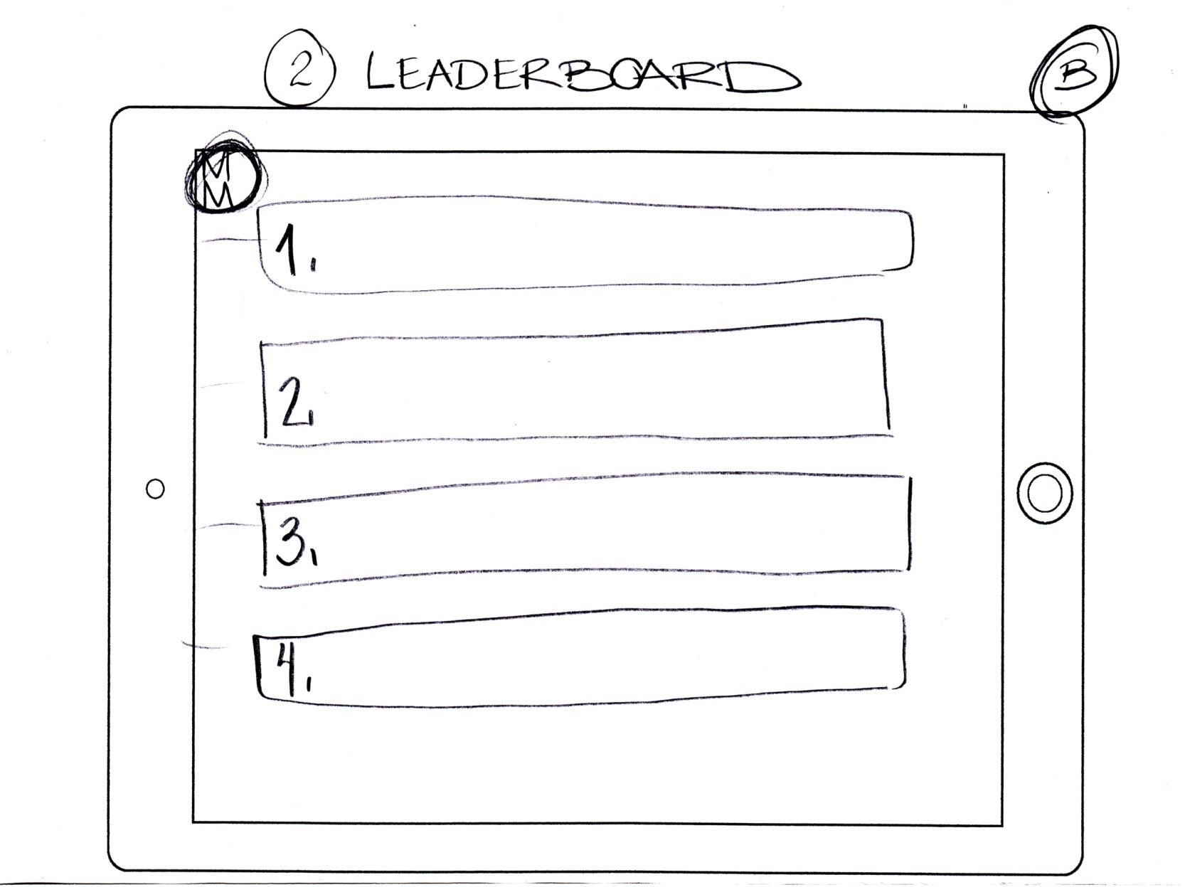
2. Leaderboard
Astronuts: Esboços

Slide 5
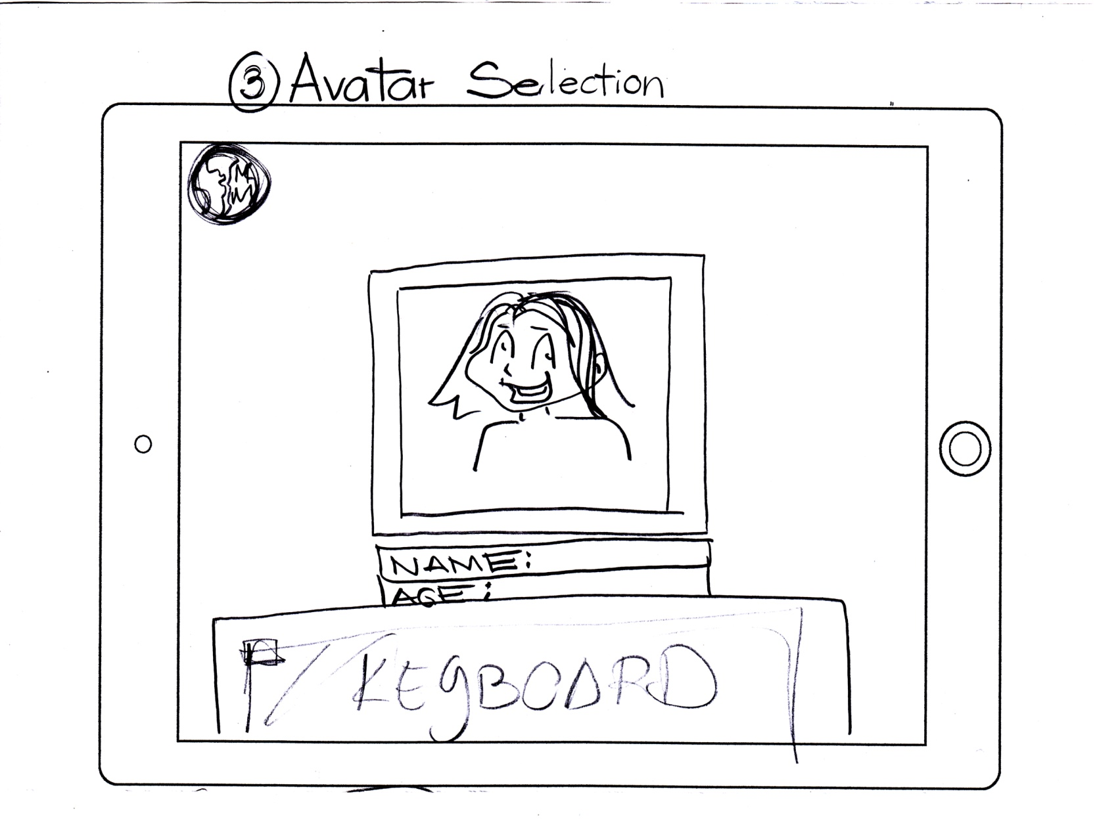
3. Avatar Selection
Astronuts: Esboços

Slide 6
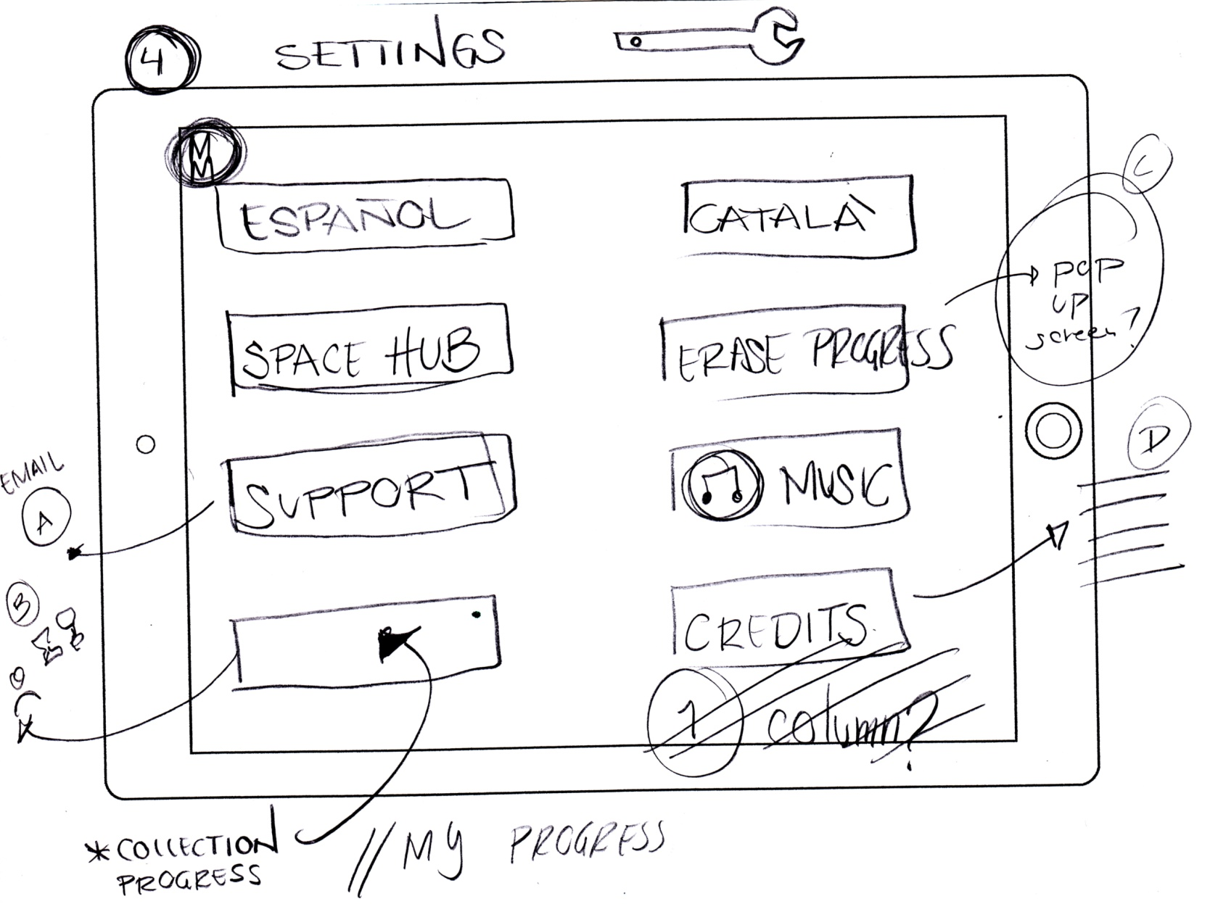
4. Settings
Astronuts: Esboços

Slide 7
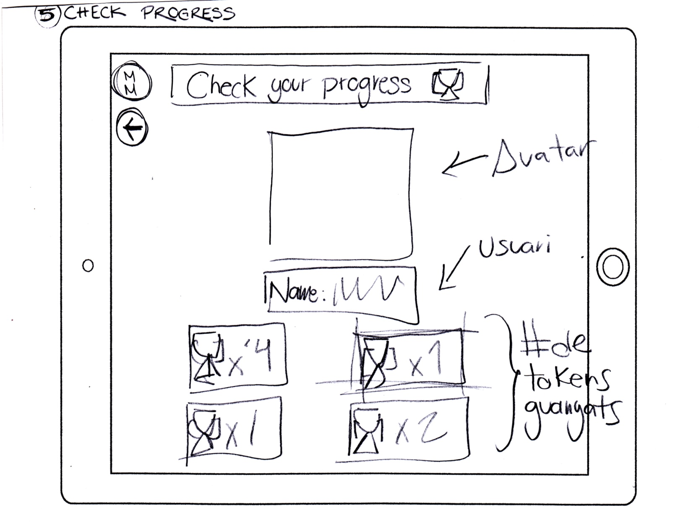
5. Check your progress
Astronuts: Esboços

Slide 8
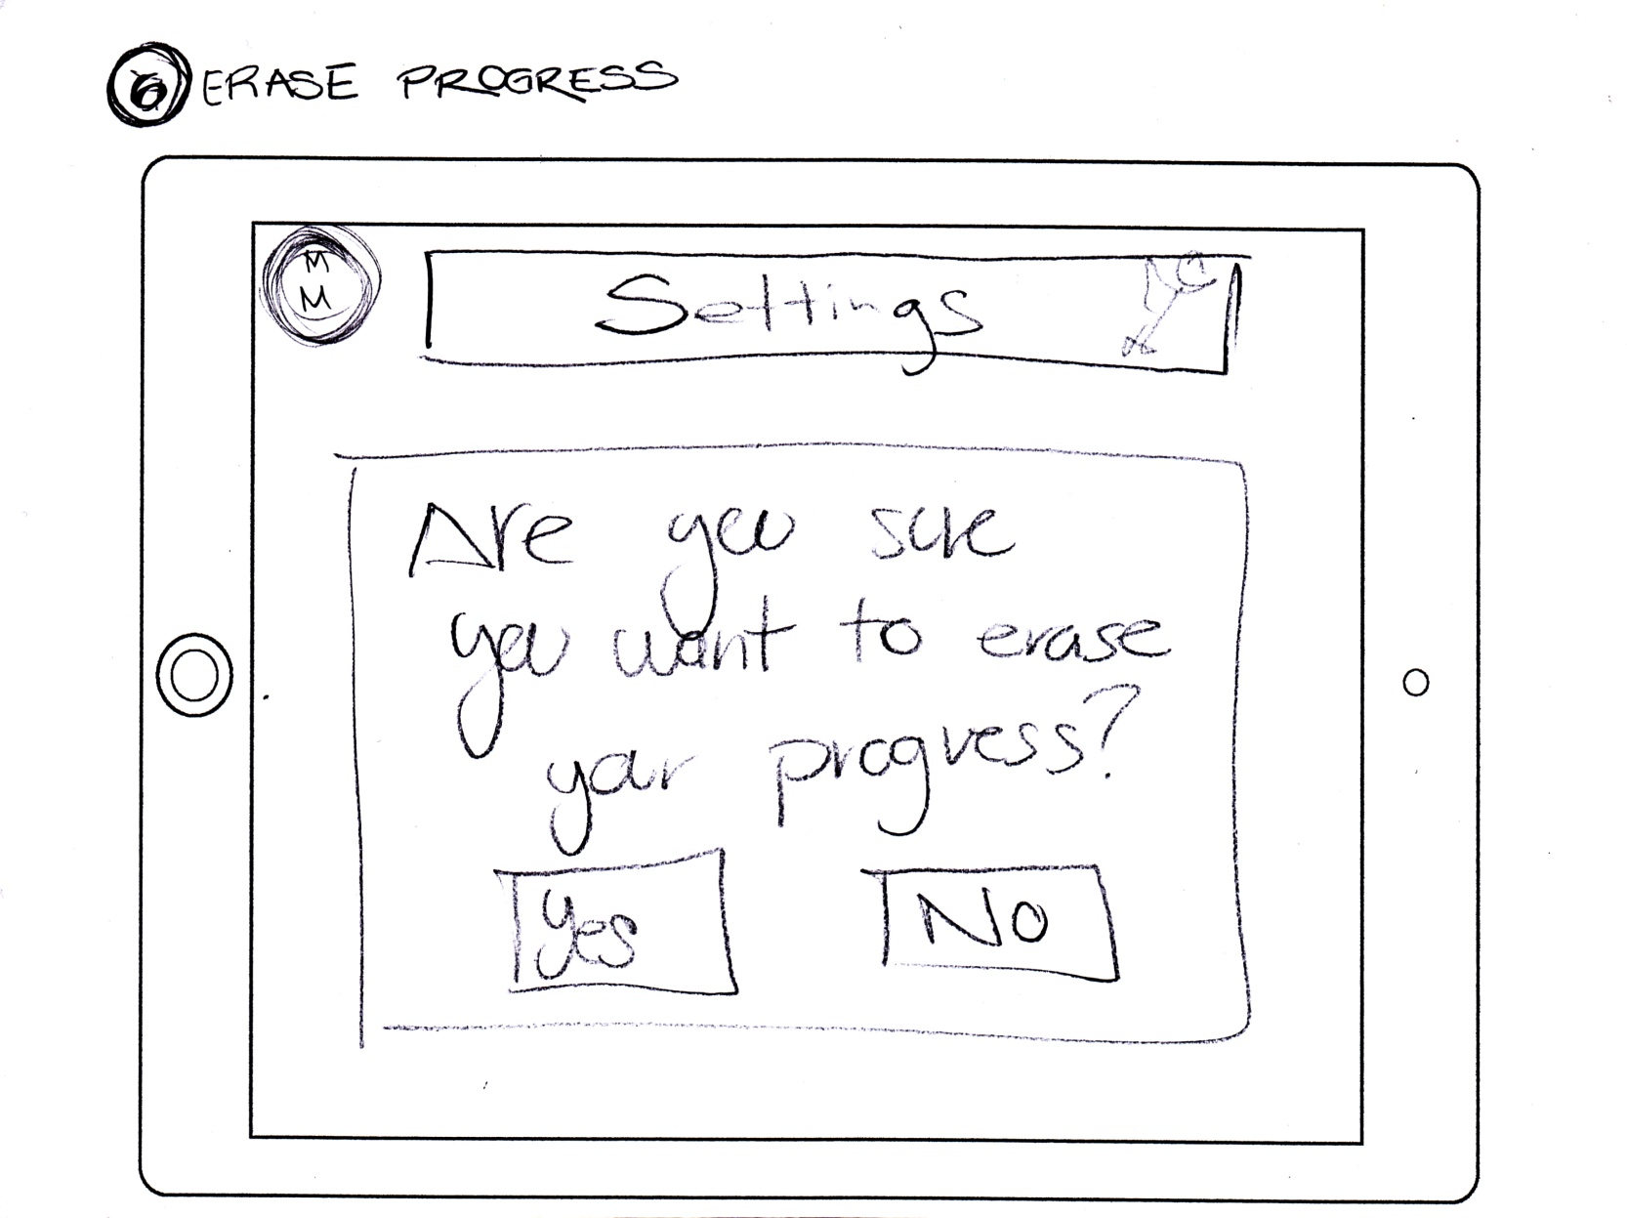
6. Erase progress
Astronuts: Esboços

Slide 9
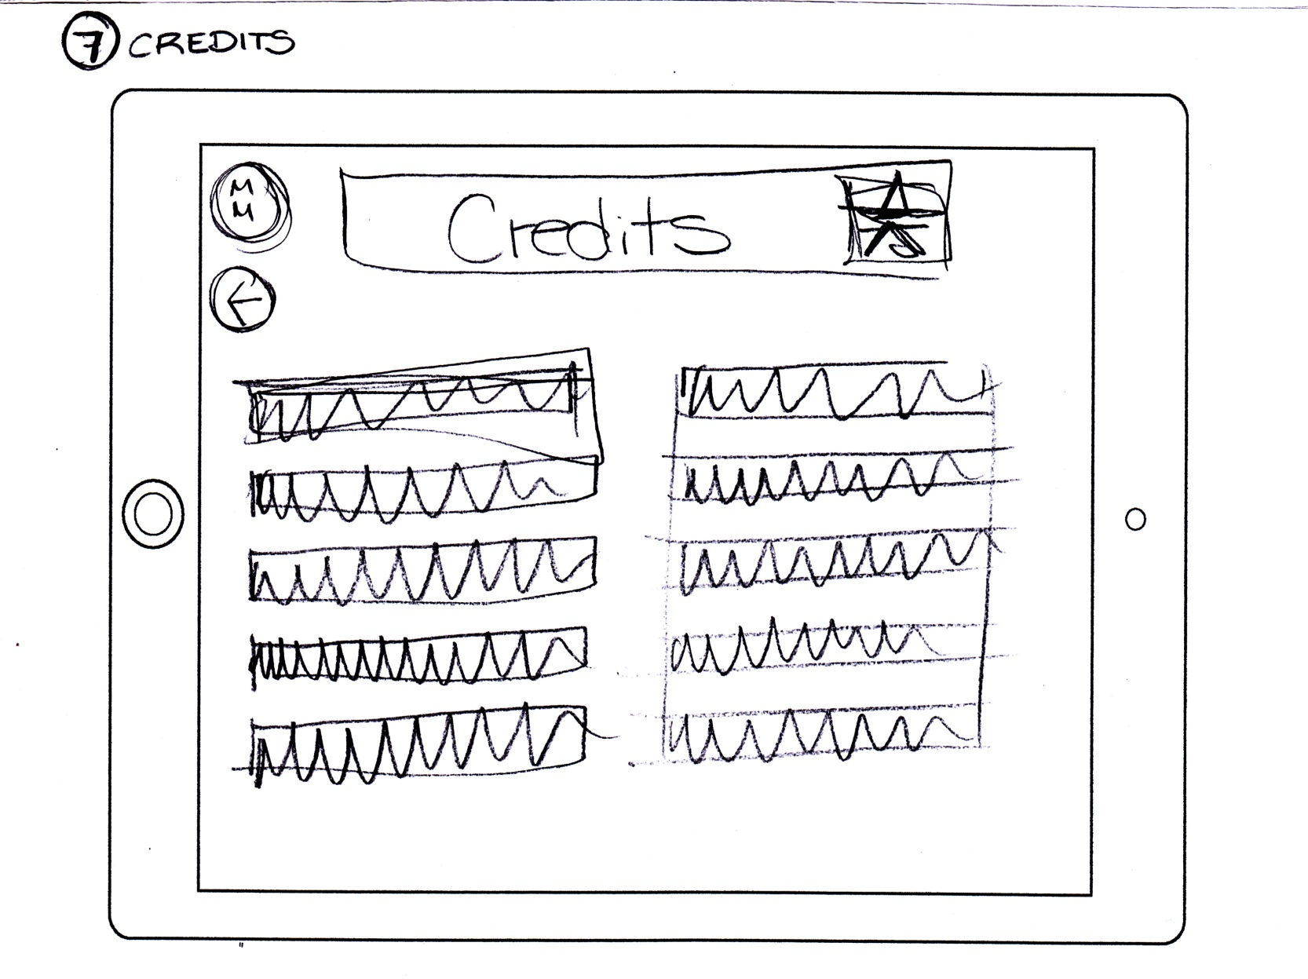
7. Credits
Astronuts: Esboços

Slide 10
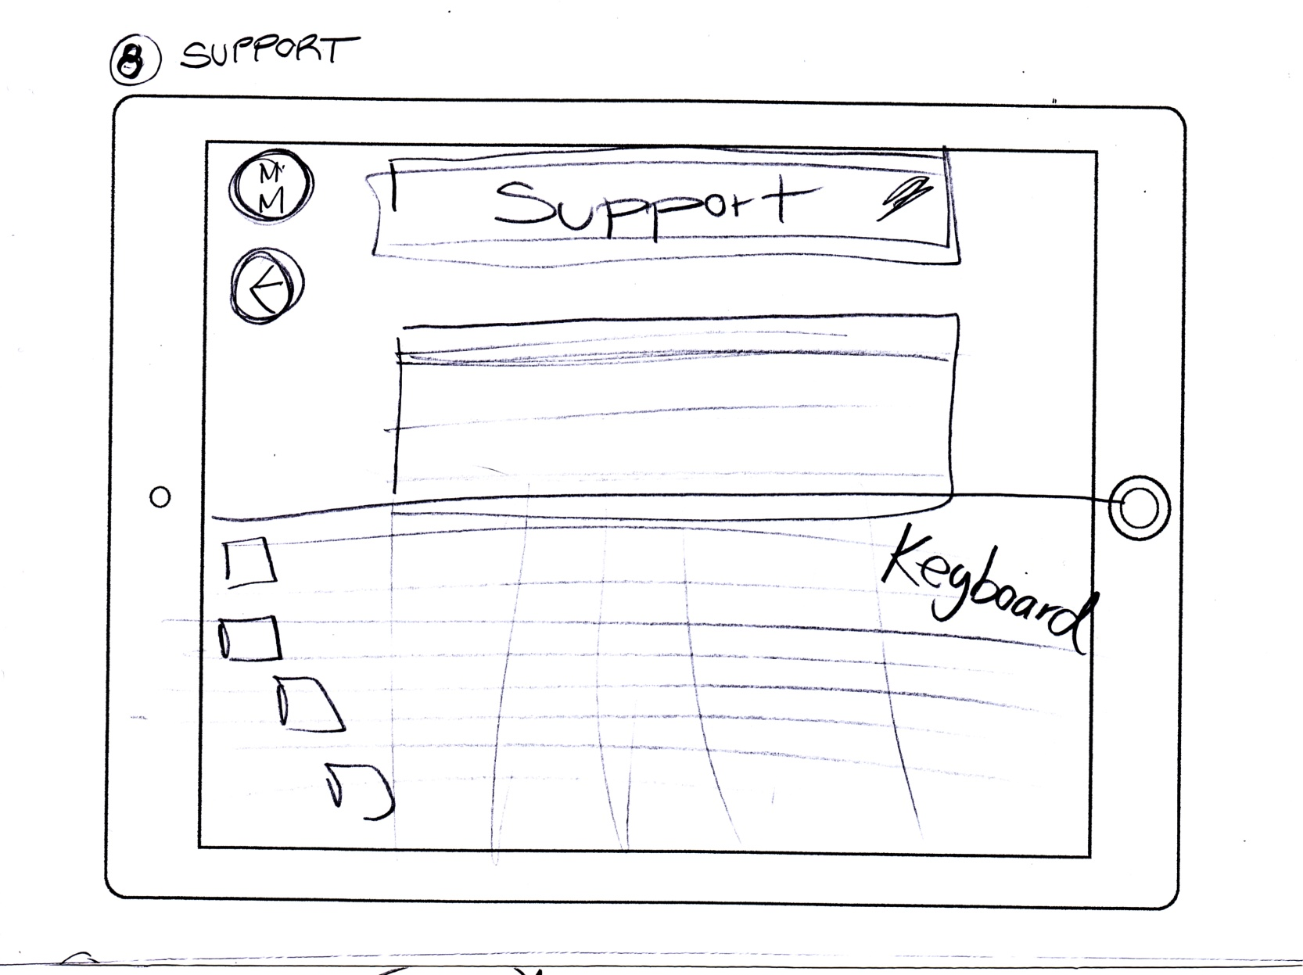
8. Support
Astronuts: Esboços

Slide 11
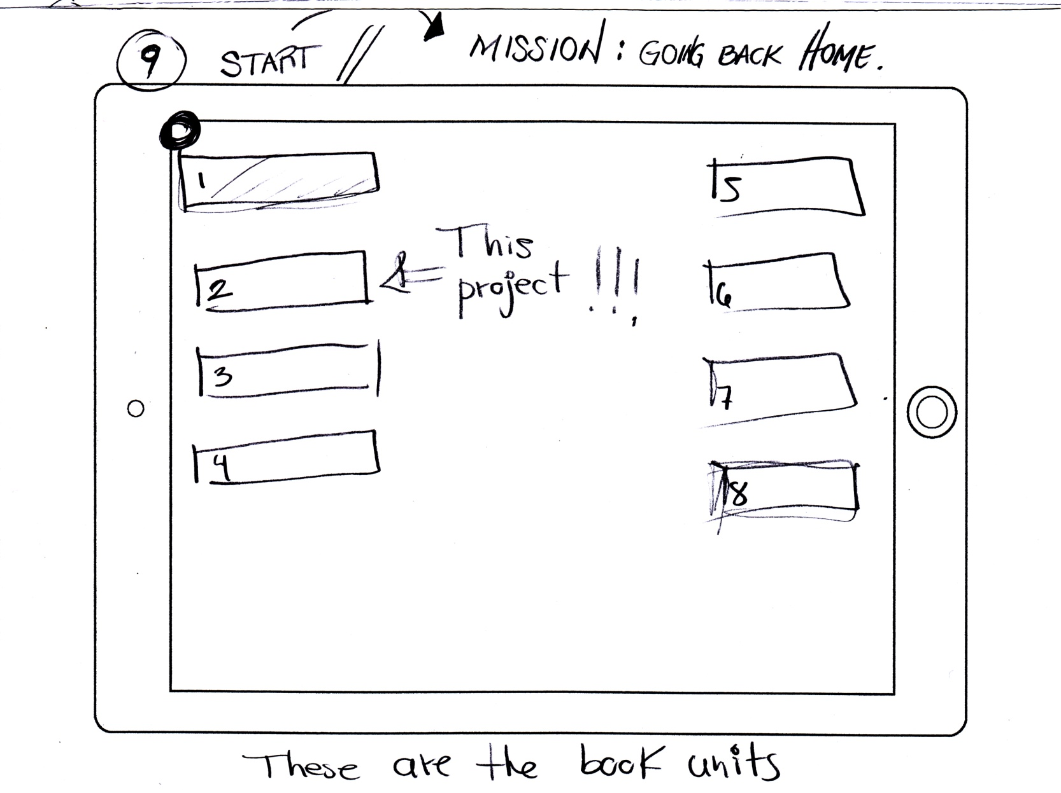
9. Mission: Going back home
Astronuts: Esboços

Slide 12
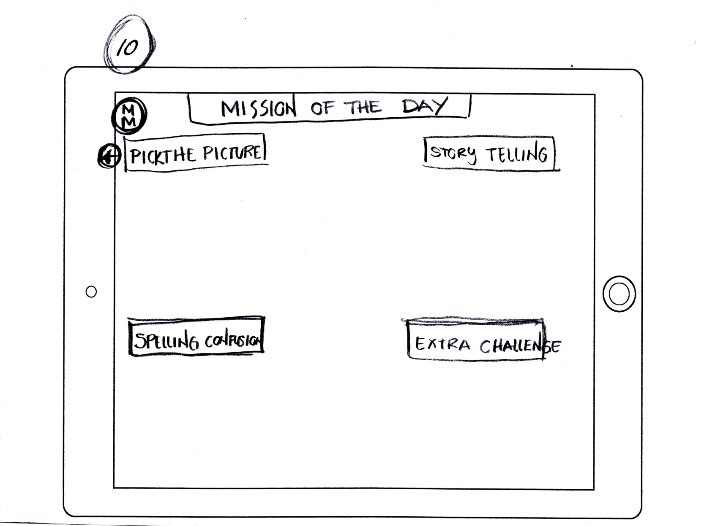
10. Mission of the day
Astronuts: Esboços

Slide 13
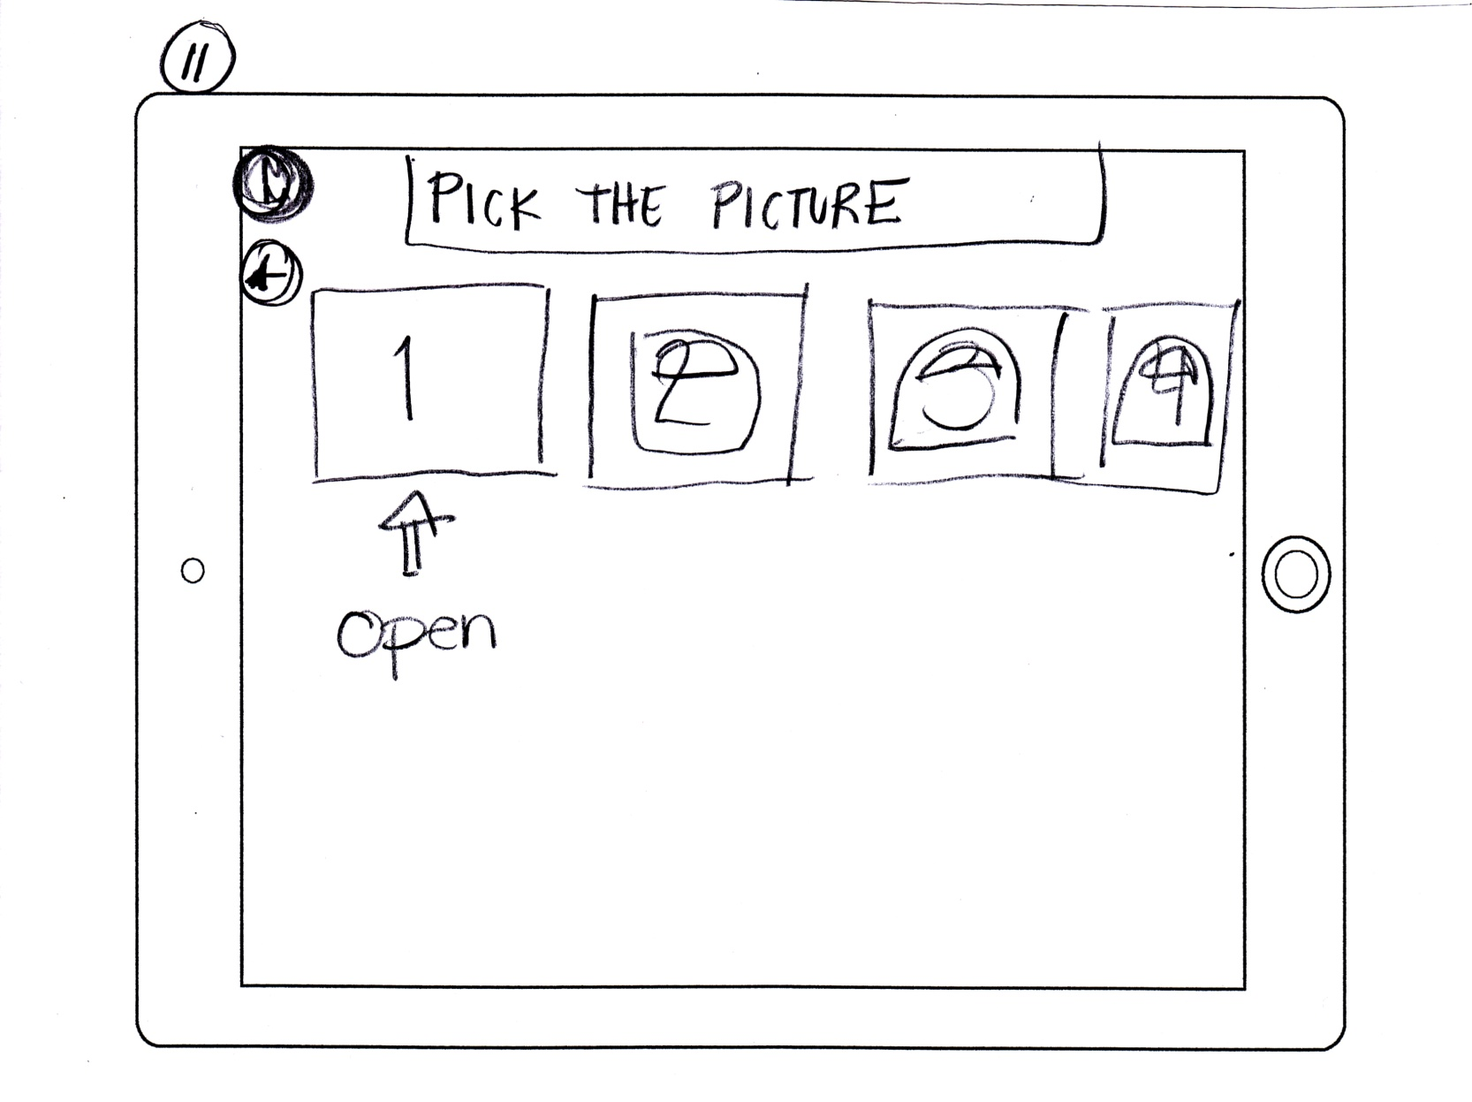
11. Pick the picture
Astronuts: Esboços

Slide 14
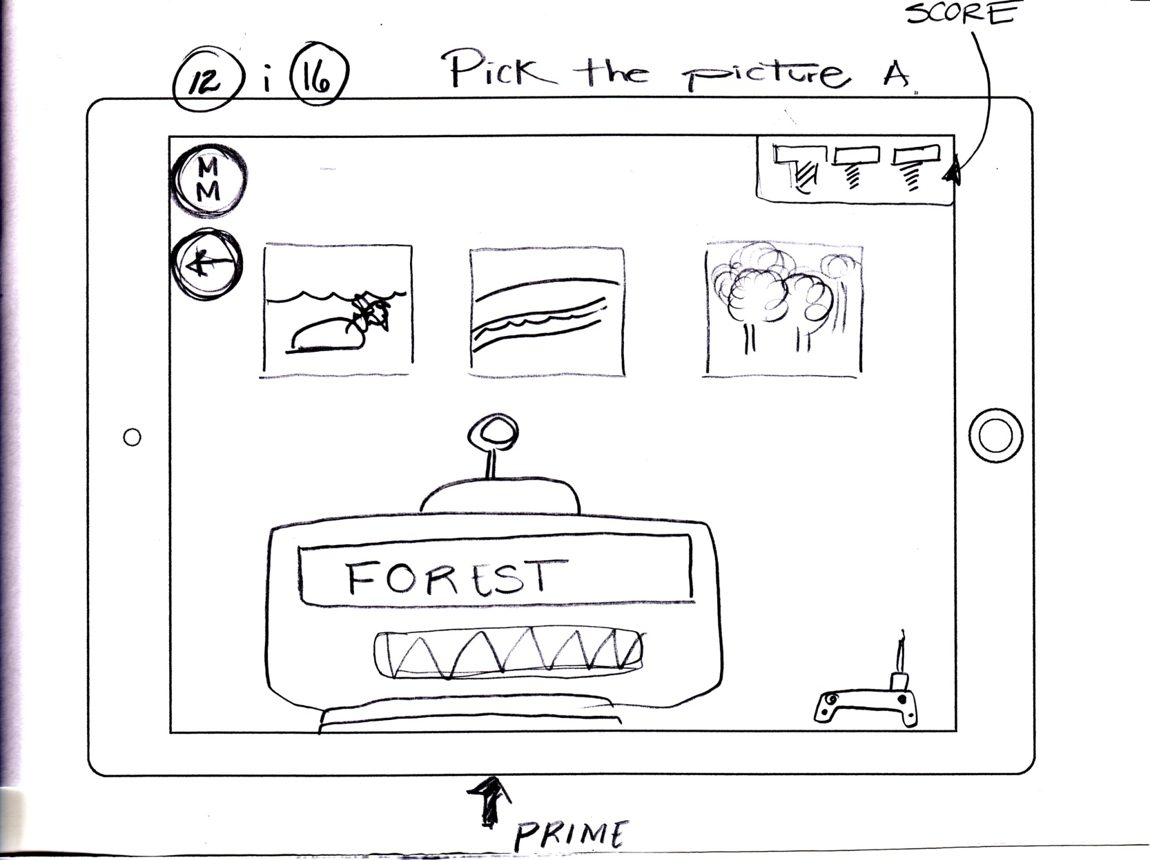
12. Pick the picture: Activity A
Astronuts: Esboços

Slide 15
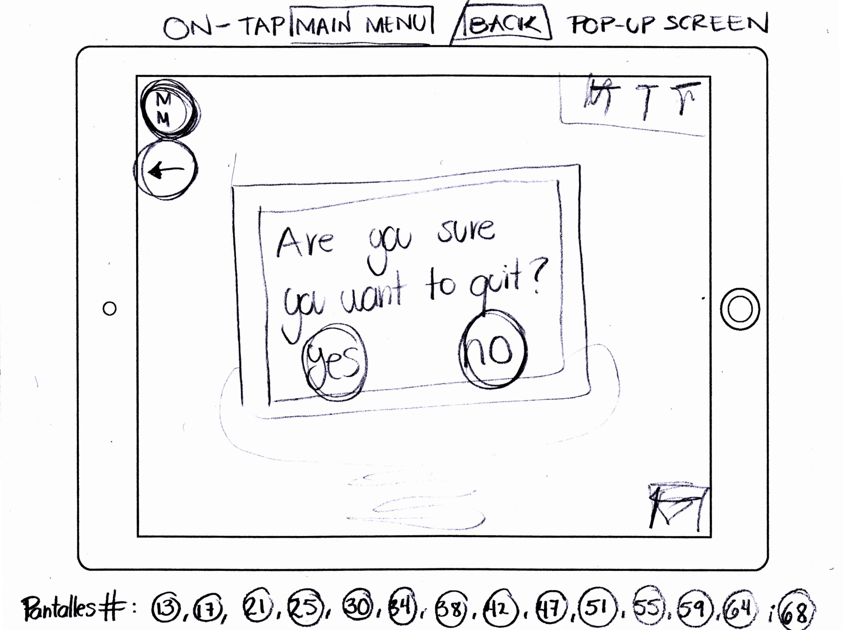
13. Confirmation screen
Astronuts: Esboços

Slide 16
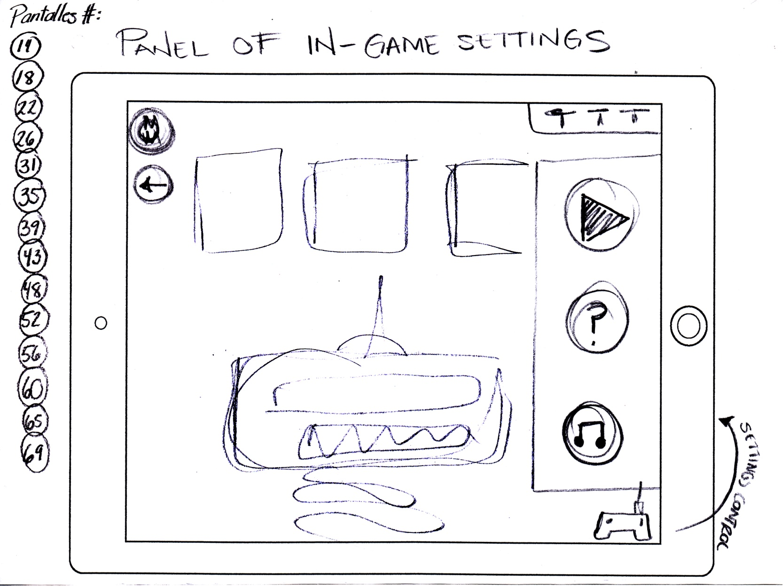
14. In-game settings
Astronuts: Esboços

Slide 17
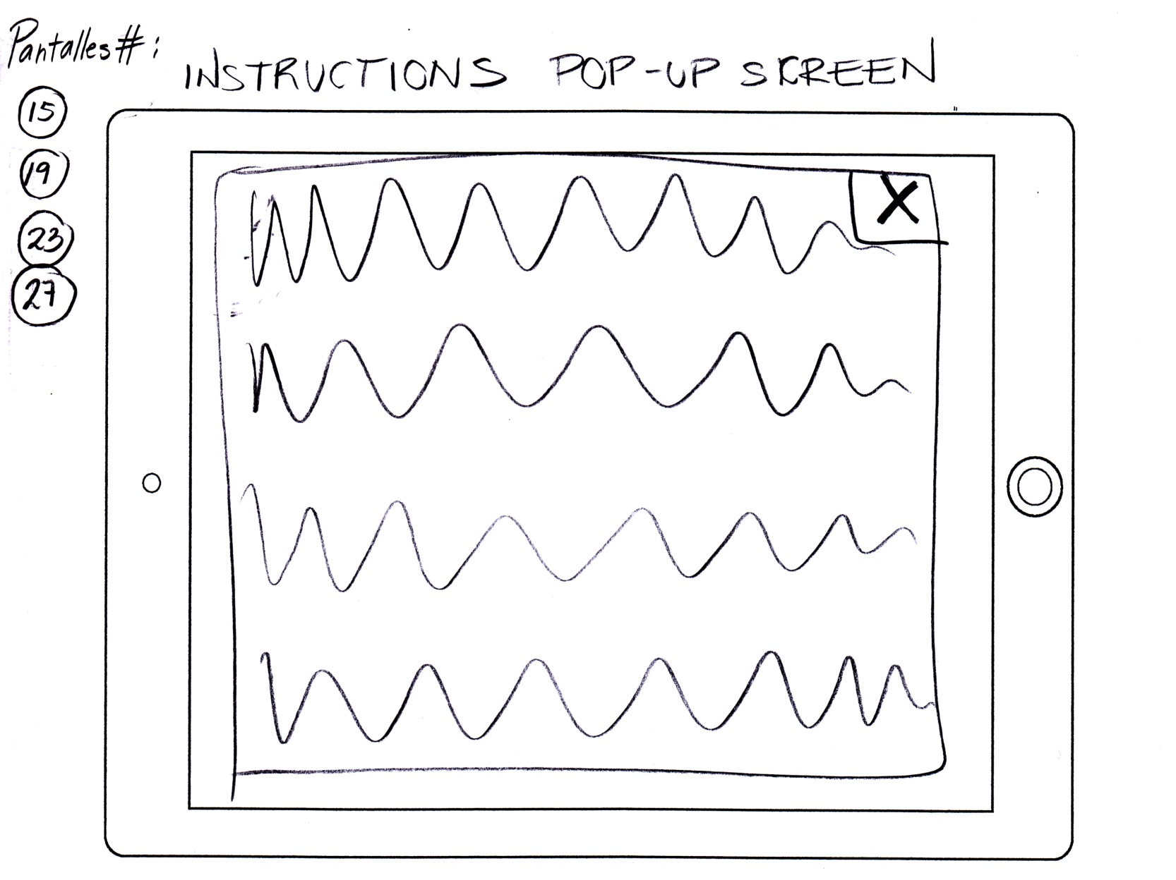
15. Instructions. Pop up
Astronuts: Esboços

Slide 18
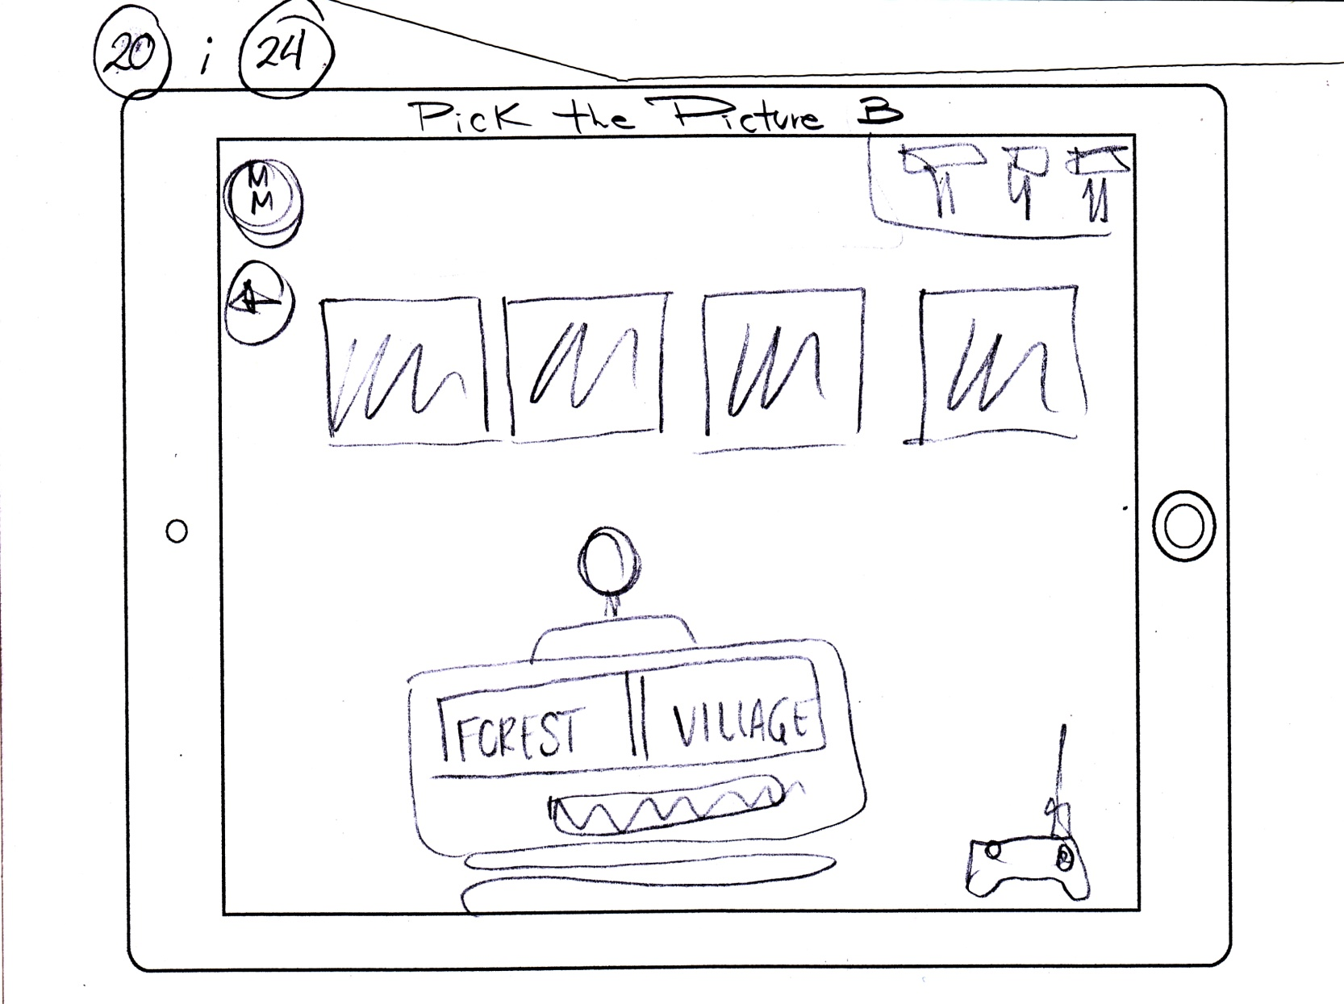
20. Pick the picture: Activity B
Astronuts: Esboços

Slide 19
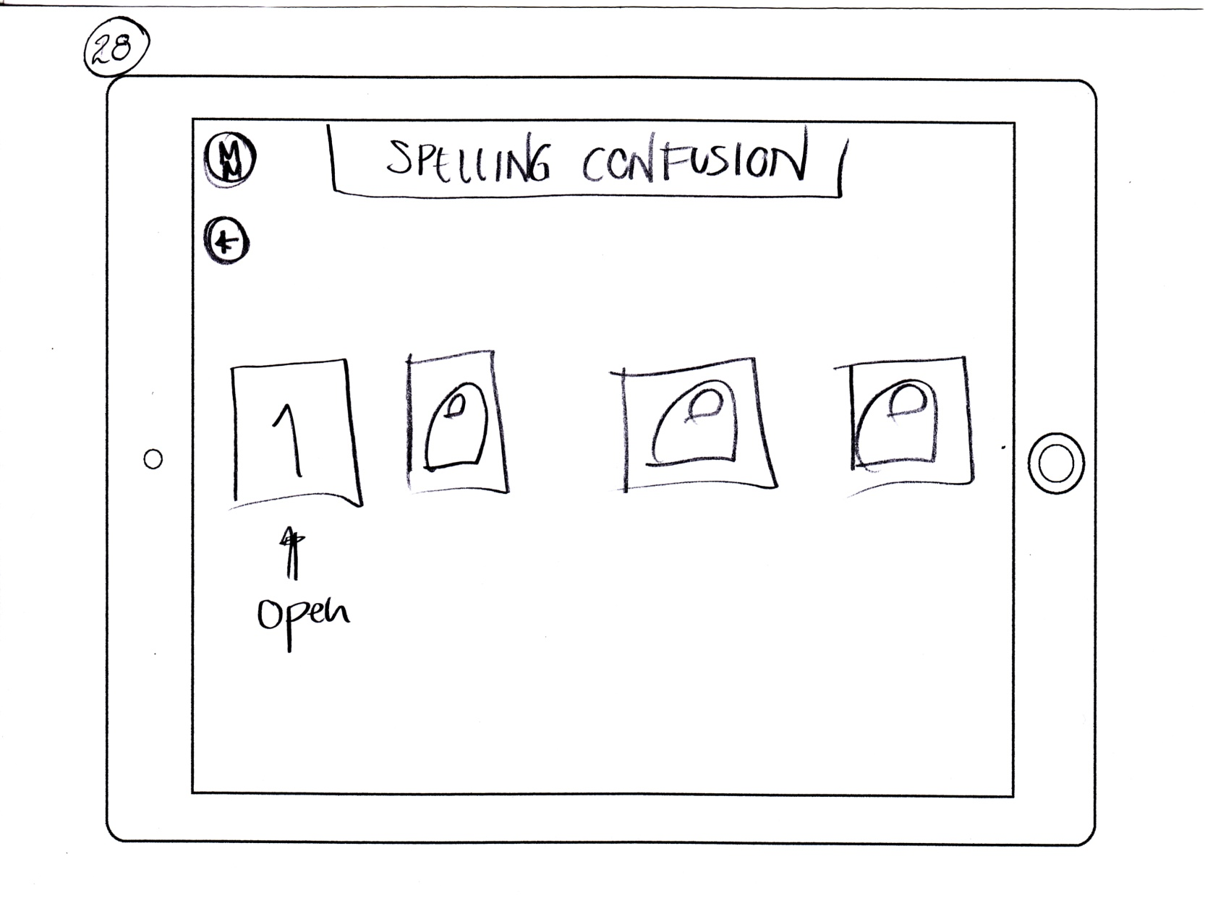
28. Spelling confusion
Astronuts: Esboços

Slide 20
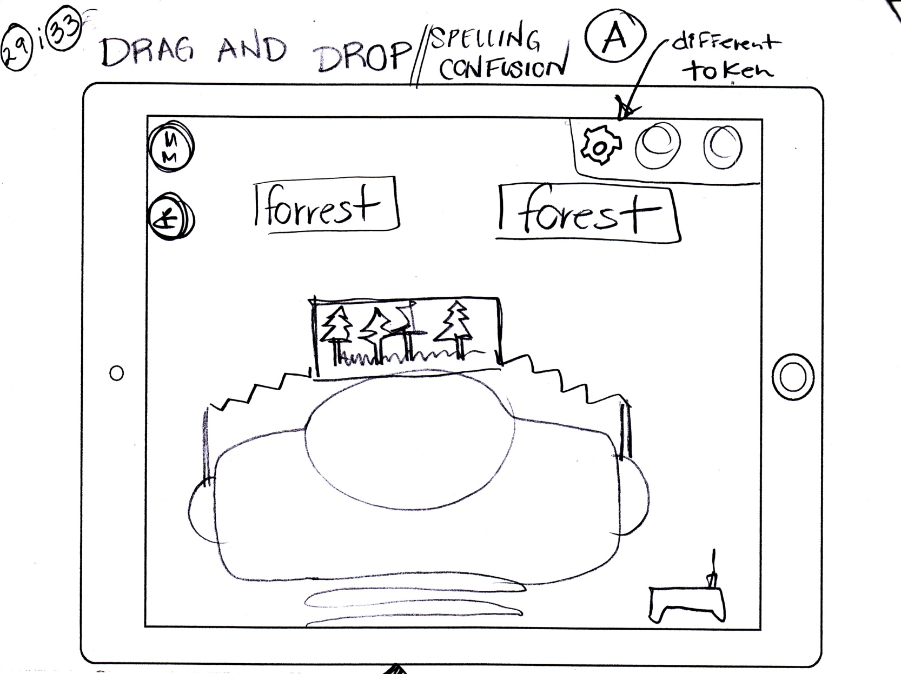
29. Spelling confusion: Activity A
Astronuts: Esboços

Slide 21
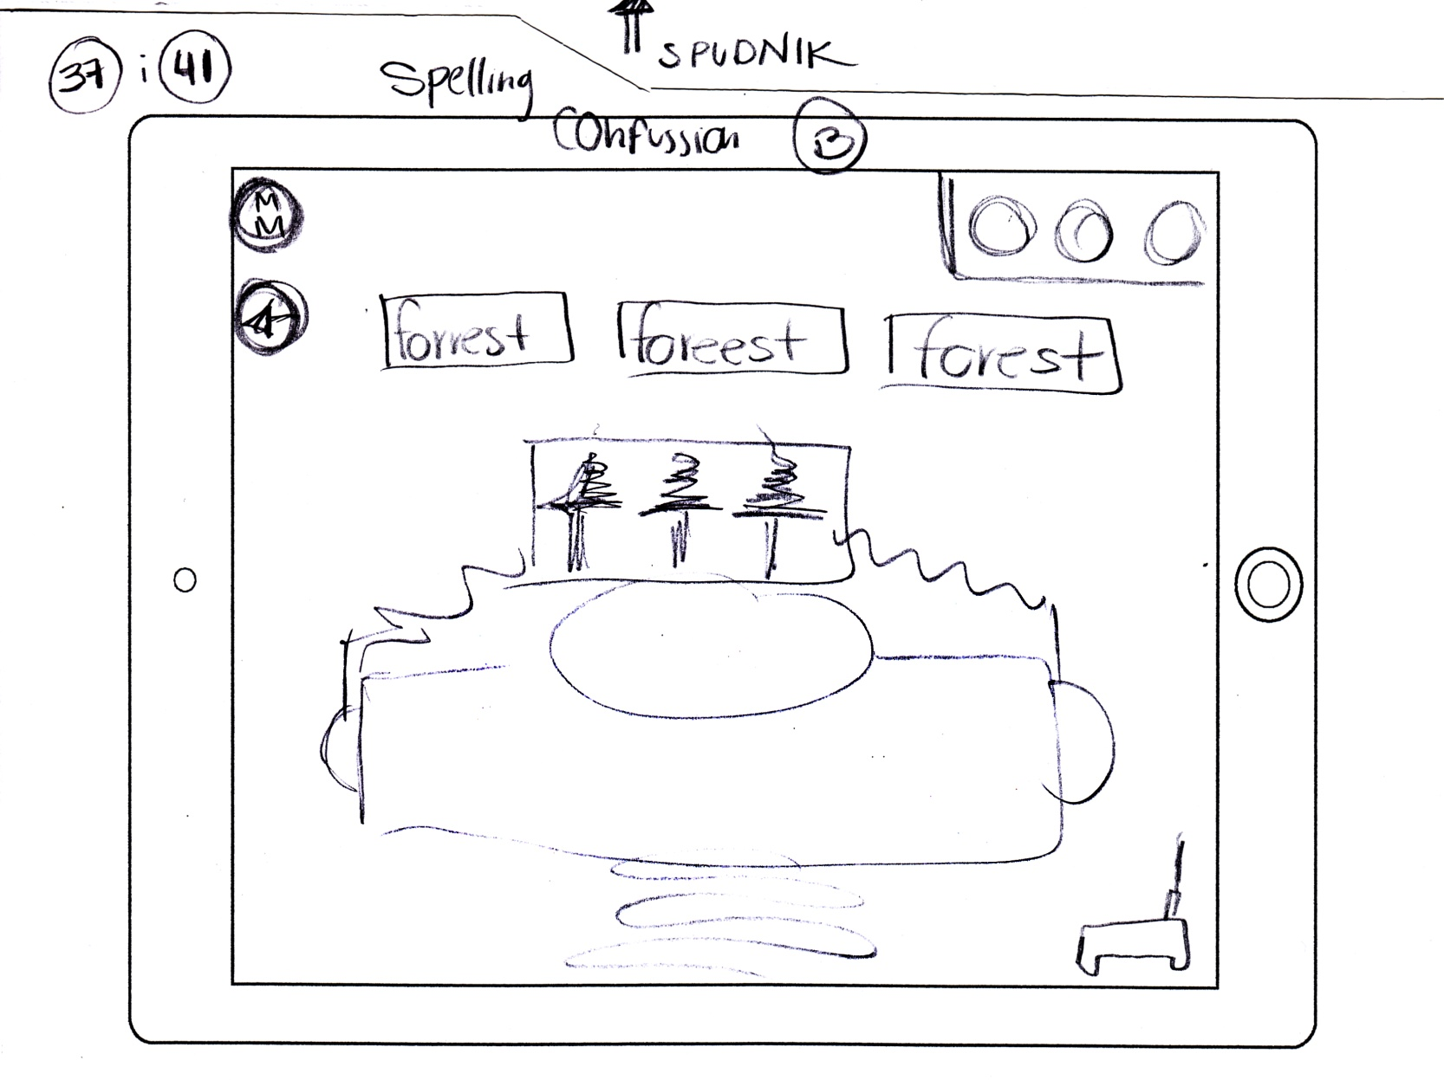
37. Spelling confusion: Activity B
Astronuts: Esboços

Slide 22
45. Storytelling
Astronuts: Esboços

Slide 23
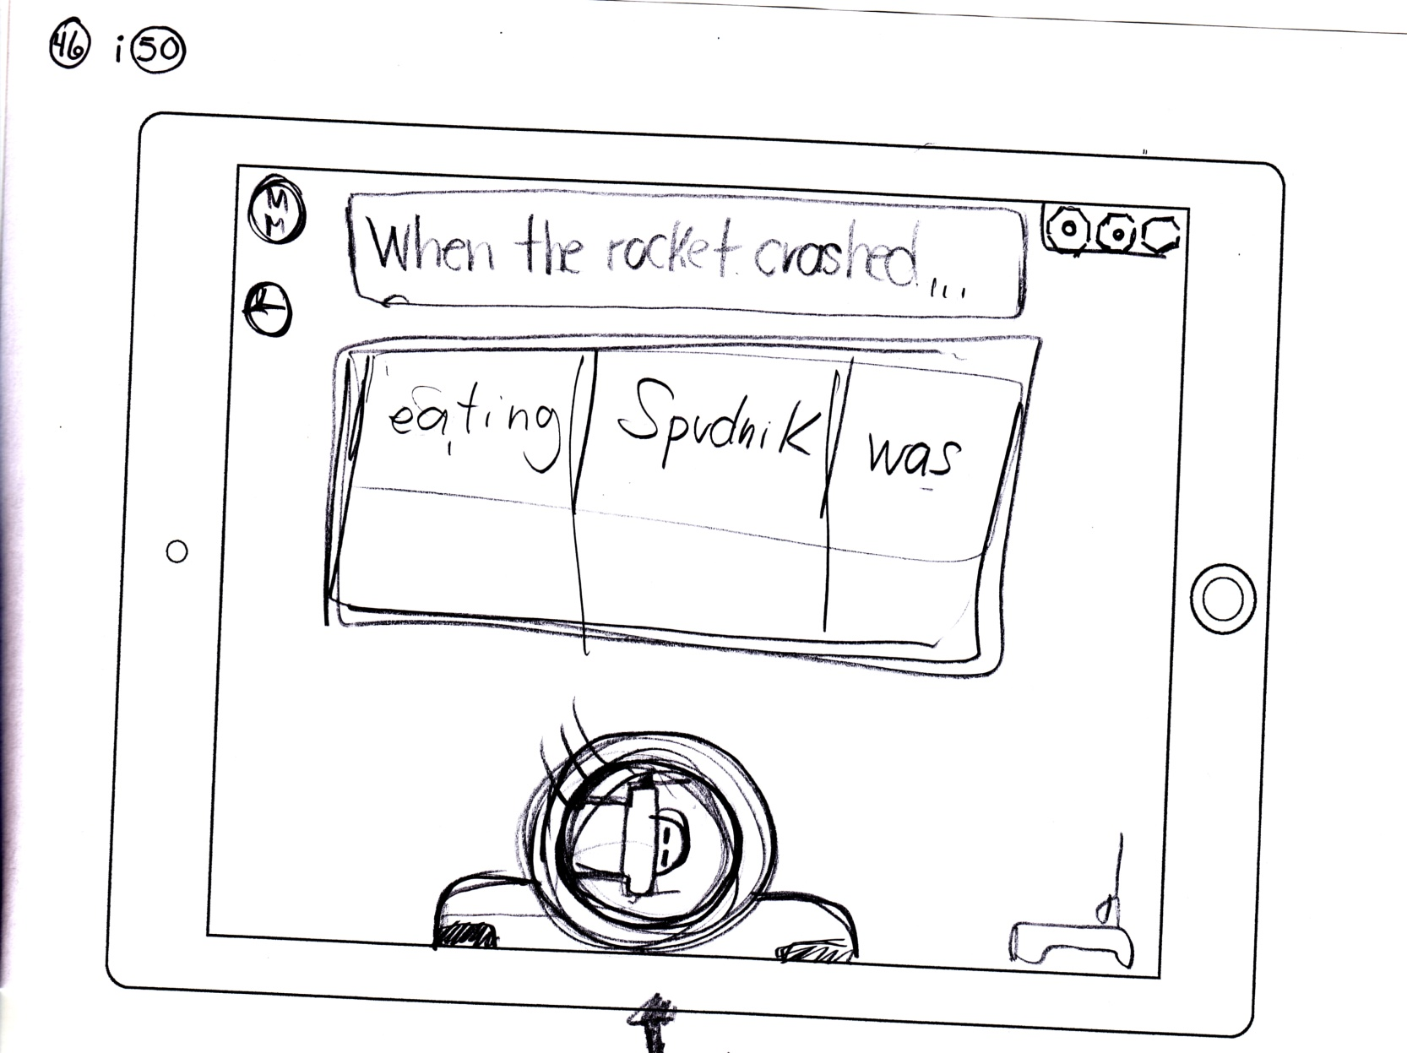
46. Storytelling: Activity A
Astronuts: Esboços

Slide 24
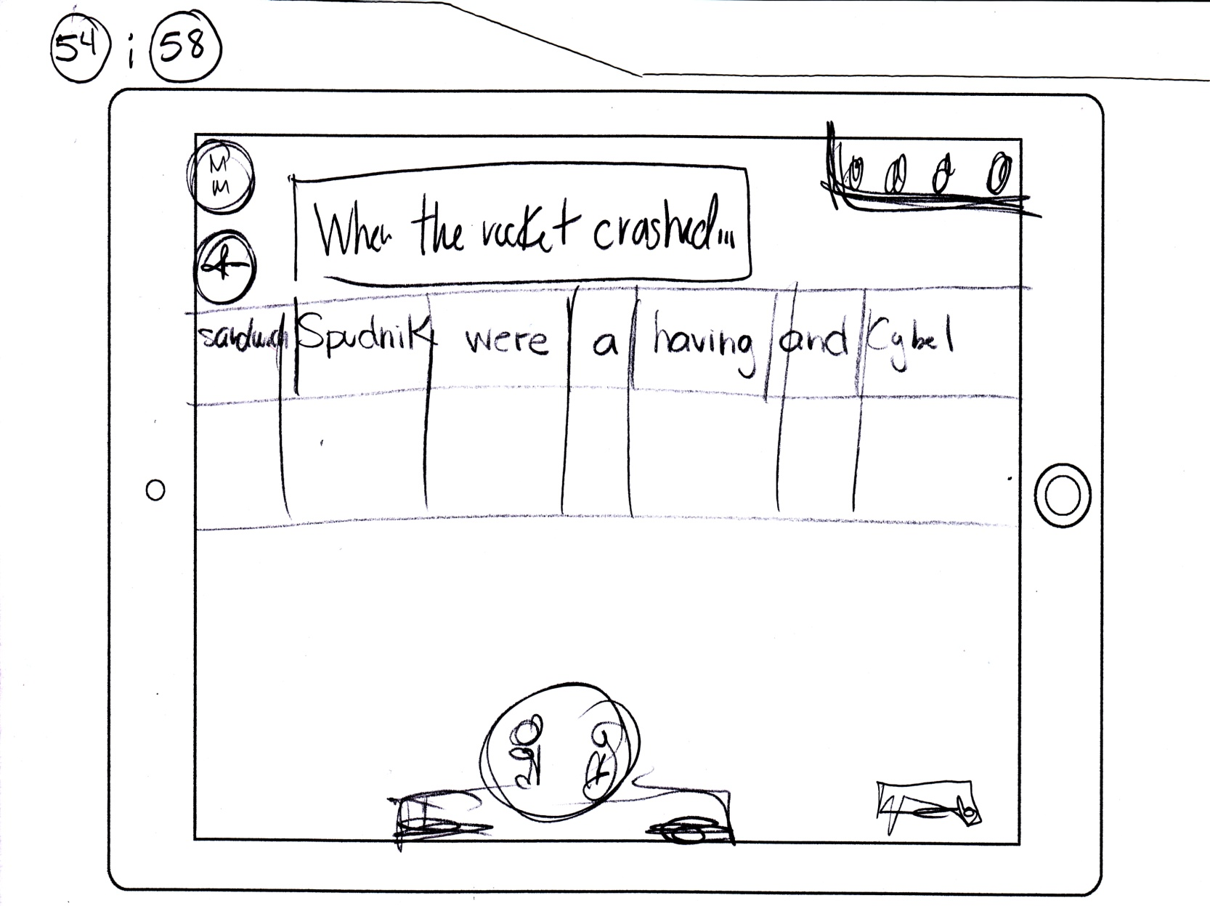
54. Storytelling: Activity B
Astronuts: Esboços

Slide 25
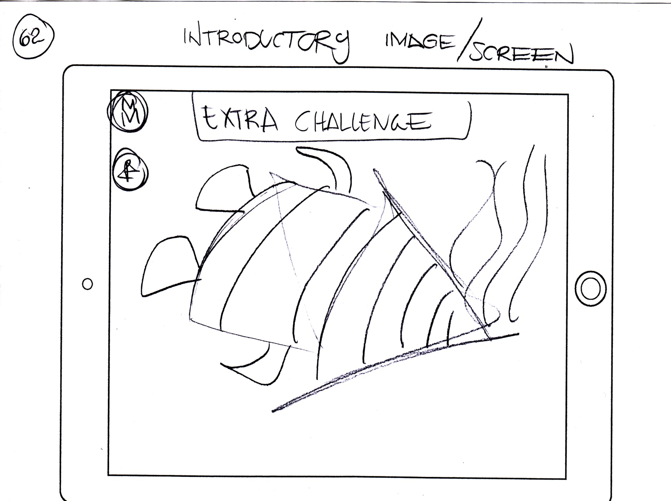
62. Extra challenge
Astronuts: Esboços

Slide 26
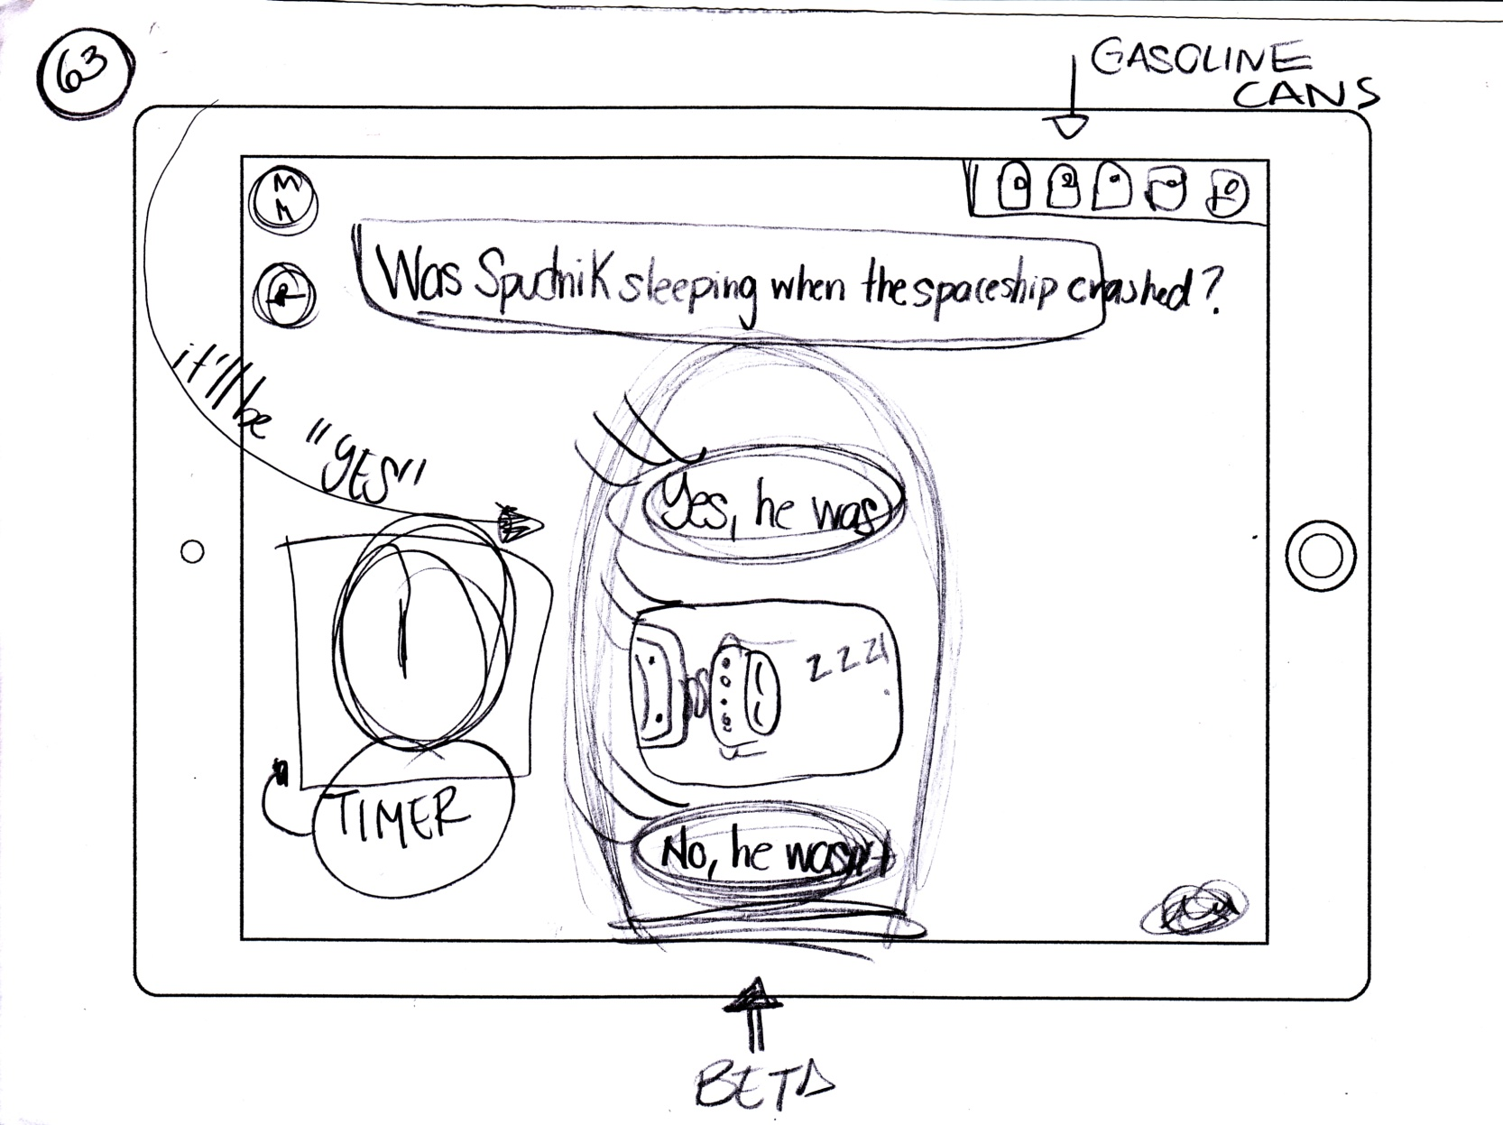
63. Extra challenge: Activity A
Astronuts: Esboços

Slide 27
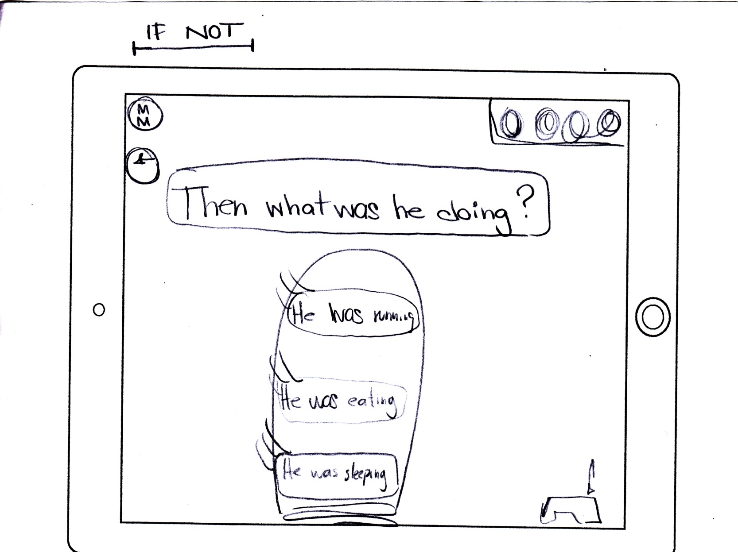
64. Extra challenge: Activity B
Astronuts: Esboços

