Slide 1
Astronuts
Mock-up

Slide 2
0. Splash screen
Astronuts: Mock-up

Slide 3
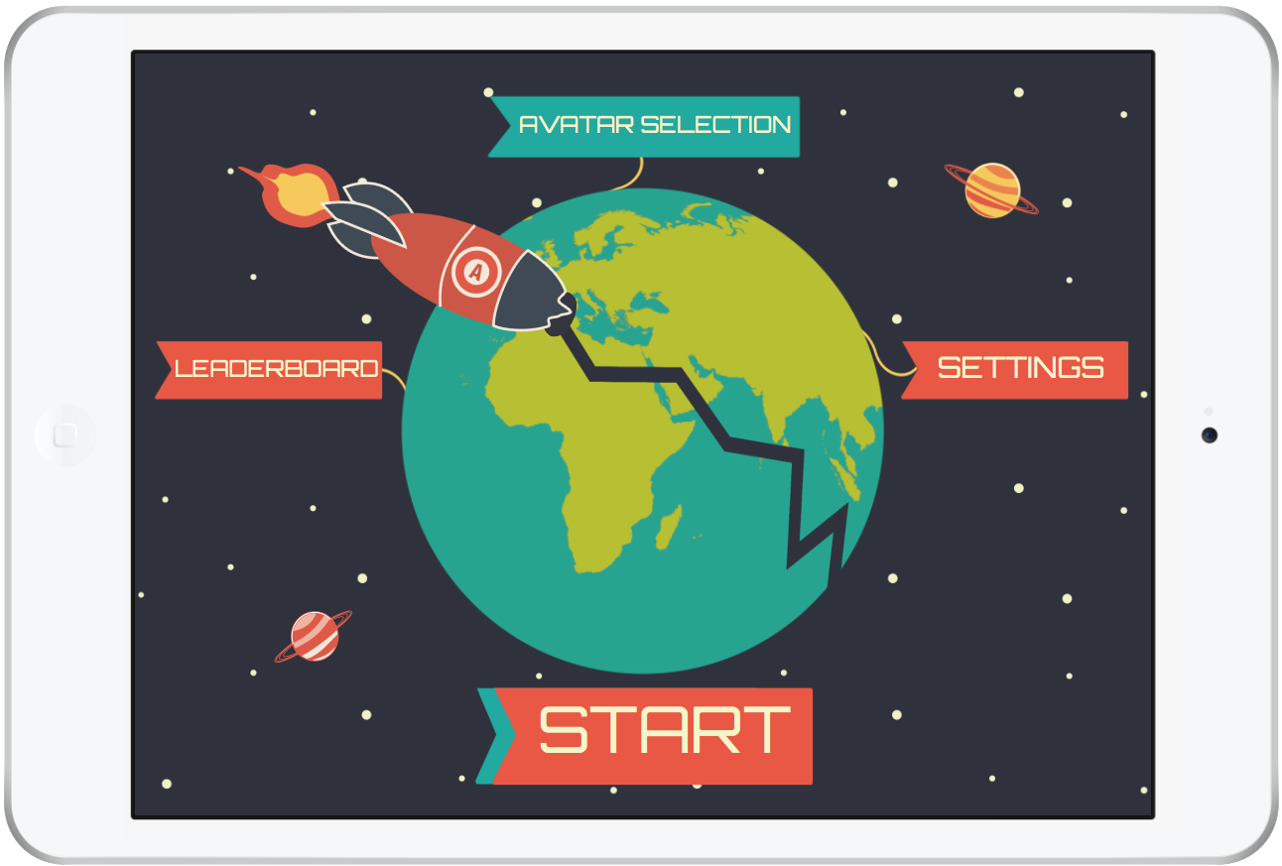
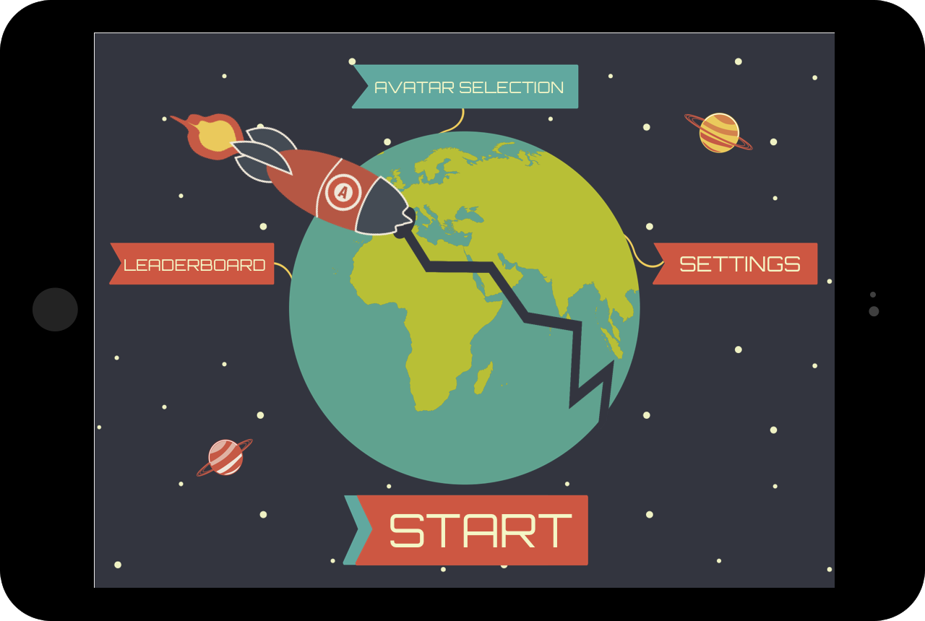
1. Main menu
Astronuts: Mock-up

Slide 4
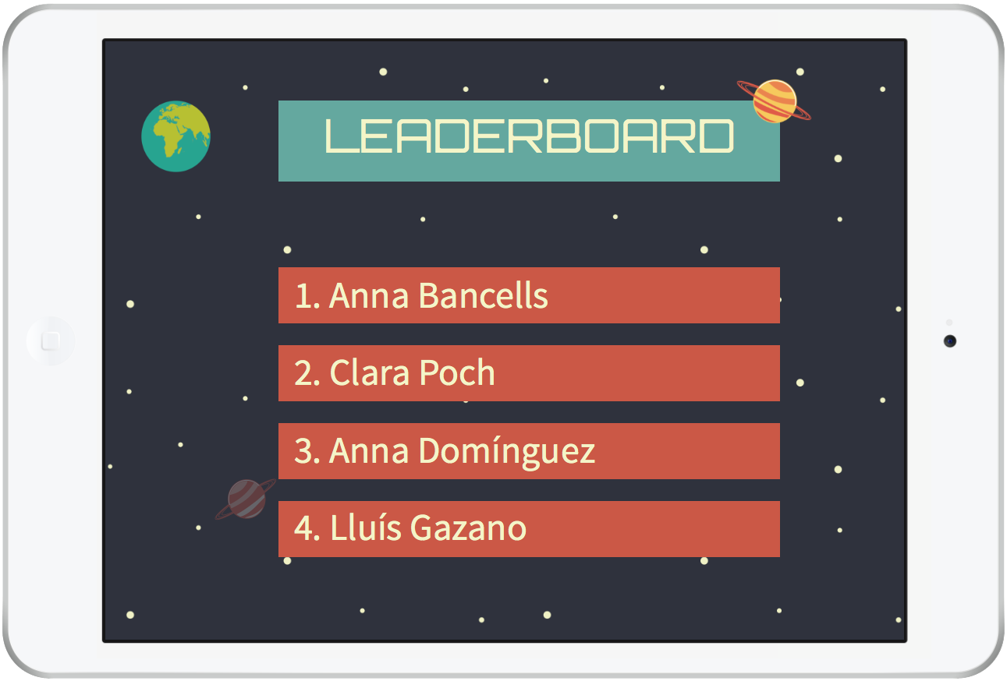
2. Leaderboard
Astronuts: Mock-up

Slide 5
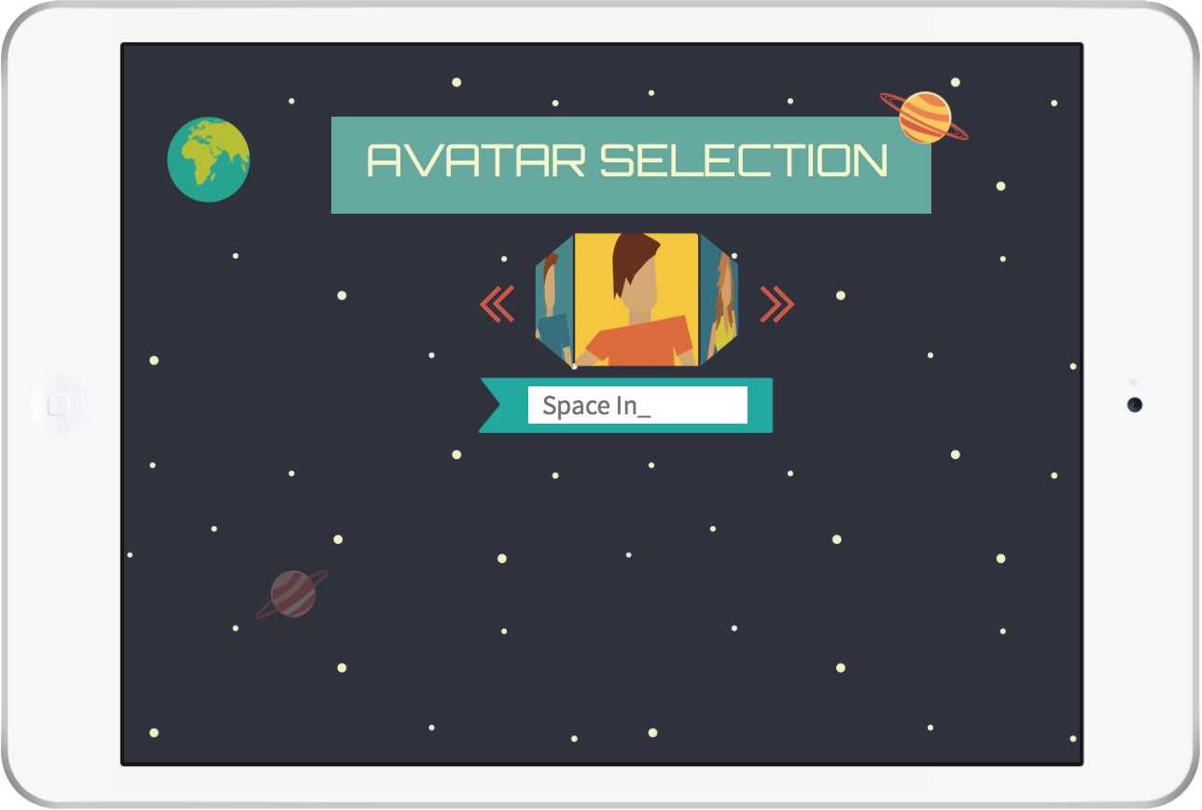
3. Avatar Selection
Astronuts: Mock-up

Slide 6
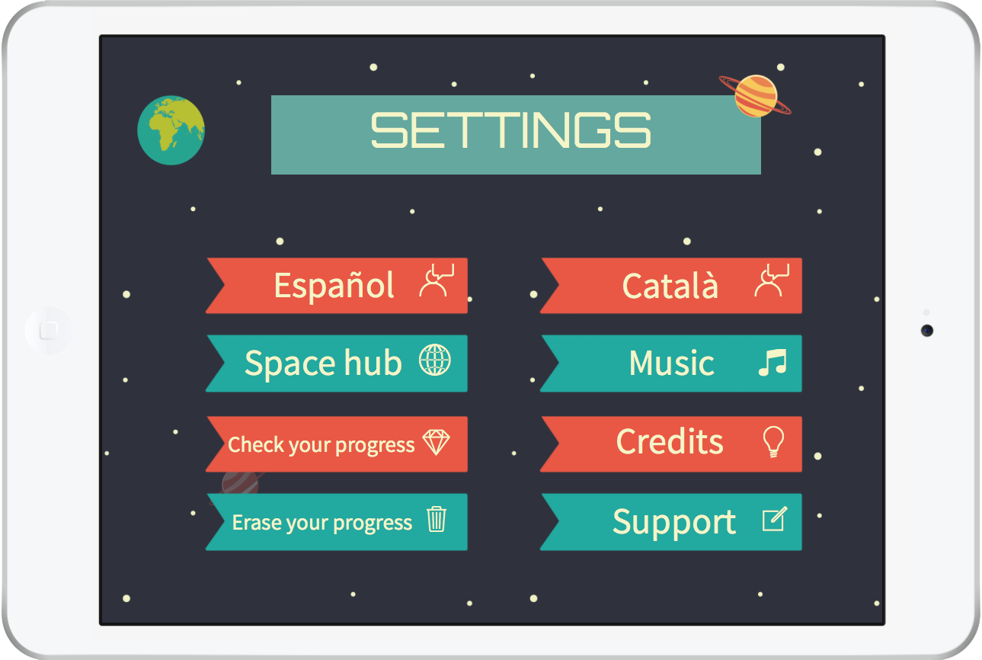
4. Settings
Astronuts: Mock-up

Slide 7
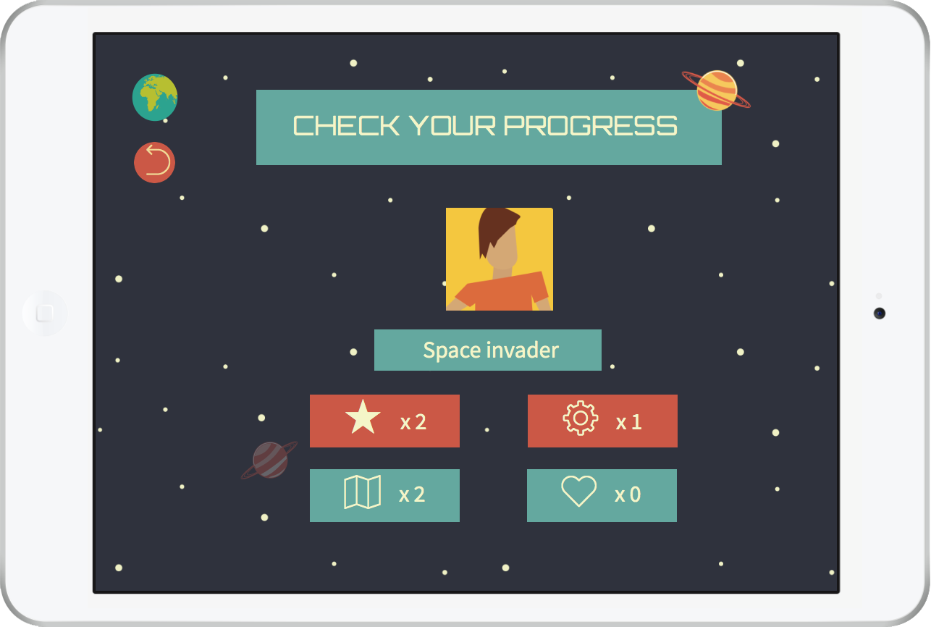
4.1 Check your progress
Astronuts: Mock-up

Slide 8
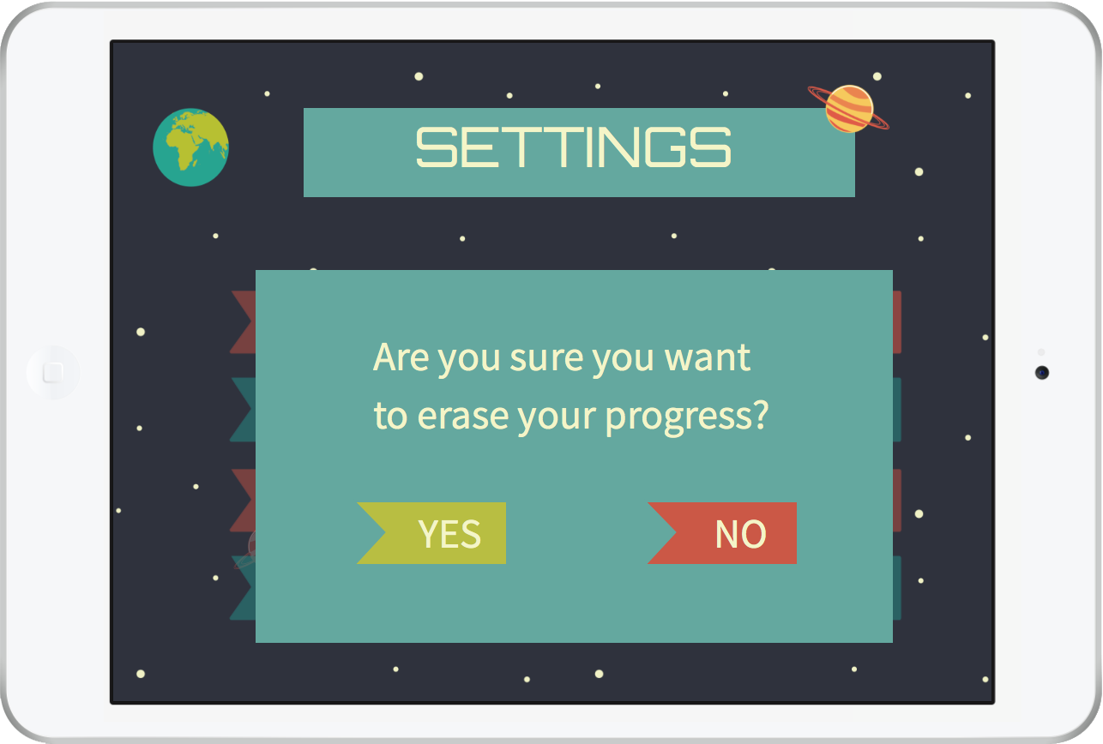
4.2 Erase progress. Pop-up
Astronuts: Mock-up

Slide 9
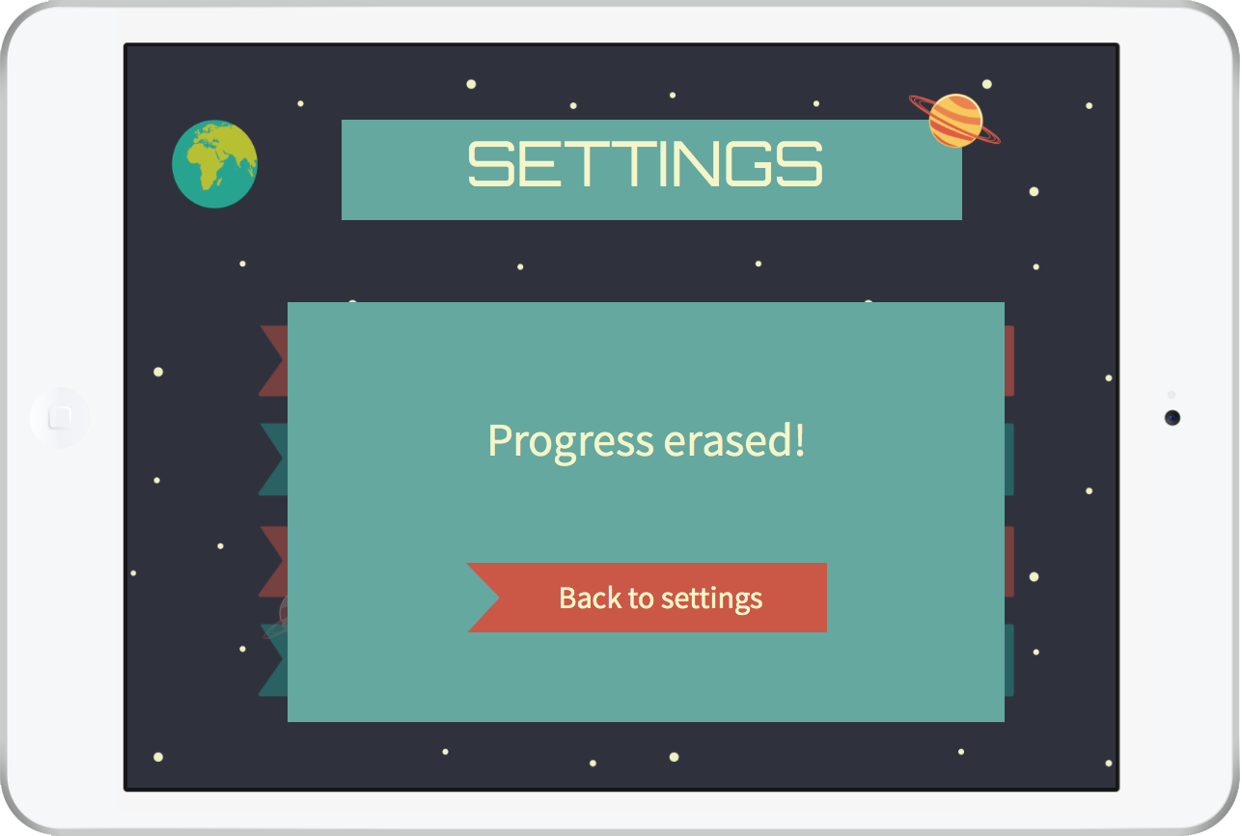
4.3 Progress erased. Pop-up
Astronuts: Mock-up

Slide 10
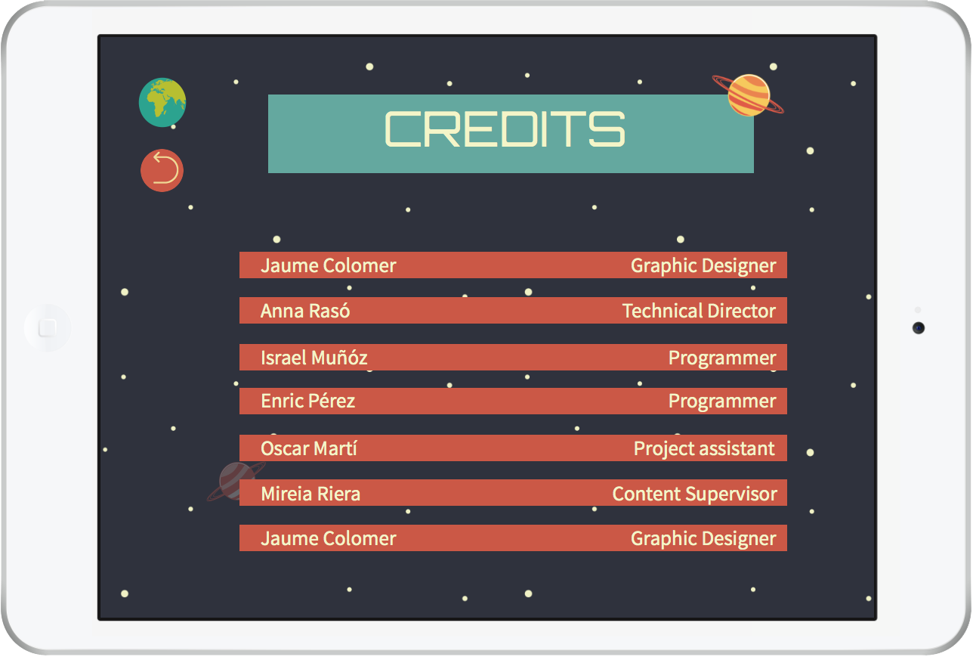
4.4 Credits
Astronuts: Mock-up

Slide 11
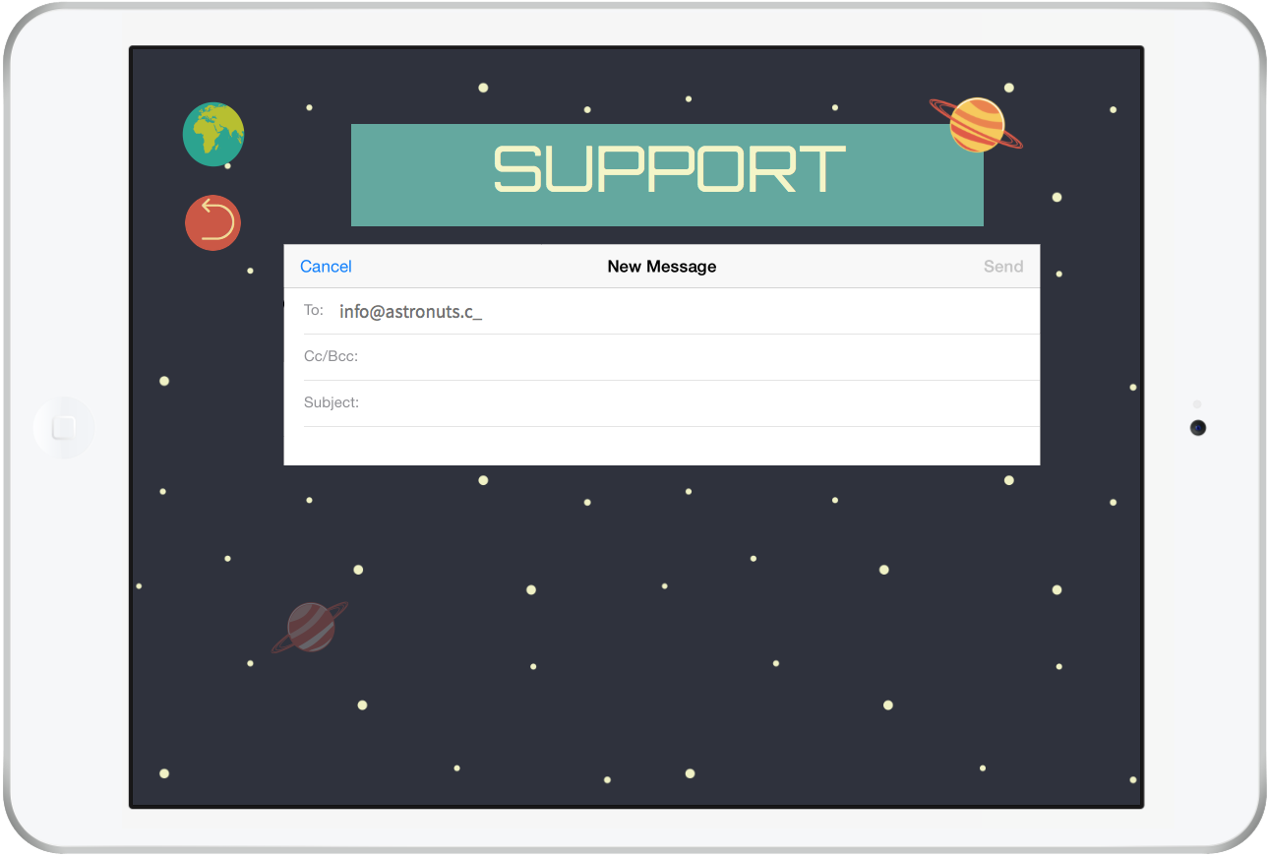
4.5 Support
Astronuts: Mock-up

Slide 12
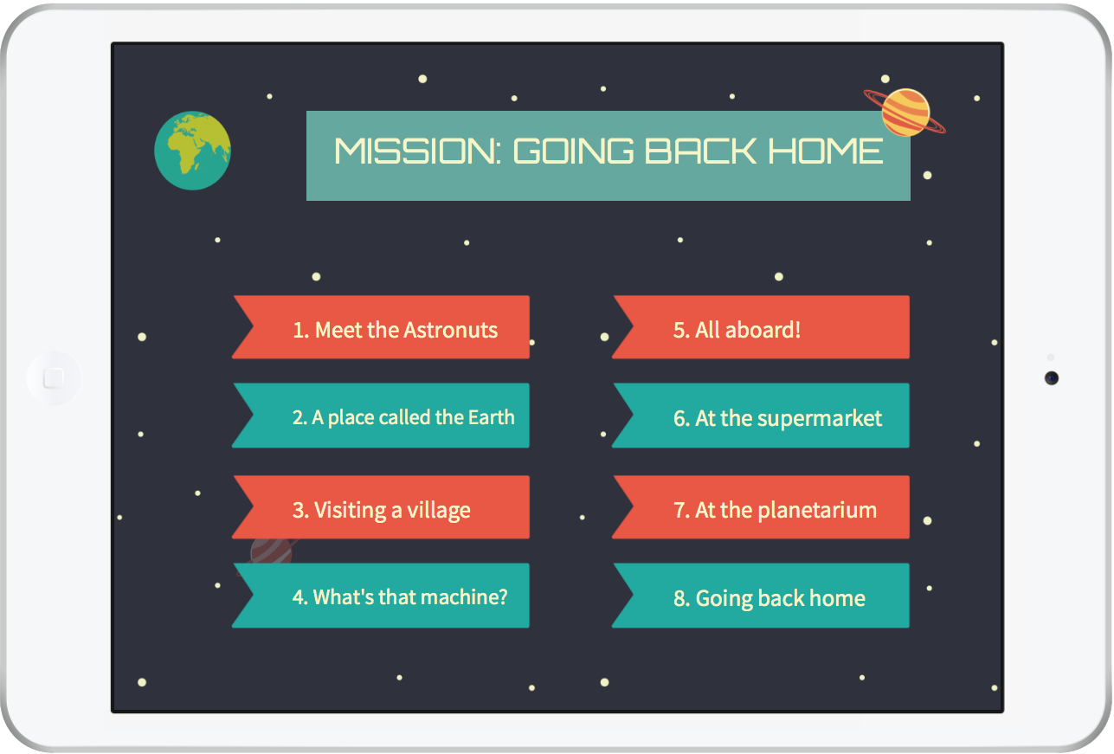
5. Mission: Going back home
Astronuts: Mock-up

Slide 13
6. Mission of the day
Astronuts: Mock-up

Slide 14
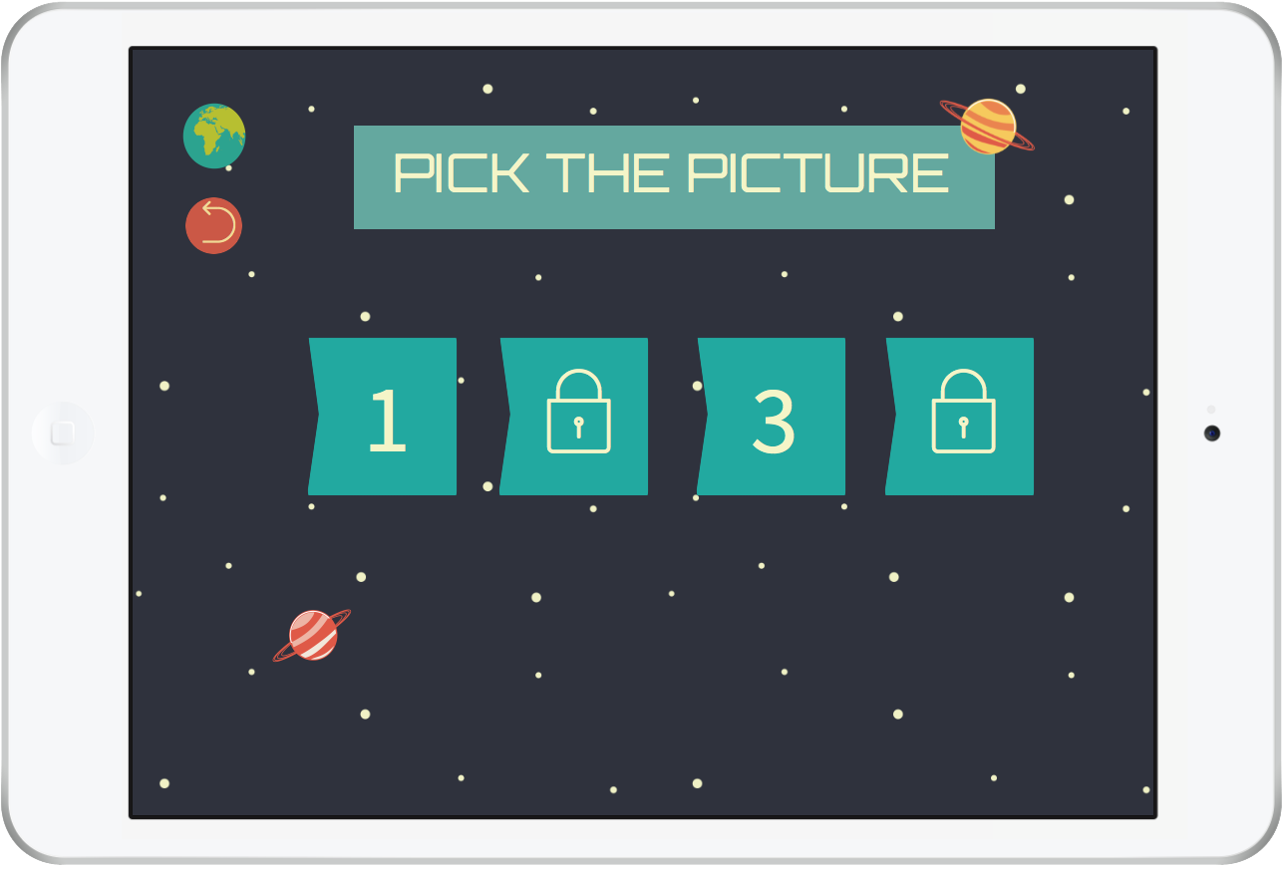
7. Pick the picture
Astronuts: Mock-up

Slide 15
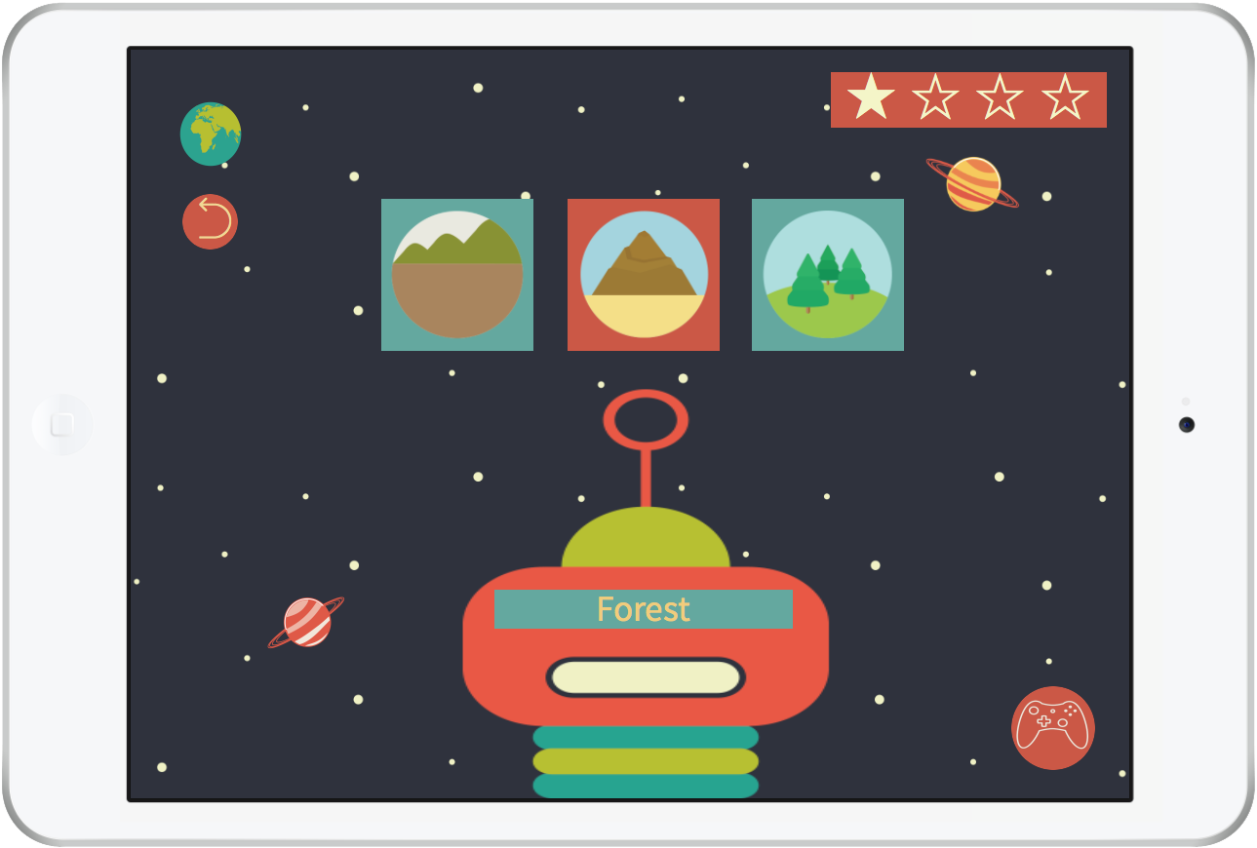
8. Pick the picture: Activity A
Astronuts: Mock-up

Slide 16
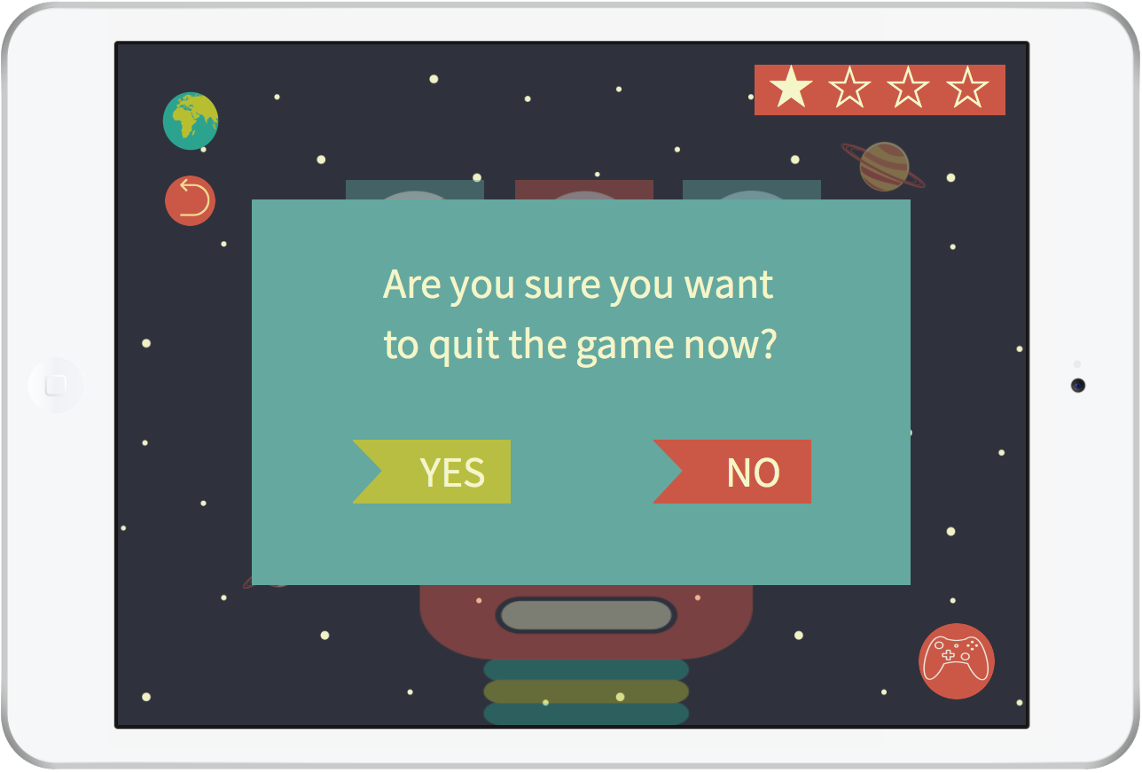
8.1 Confirmation screen A1
Astronuts: Mock-up

Slide 17
8.2 Confirmation screen A2
Astronuts: Mock-up

Slide 18
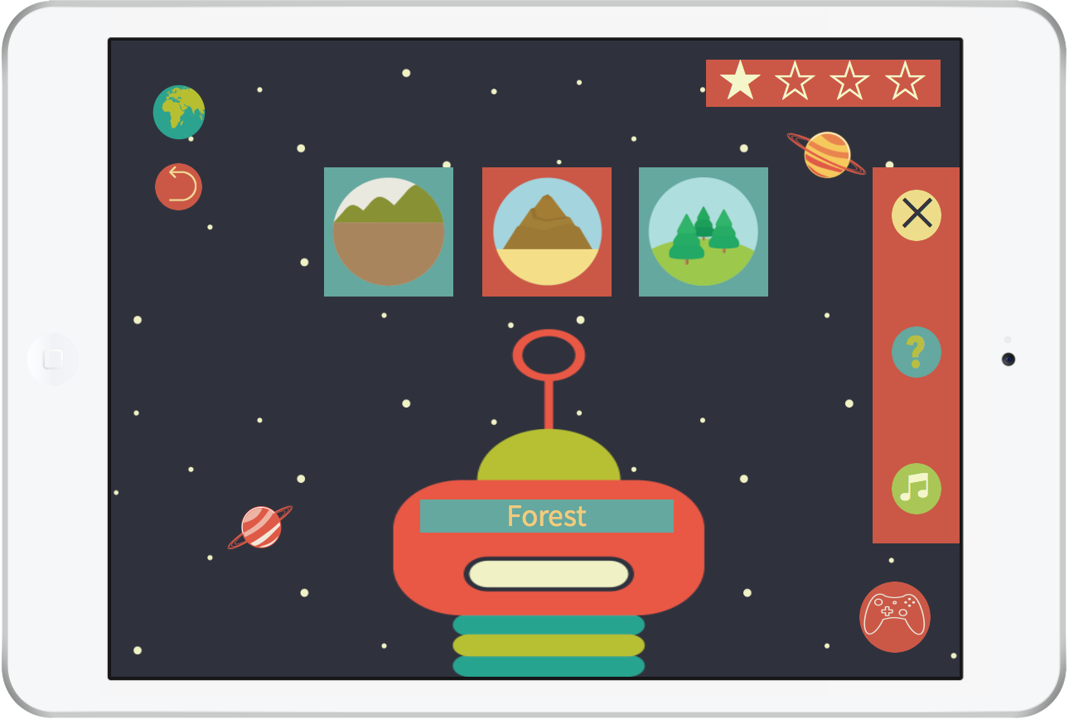
8.3 In-game settings A
Astronuts: Mock-up

Slide 19
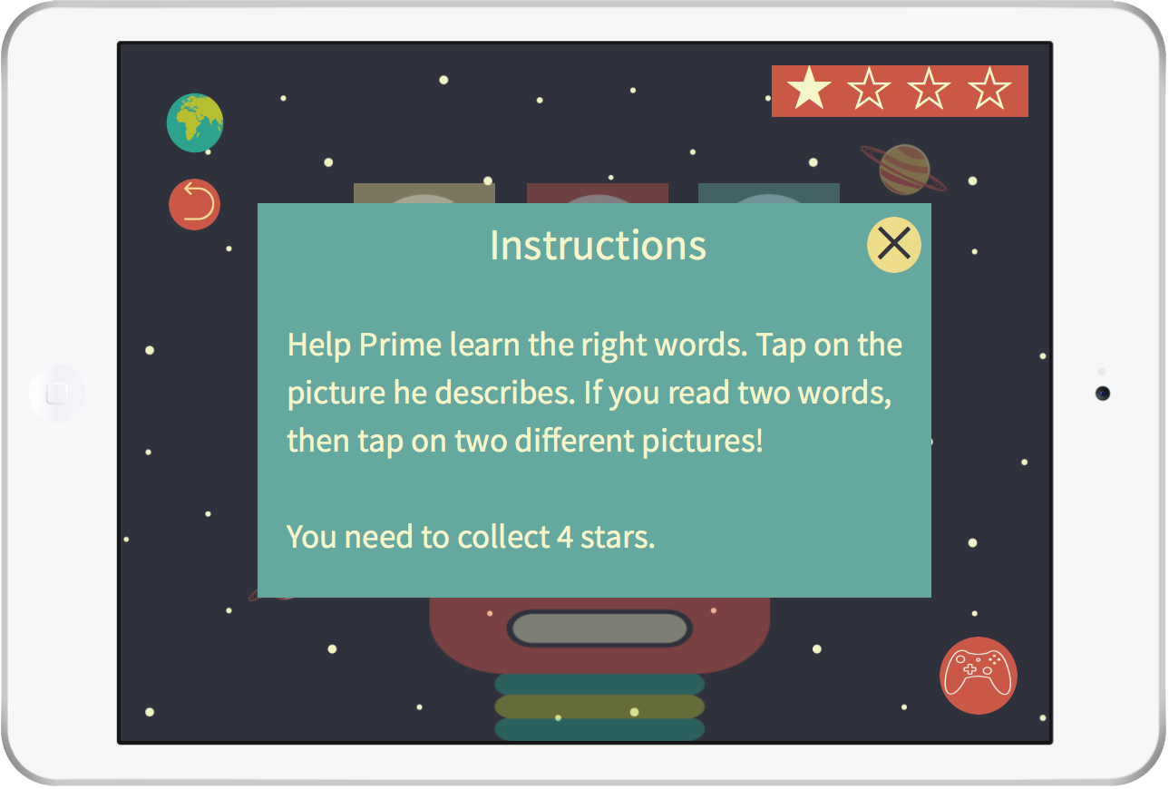
8.4 Instructions A
Astronuts: Mock-up

Slide 20
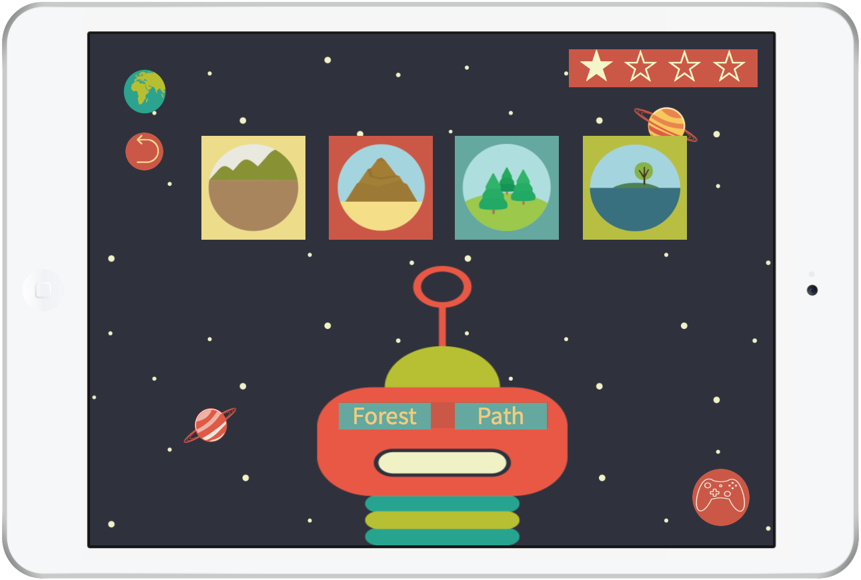
9. Pick the picture: Activity B
Astronuts: Mock-up

Slide 21
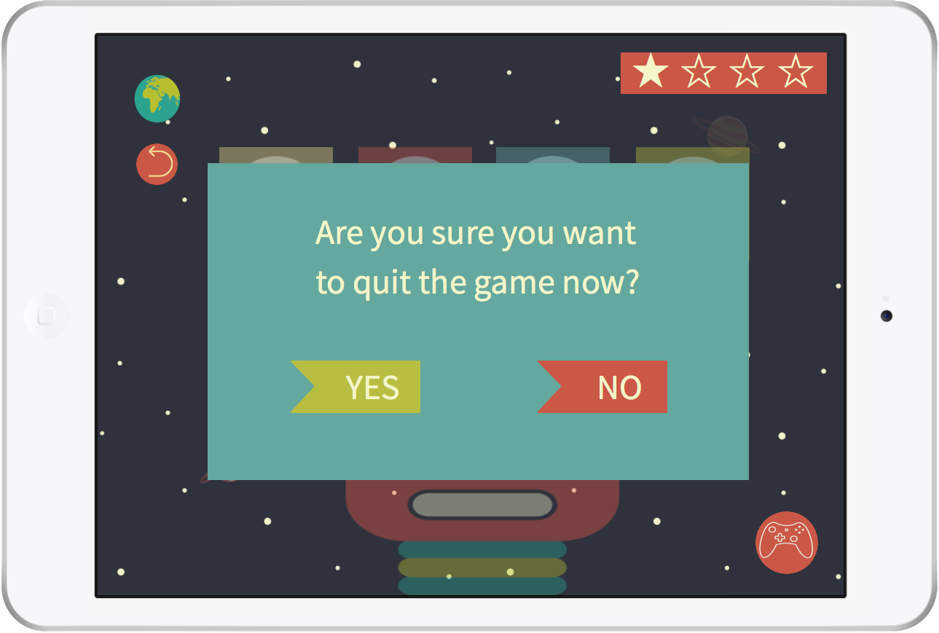
9.1 Confirmation screen B1
Astronuts: Mock-up

Slide 22
9.2 Confirmation screen B2
Astronuts: Mock-up

Slide 23
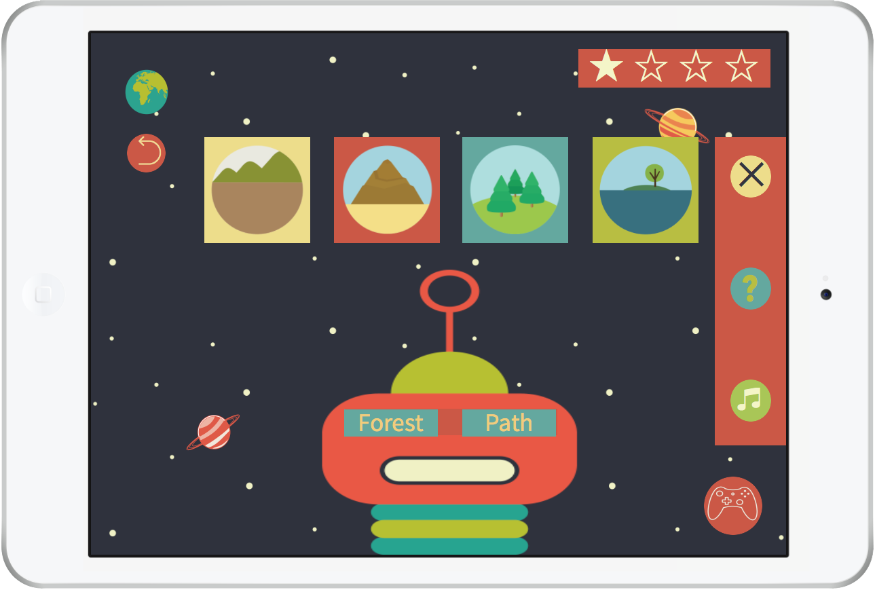
9.3 In-game settings B
Astronuts: Mock-up

Slide 24
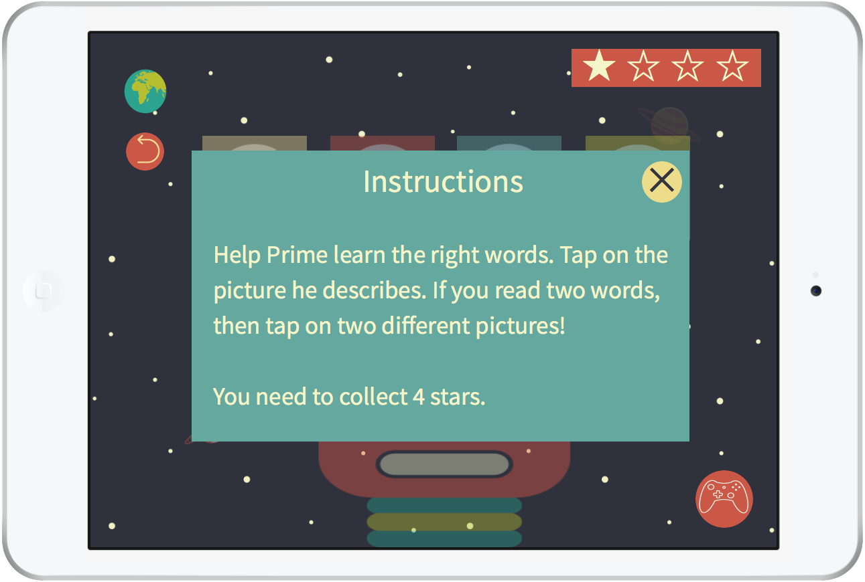
9.4 Instructions B
Astronuts: Mock-up

Slide 25
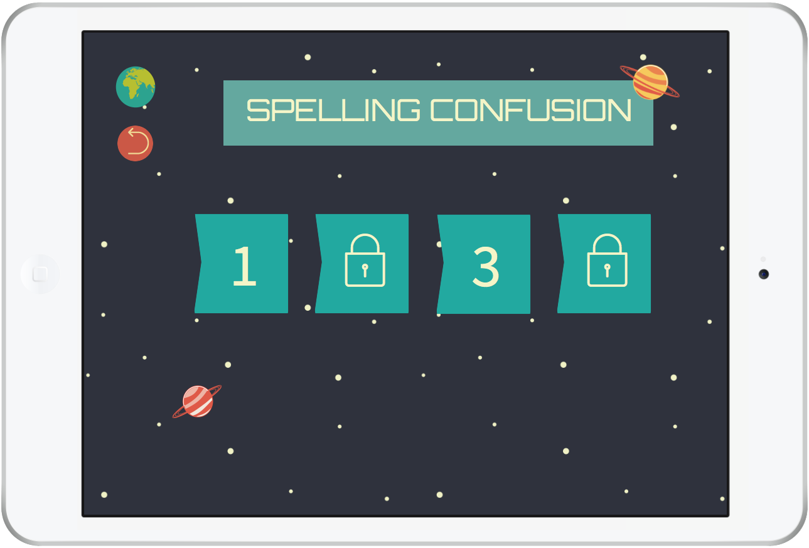
10. Spelling confusion
Astronuts: Mock-up

Slide 26
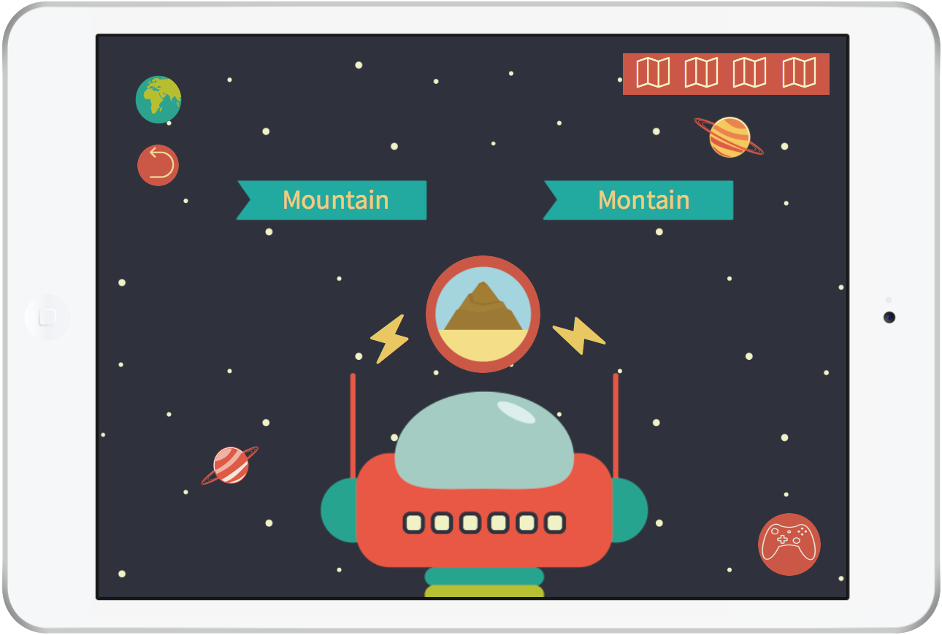
11. Spelling confusion: Activity A
Astronuts: Mock-up

Slide 27
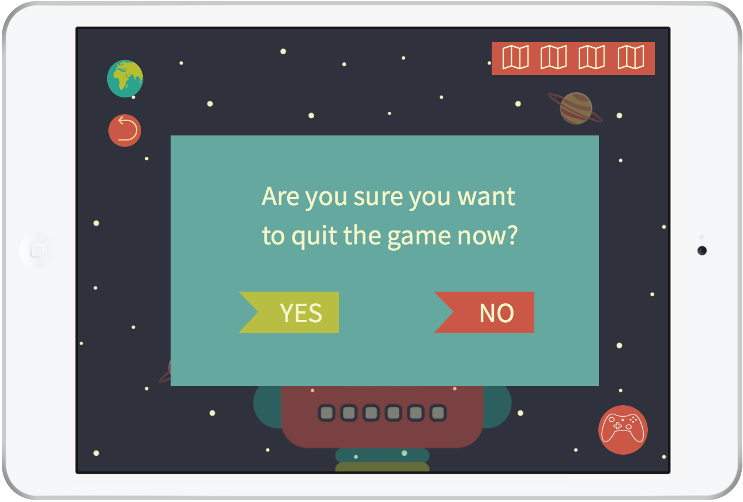
11.1 Confirmation screen A1
Astronuts: Mock-up

Slide 28
11.2 Confirmation screen A2
Astronuts: Mock-up

Slide 29
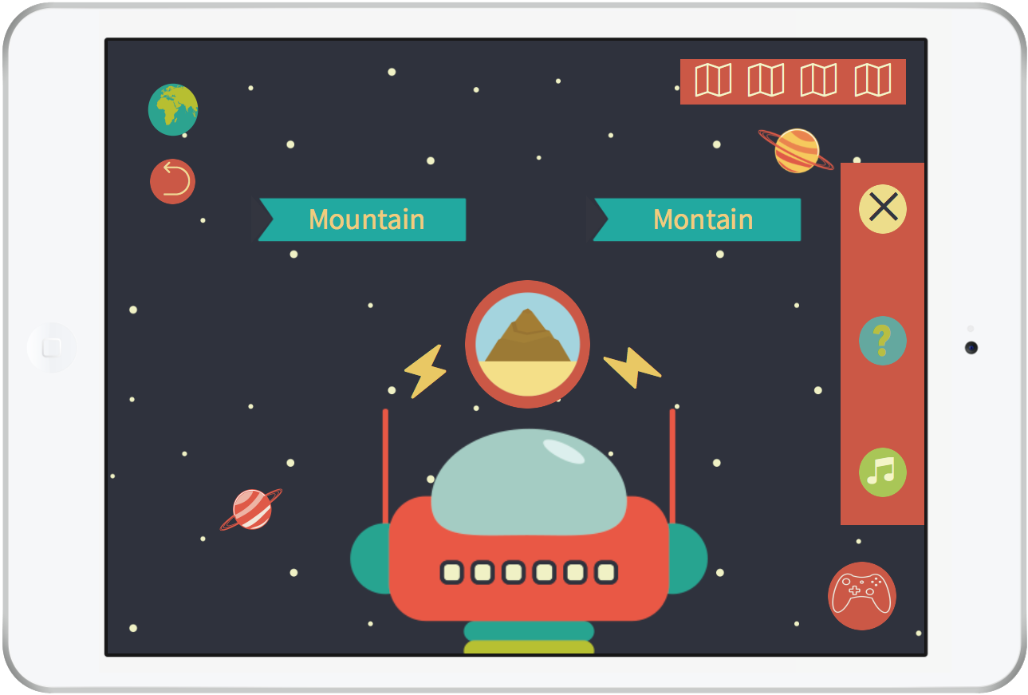
11.3 In-game settings A
Astronuts: Mock-up

Slide 30
Astronuts: Mock-up
11.4 Instructions A

Slide 31
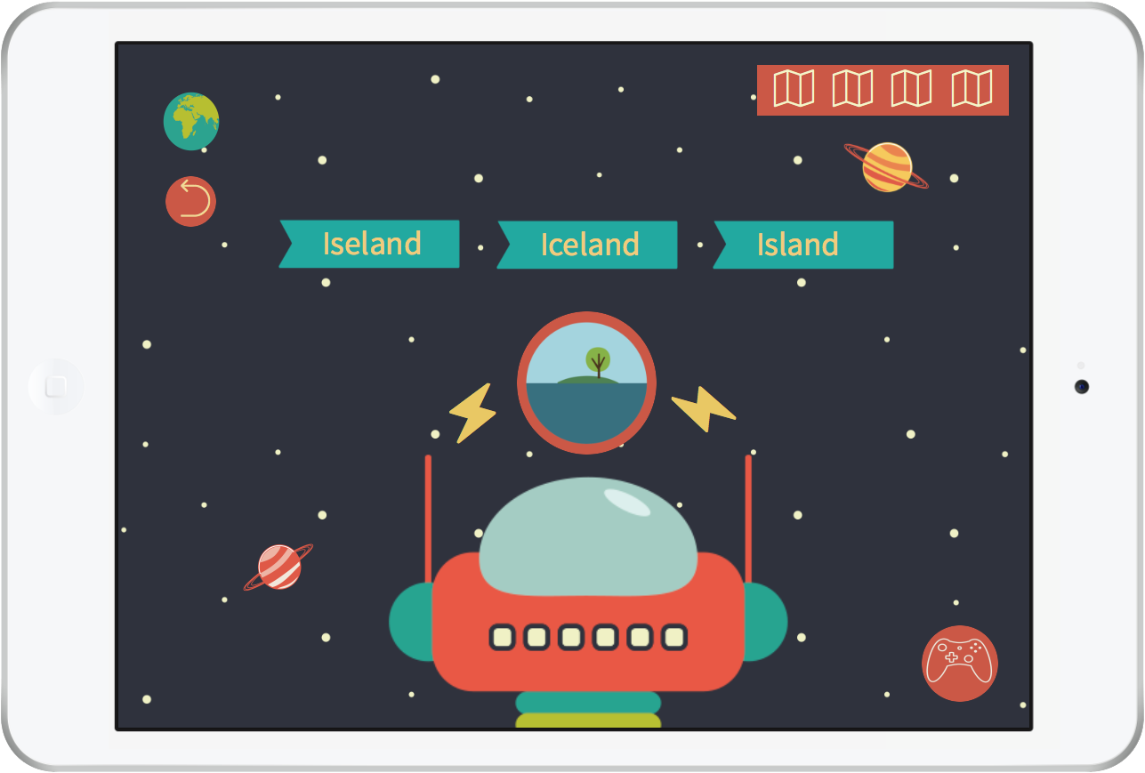
12. Spelling confusion: Activity B
Astronuts: Mock-up

Slide 32
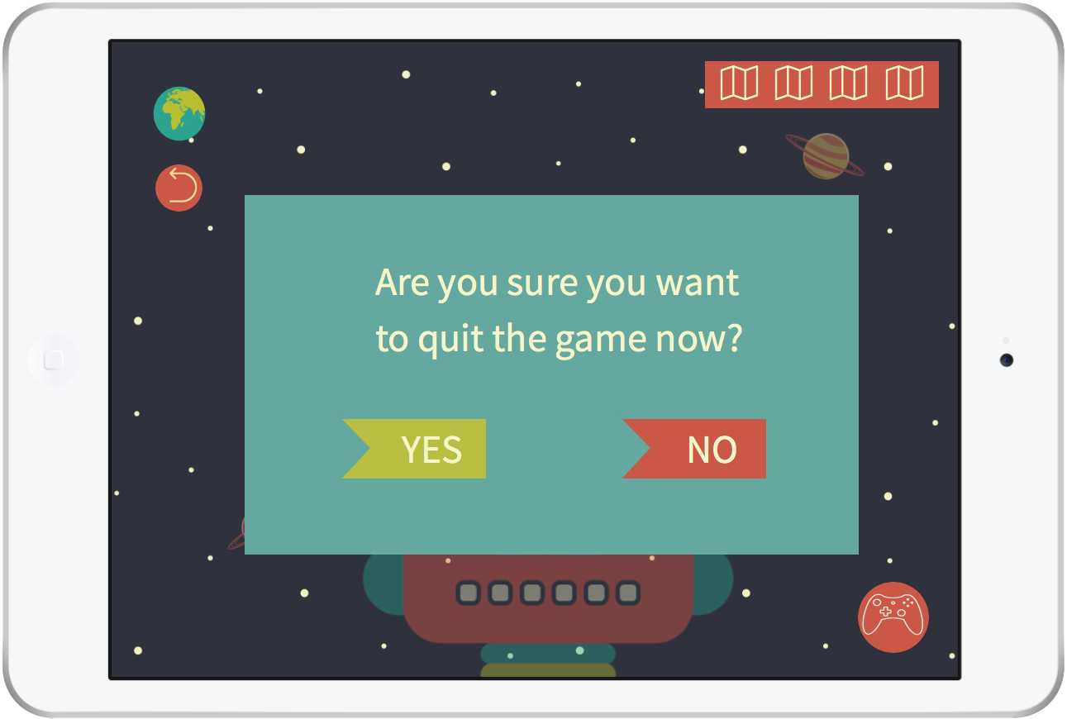
12.1 Confirmation screen B1
Astronuts: Mock-up

Slide 33
12.2 Confirmation screen B2
Astronuts: Mock-up

Slide 34
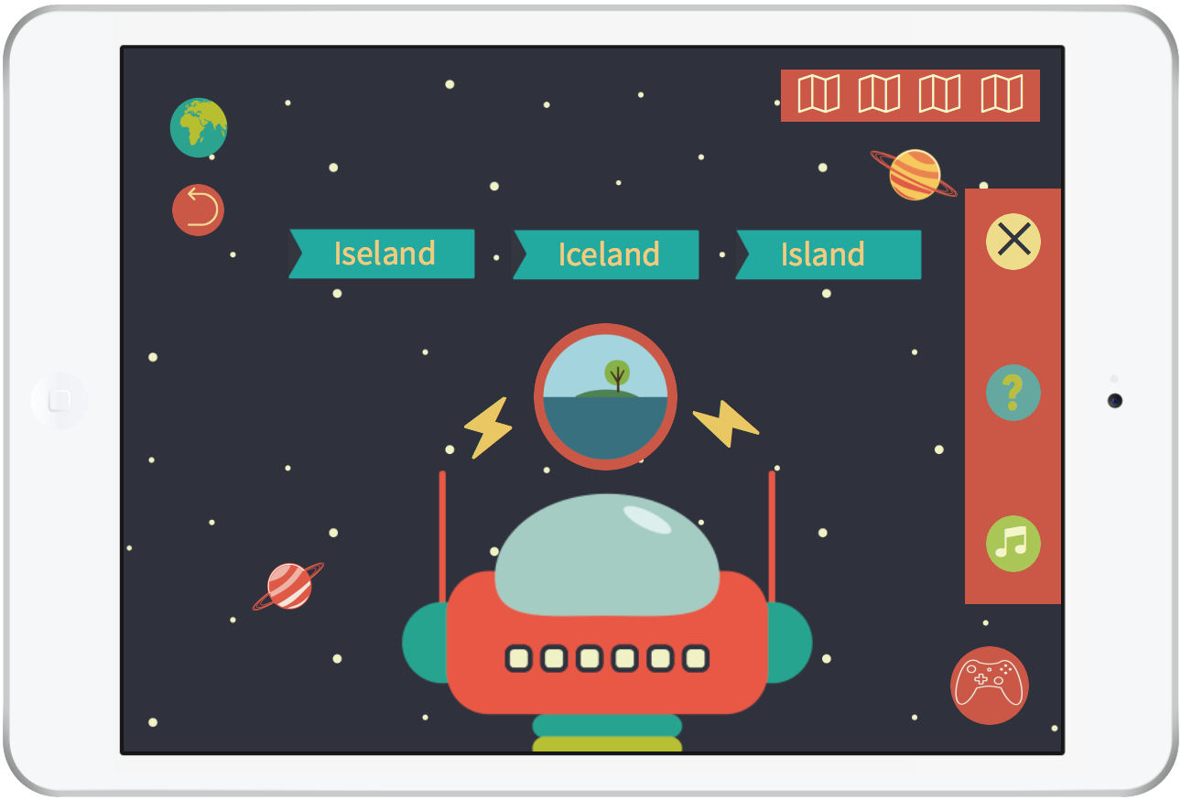
12.3 In-game settings B
Astronuts: Mock-up

Slide 35
12.4 Instructions B
Astronuts: Mock-up

Slide 36
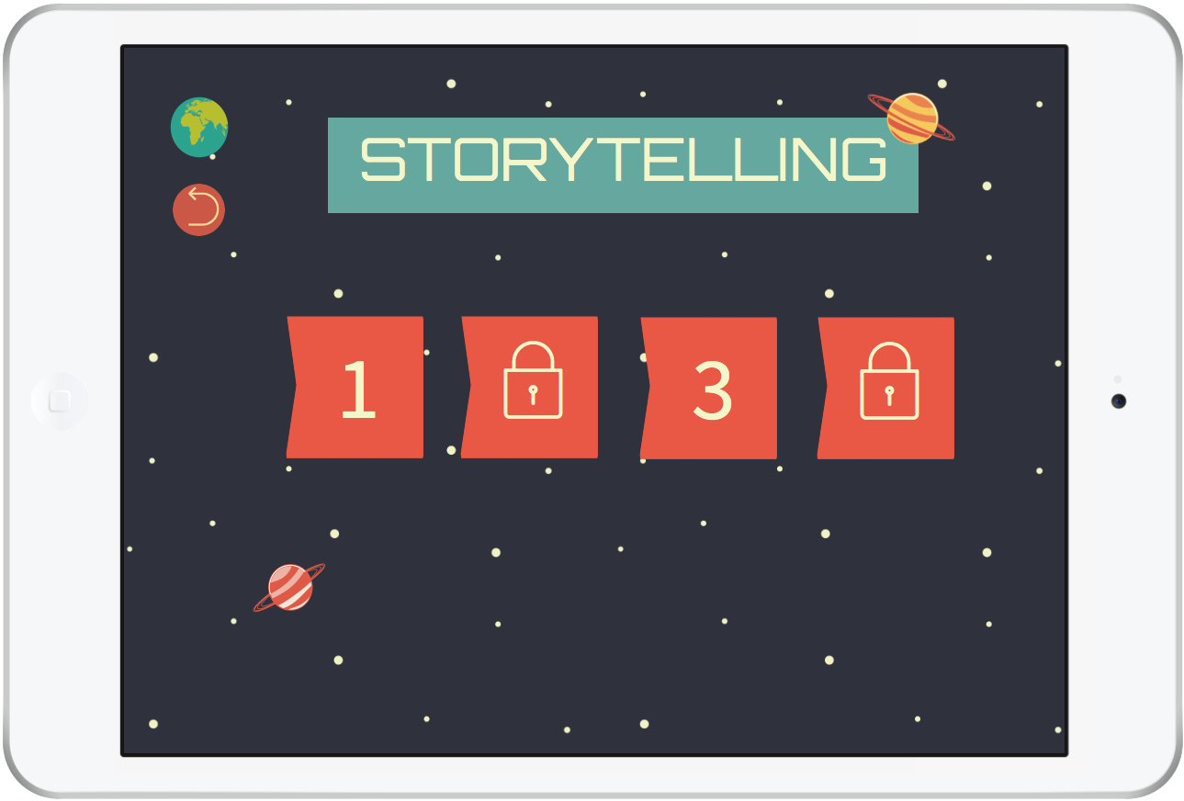
13. Storytelling
Astronuts: Mock-up

Slide 37
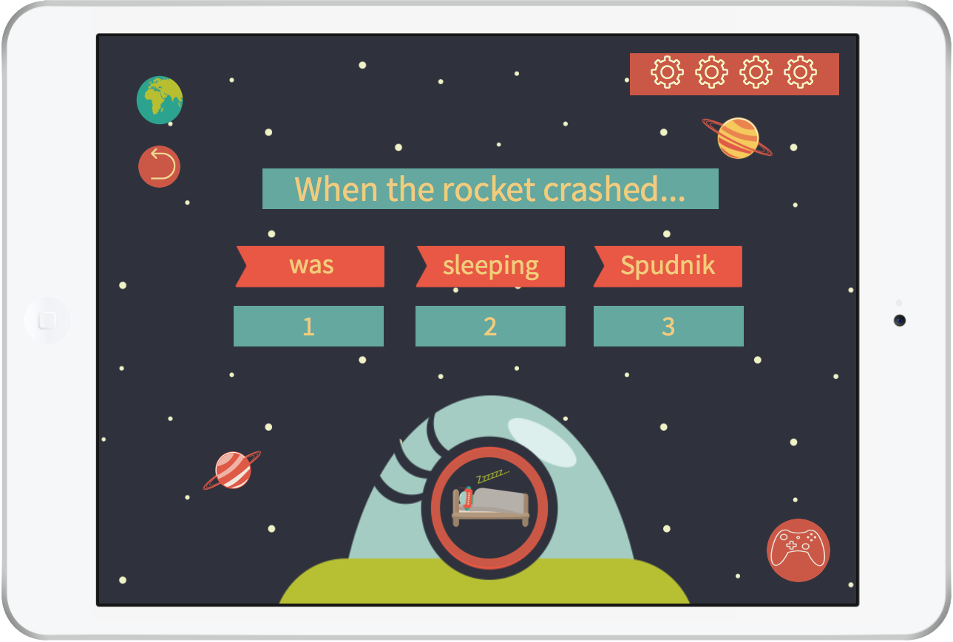
14. Storytelling: Activity A
Astronuts: Mock-up

Slide 38
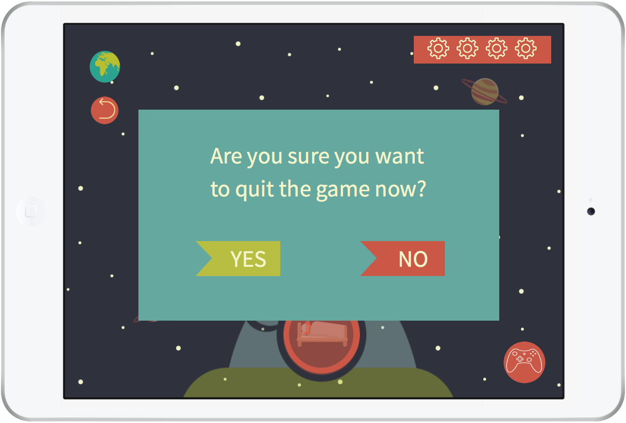
14.1 Confirmation screen A1
Astronuts: Mock-up

Slide 39
14.2 Confirmation screen A2
Astronuts: Mock-up

Slide 40
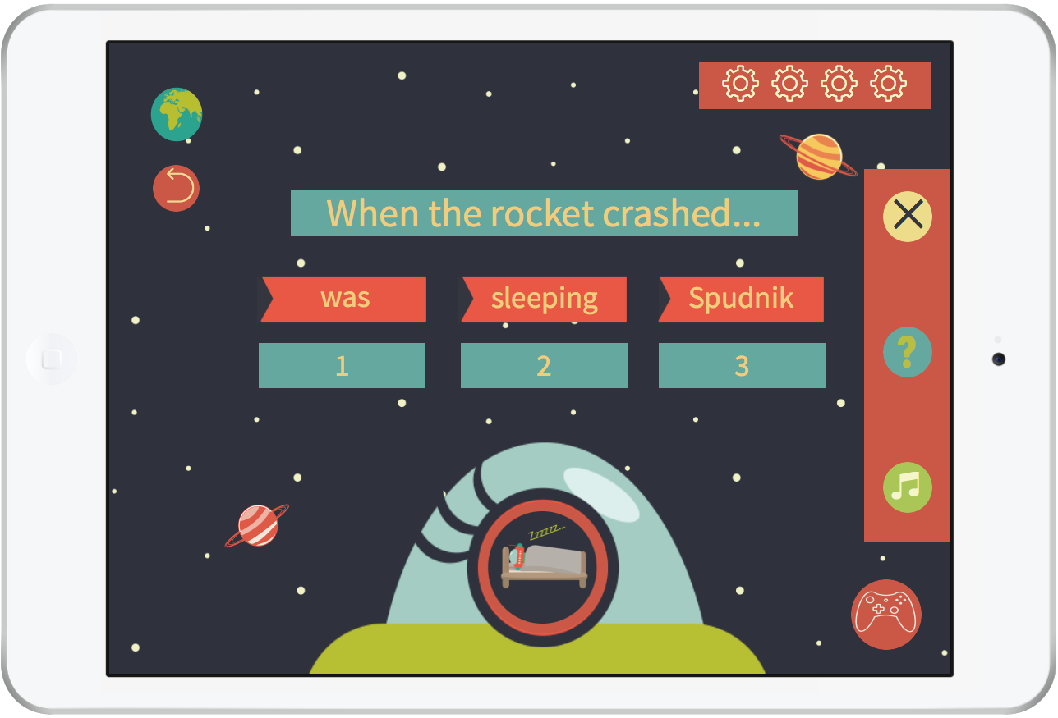
14.3 In-game settings A
Astronuts: Mock-up

Slide 41
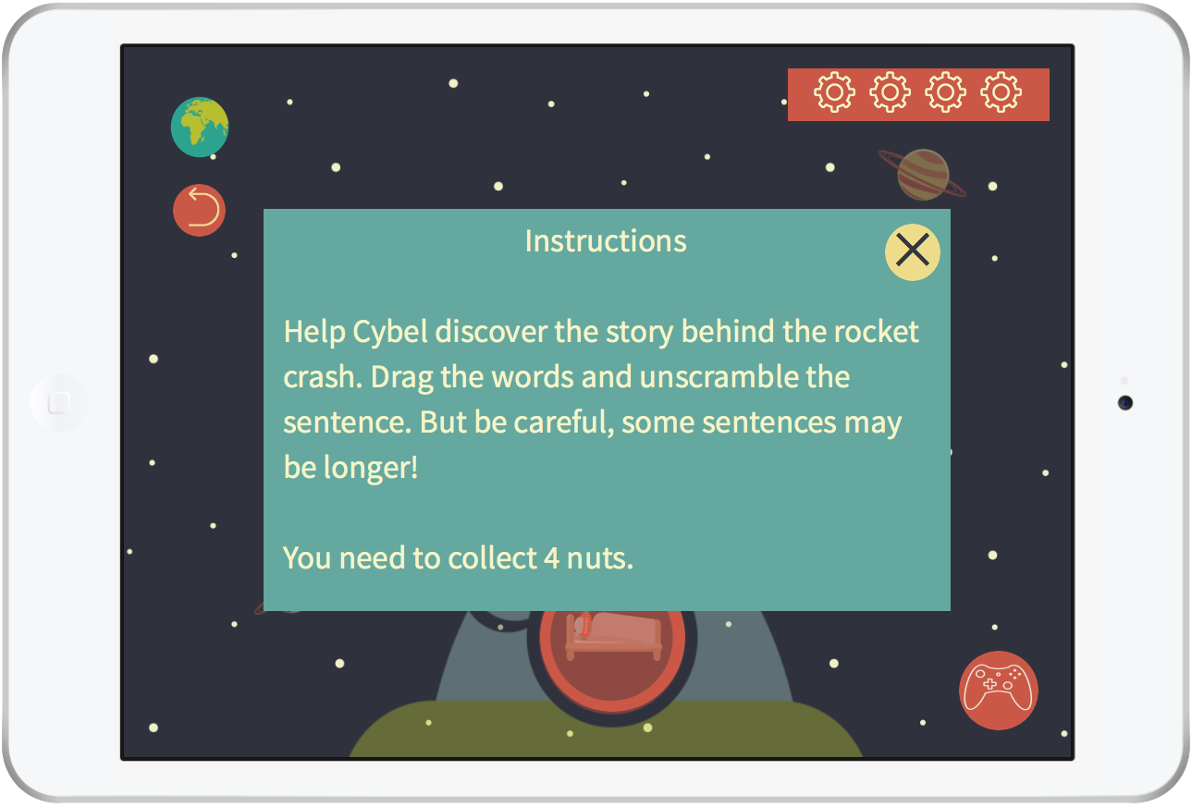
14.4 Instructions A
Astronuts: Mock-up

Slide 42
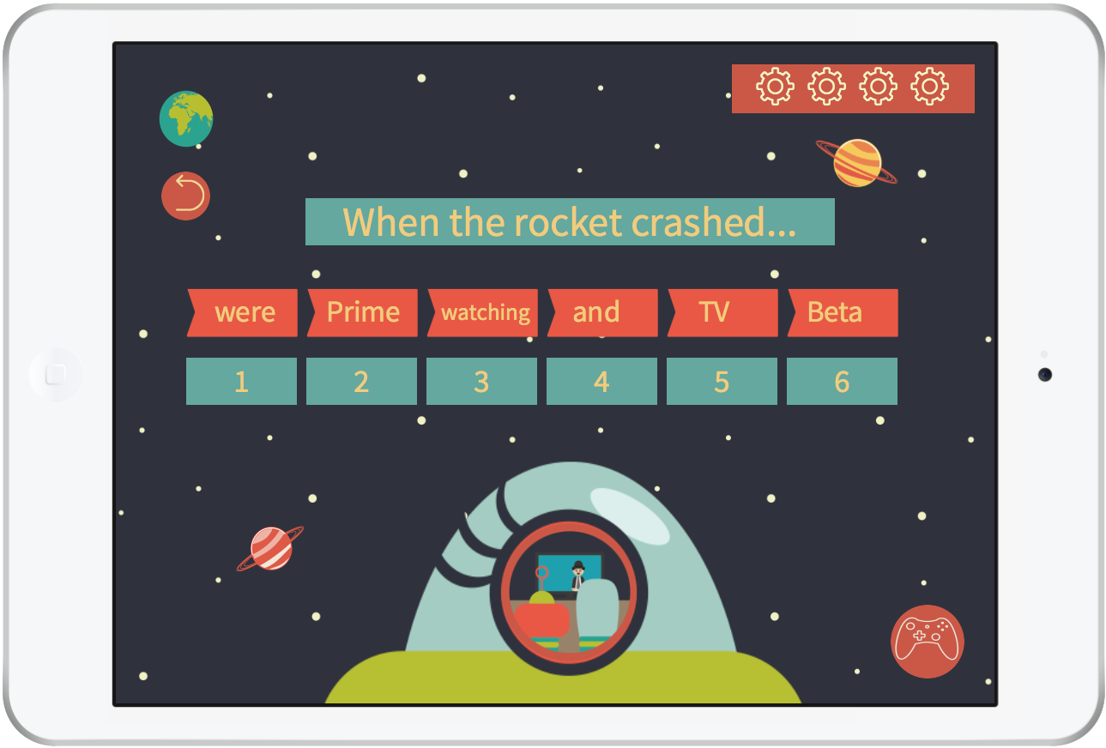
15. Storytelling: Activity B
Astronuts: Mock-up

Slide 43
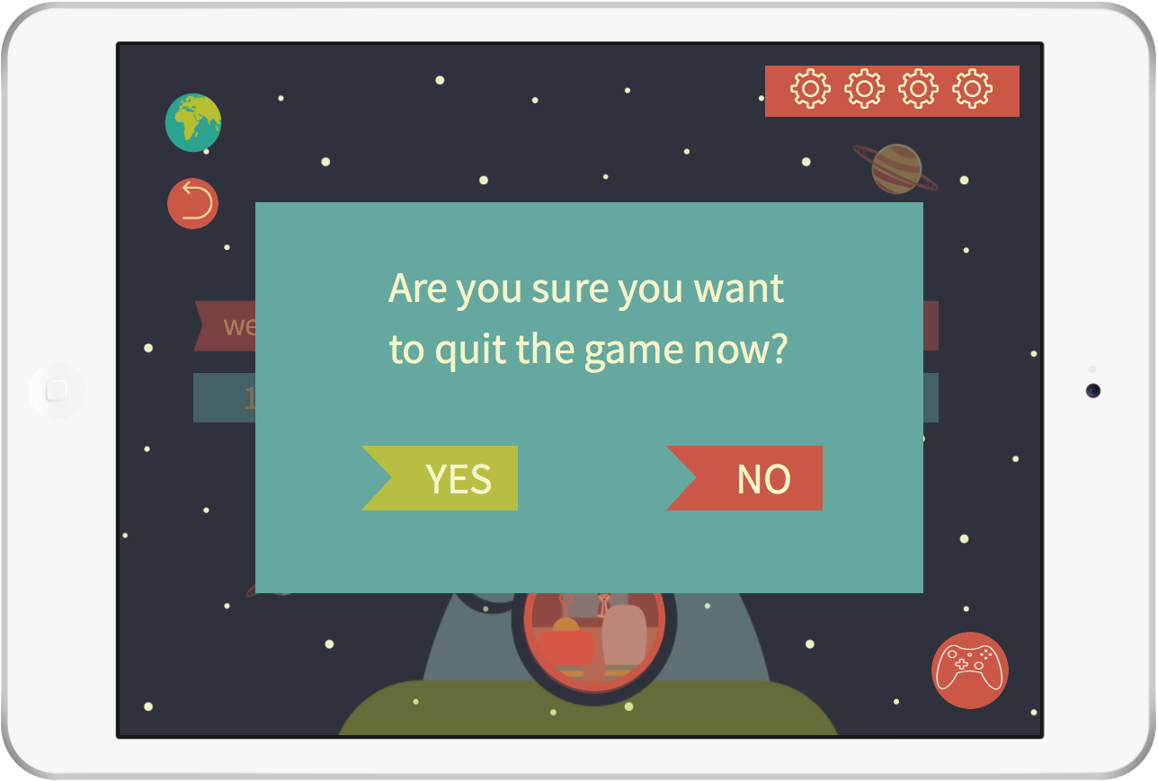
15.1 Confirmation screen B1
Astronuts: Mock-up

Slide 44
15.2 Confirmation screen B2
Astronuts: Mock-up

Slide 45
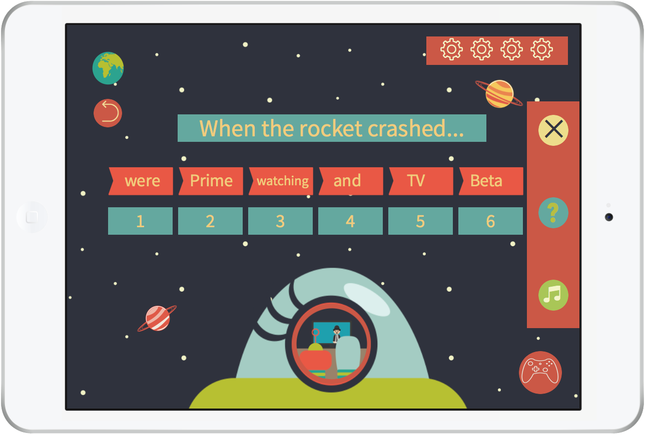
15.3 In-game settings B
Astronuts: Mock-up

Slide 46
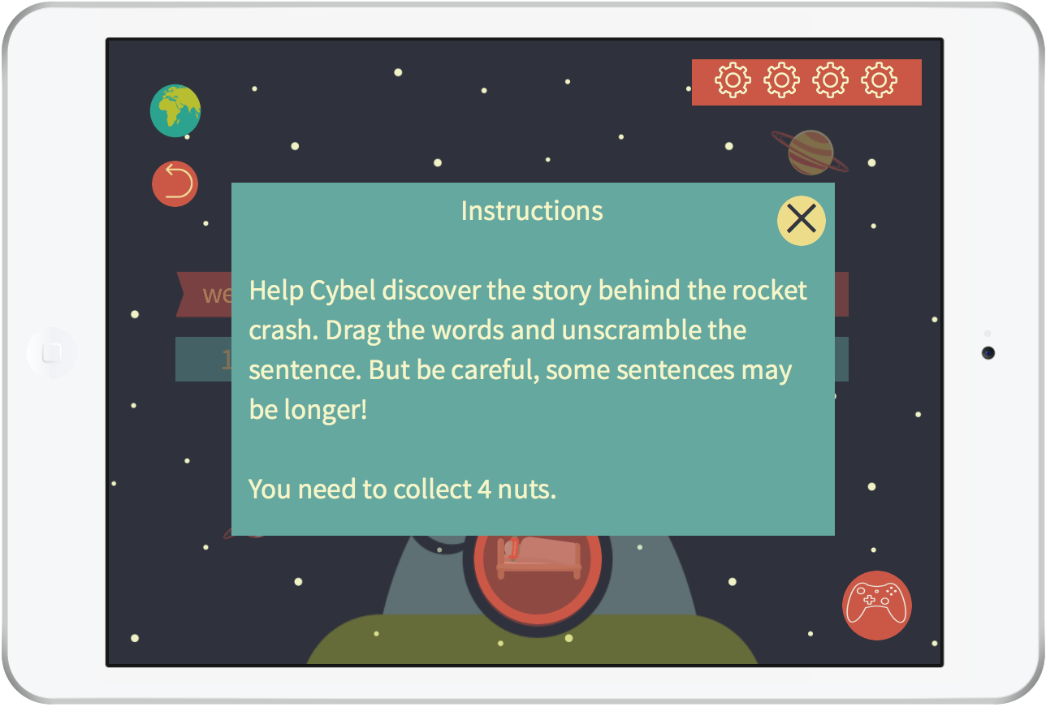
15.4 Instructions B
Astronuts: Mock-up

Slide 47
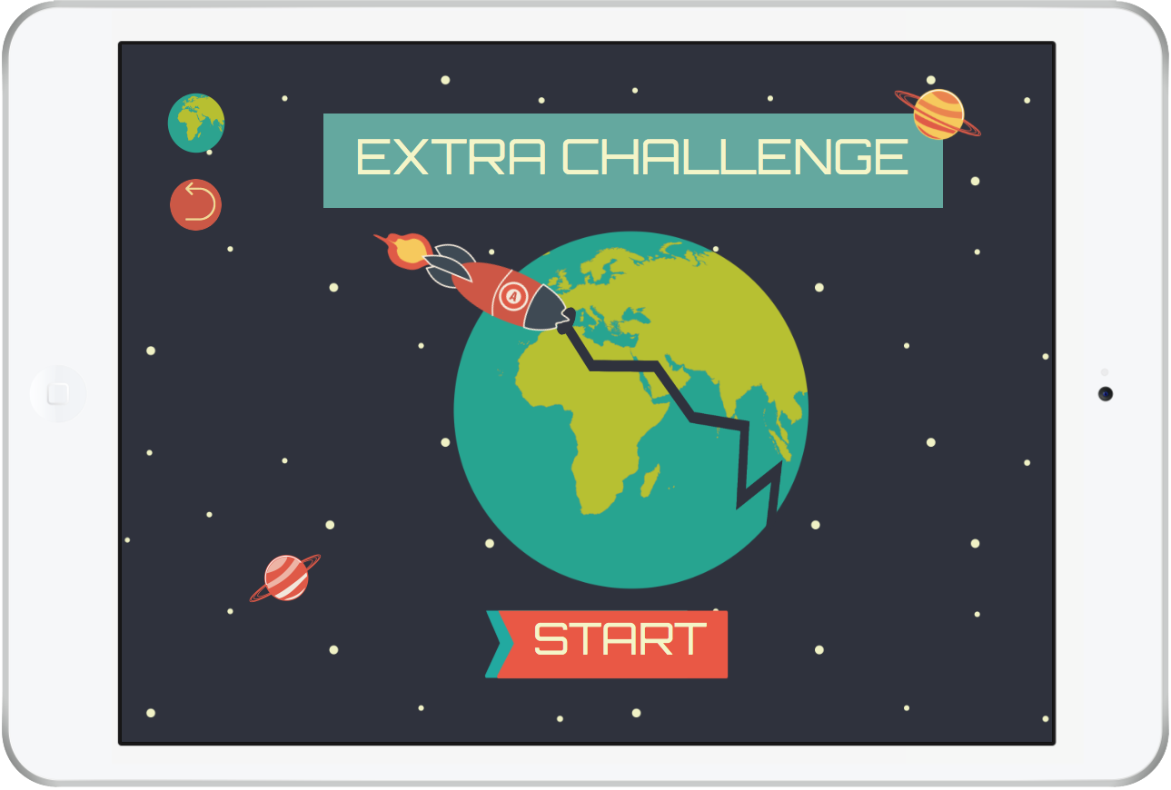
16. Extra challenge
Astronuts: Mock-up

Slide 48
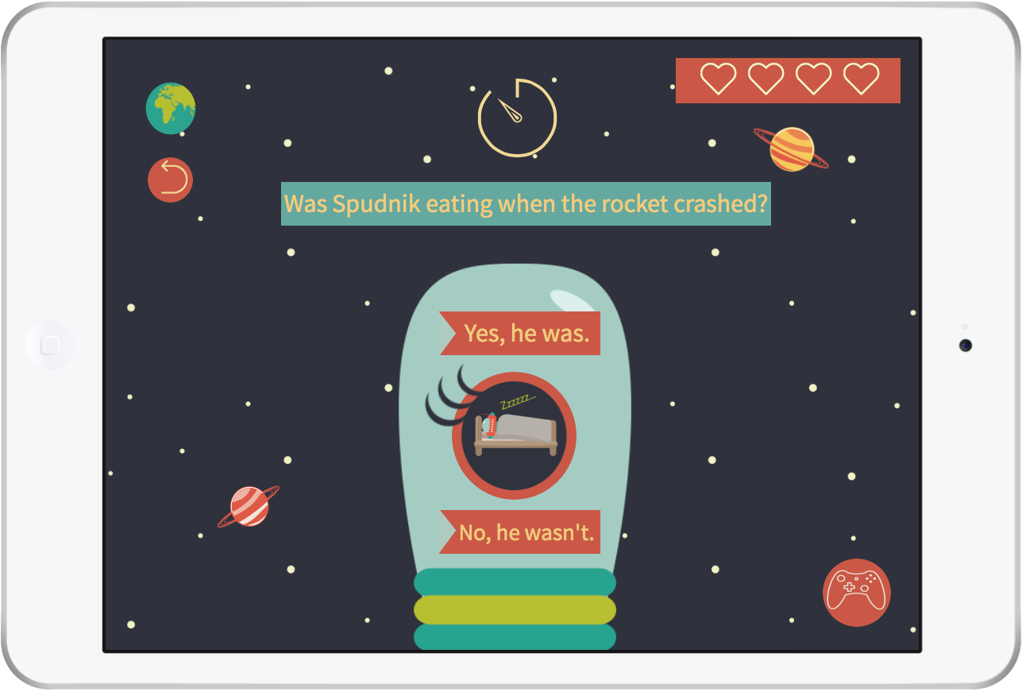
17. Extra challenge: Activity A
Astronuts: Mock-up

Slide 49
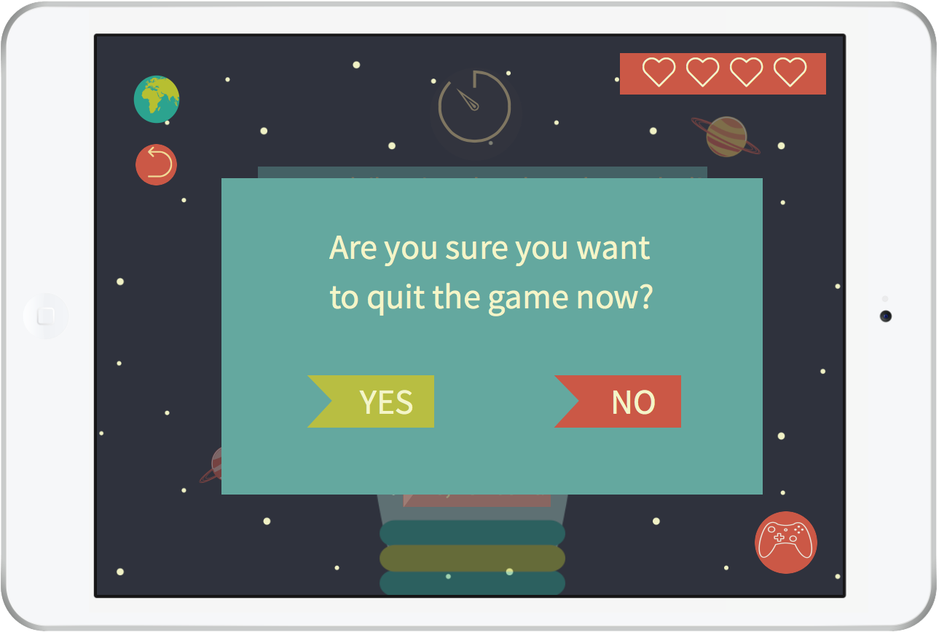
17.1 Confirmation screen A1
Astronuts: Mock-up

Slide 50
17.2 Confirmation screen A2
Astronuts: Mock-up

Slide 51
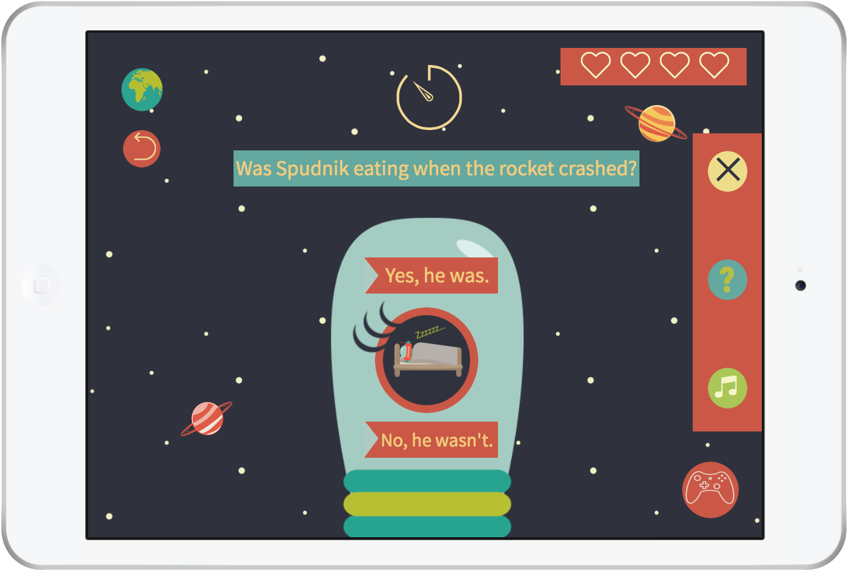
17.3 In-game settings A
Astronuts: Mock-up

Slide 52
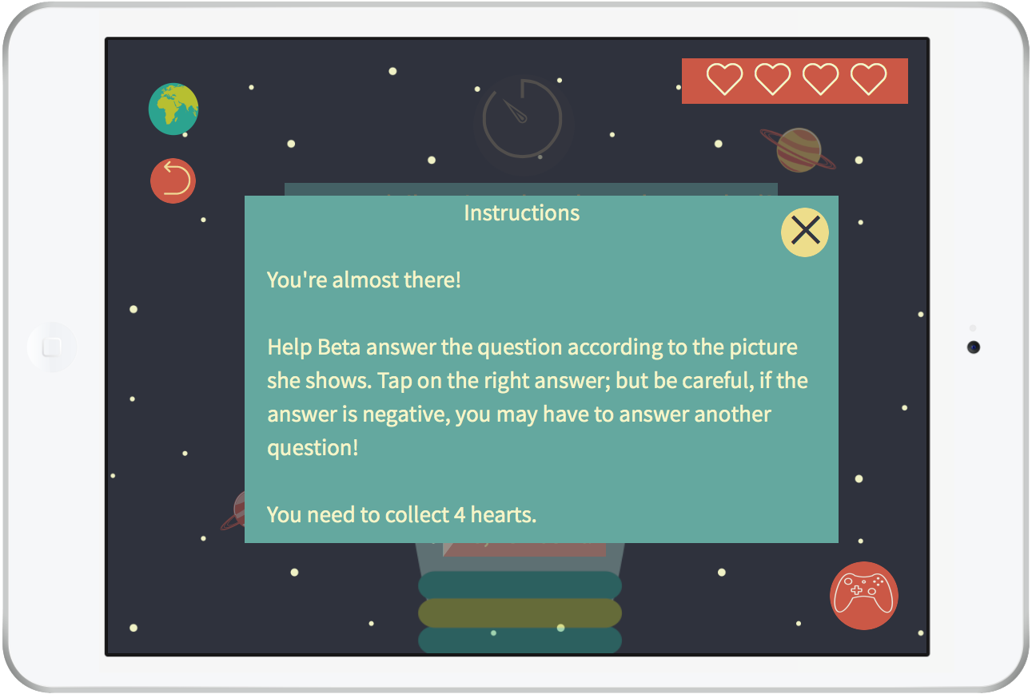
17.4 Instructions A
Astronuts: Mock-up

Slide 53
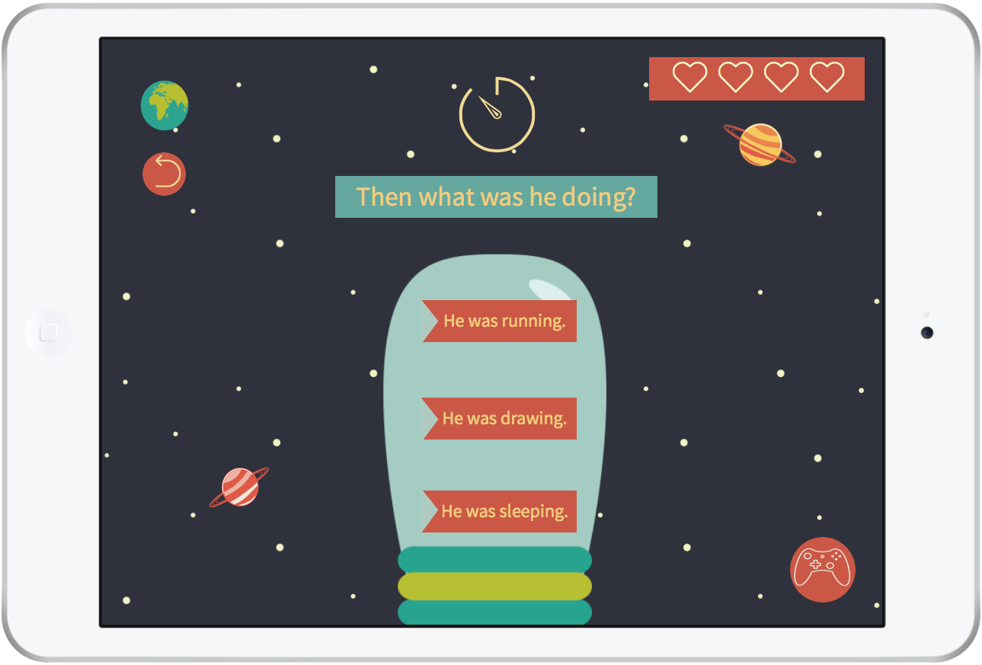
18. Extra challenge: Activity B
Astronuts: Mock-up

Slide 54
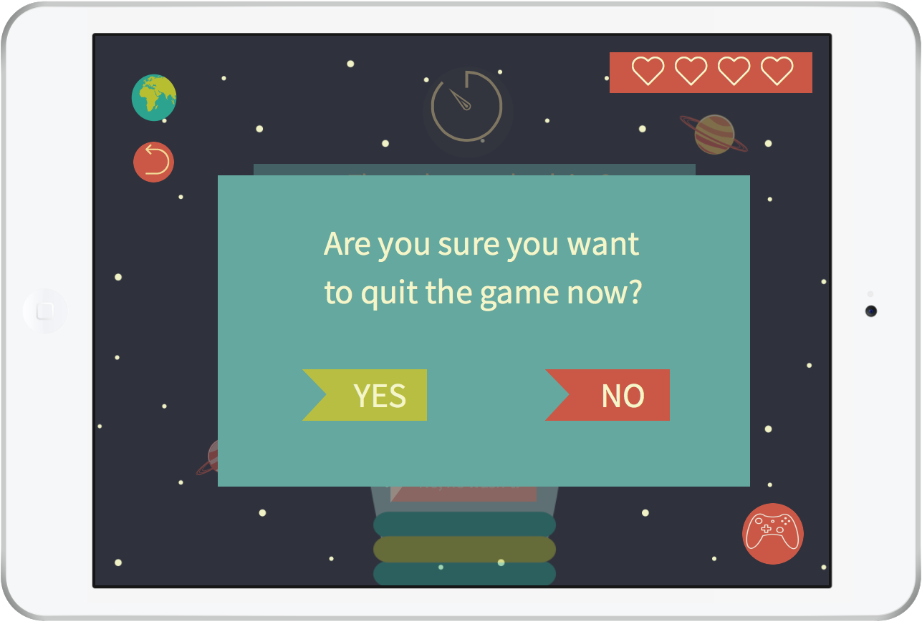
18.1 Confirmation screen B1
Astronuts: Mock-up

Slide 55
18.2 Confirmation screen B2
Astronuts: Mock-up

Slide 56
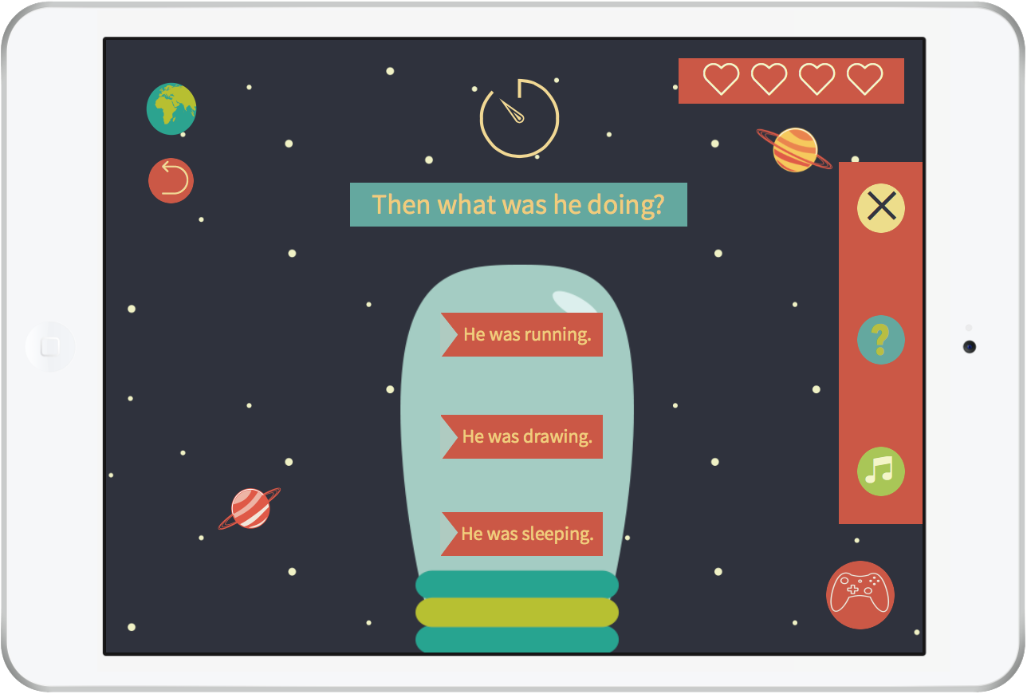
18.3 In-game settings B
Astronuts: Mock-up

Slide 57
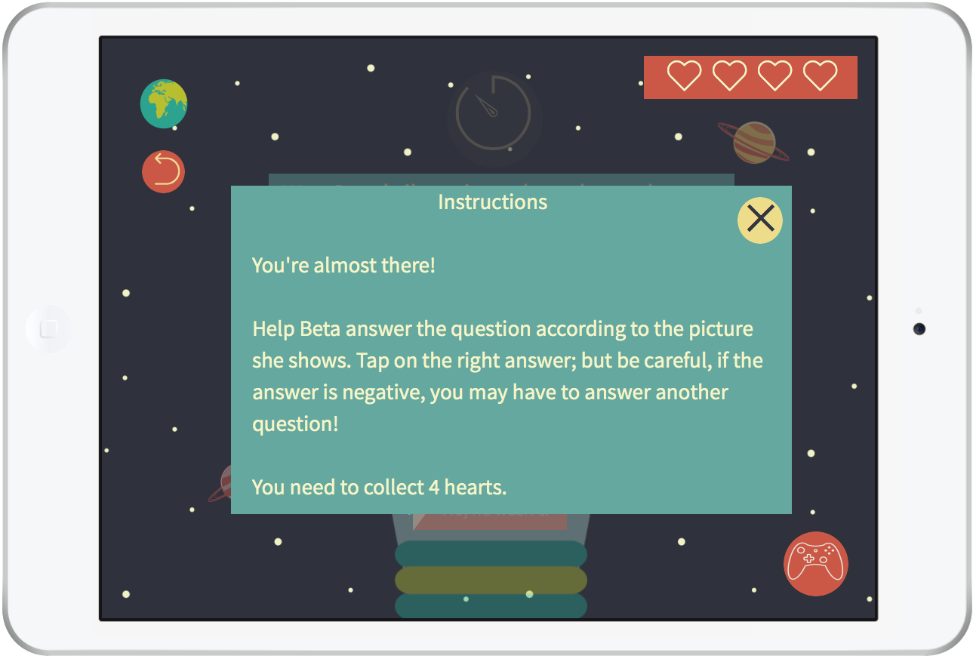
18.4 Instructions B
Astronuts: Mock-up

Slide 58
19. End of unit
Astronuts: Mock-up

