Slide 1
Characterization of Parallel Scientific Simulations
January 2017
Borja Miñano Maldonado
Masther Project Thesis in Computer Engineering
High Performance Computing

Slide 2
Presentation outline
Introduction
Objectives
Scientific simulations
Metric and tool overview
Result from
Characterization
Modelization
Conclusions

Slide 3
Introduction
High Performance Computing (HPC) for
Engineering
Scientific research
Business analytics
Weather forecast
Performance through
Hardware improvement
Programming skills

Slide 4
Objectives
Analysis and characterization of parallel scientific simulations
Bottleneck detection
Improvement proposals

Slide 5
Scientific simulations
Single Program, Multiple Data (SPMD)
Different resource demands
CPU
Memory
I/O requests
3 phases
Initial setup
Initialization – Memory allocation
Evolution – High computing and I/O demand

Slide 6
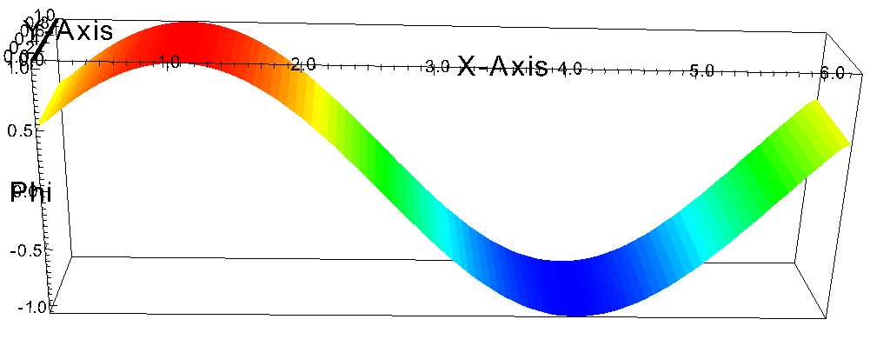
Memory-bound - Advection
Advection equation
Fluid transport
Simulation objective
Numerical discretization test
Simple algorithm + Huge size

Slide 7
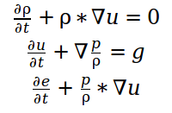
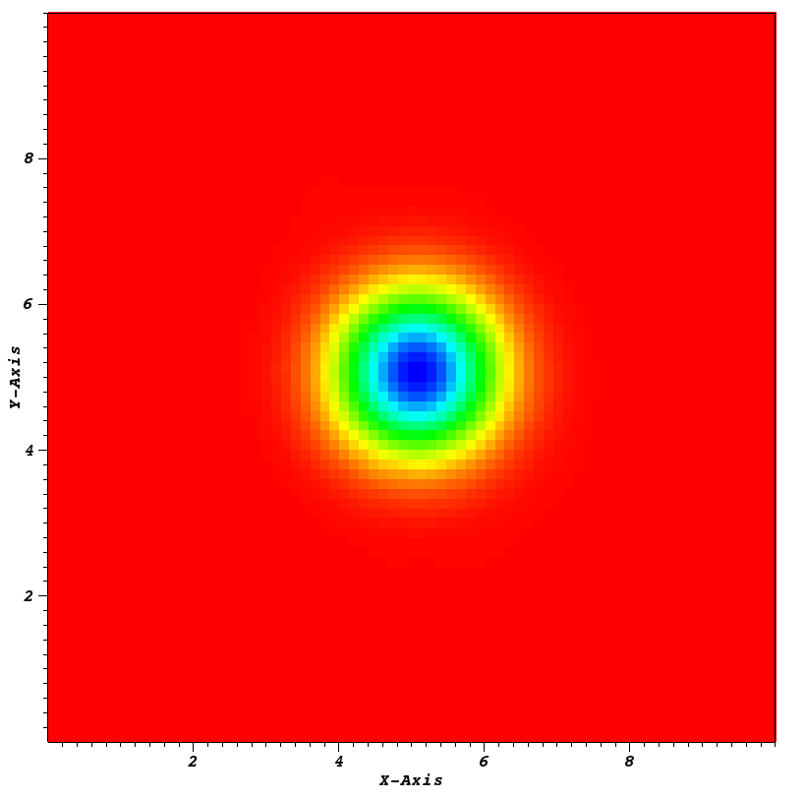
CPU-bound - Euler
Euler equations
Movement of incompressible flow
Simulation objective
Numerical discretization test
Complex algorithm + Regular size

Slide 8
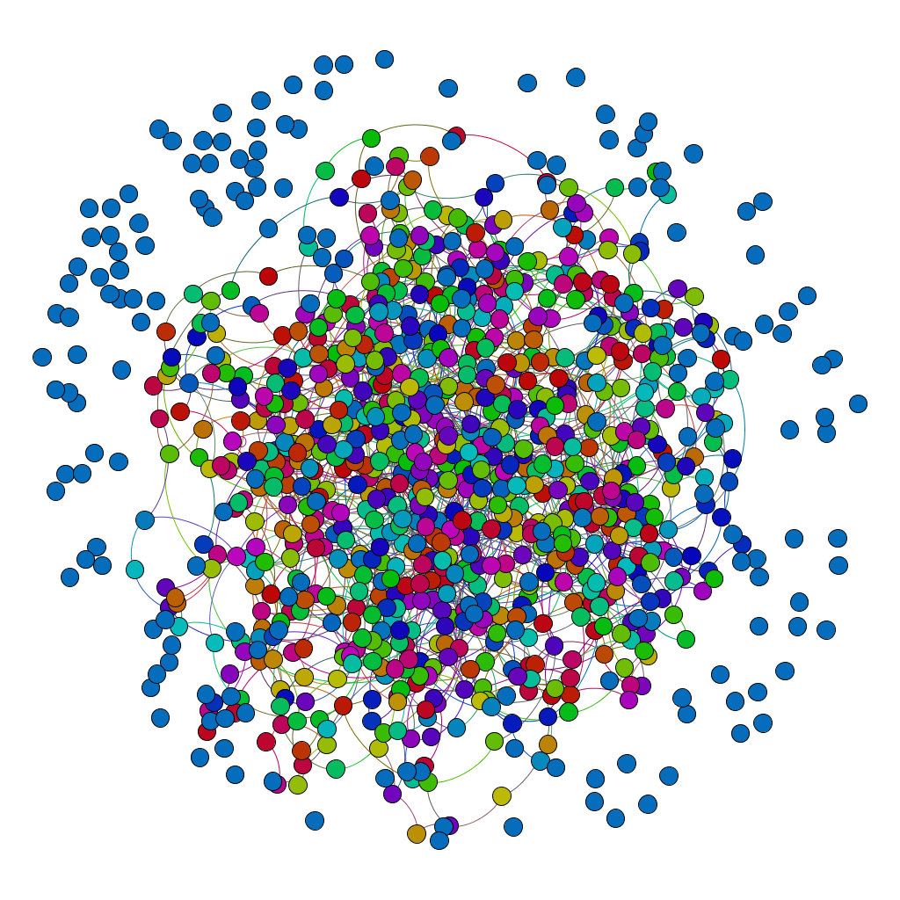
I/O-bound – Cash and Goods
Cash and goods Agent Based Model
Complex system on trading
Simulation objective
Find unexpected behaviour
Extremely simple algorithm + High output frequency

Slide 9
Metric overview
CPU metrics
Usage detail
Arithmetic operations
Function calls
I/O metrics
Read
Write
Memory metrics
Read
Write
Page & cache faults
Network metrics
Sending
Receiving
Summary and temporal statistics

Slide 10
Profiler tool selection
Sar (temporal prof.)
CPU usage
Paging and cache
I/O usage
Network usage
Valgrind Massif (temporal prof.)
Memory consuption
Perf (summary prof.)
FLOPs
Cache rates
Memory access
Gprof (summary prof.)
Function calls
Elapsed time

Slide 11
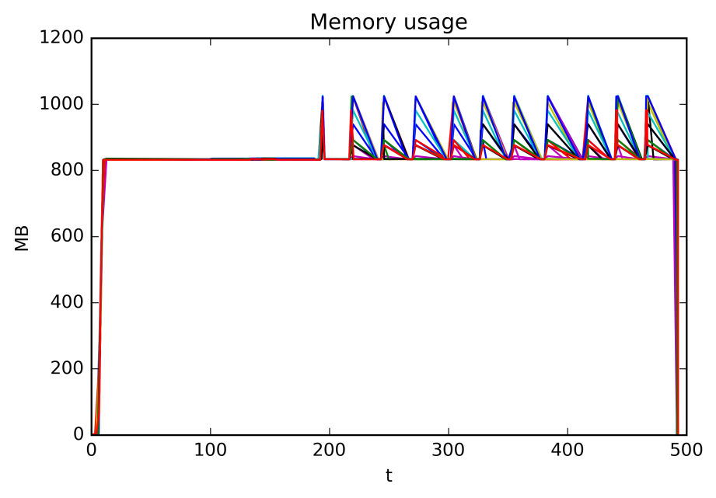
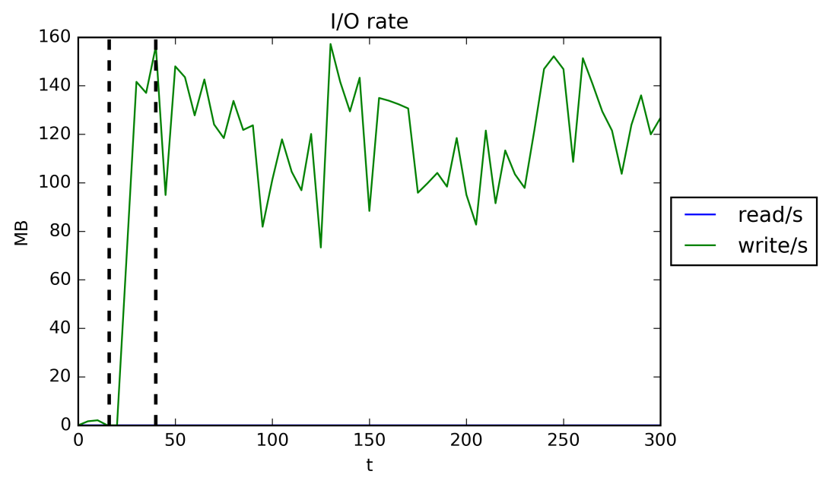
Performance characterization Advection

Slide 12
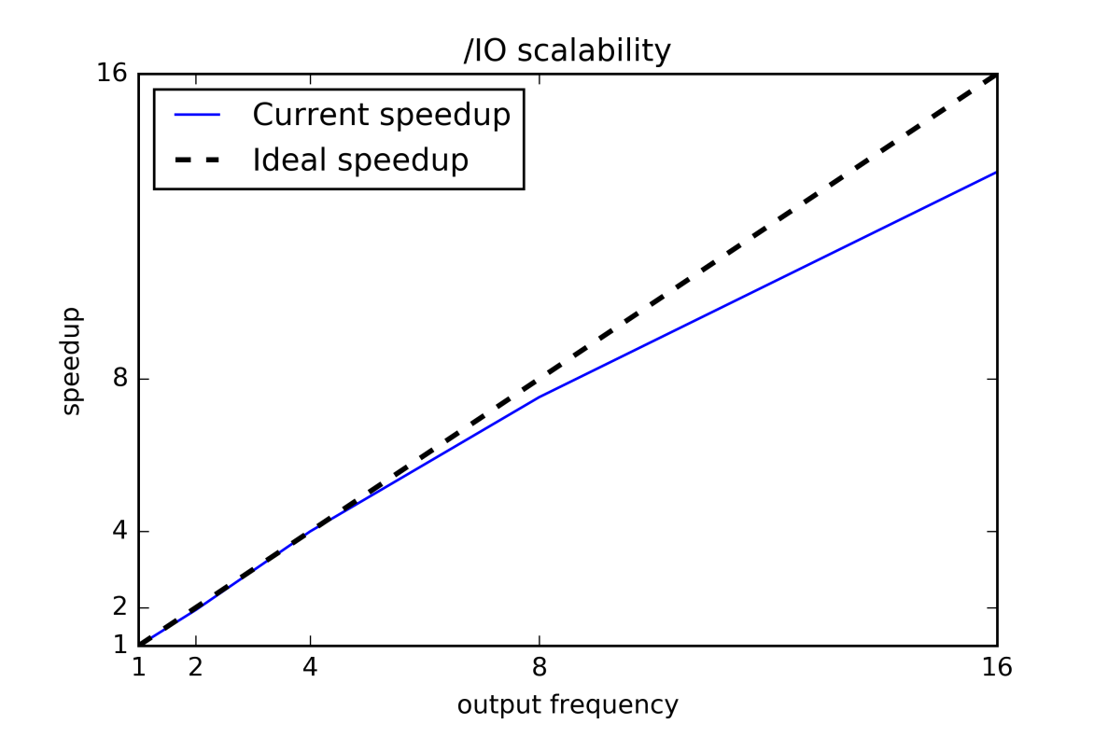
Performance modeling - Advection

Slide 13
Conclusions - Advection
Memory-bound -> I/O-bound
Output size was too demanding
Bottleneck: unique hard disk drive
Suggestions:
Higher rate HDD (hardware)
Distributed architecture, multiple HDDs
Less frequent or lighter output

Slide 14
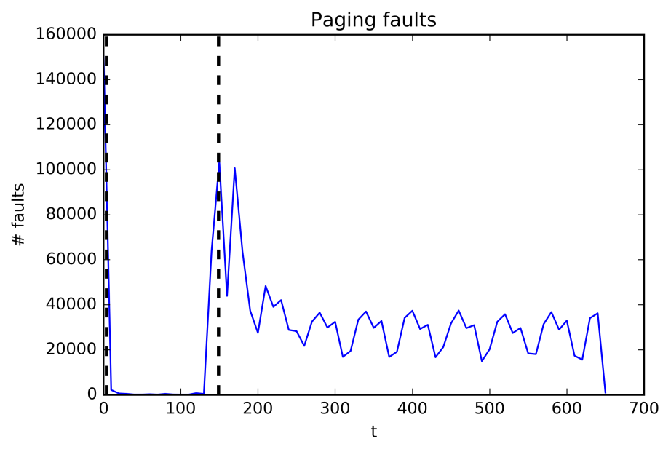
Performance characterization Euler
Event | Count | Events/ins | Events/s
cache-references | 3.522.270.172 | 0,36 % | 5,38 M
cache-misses | 1.237.187.524 | 0,13 % | 1,89 M
mem-stores | 110.211.636.380 | 11,22 % | 168,34 M
L1-dcache-loads | 308.795.201.413 | 31,43 % | 471,65 M
L1-dcache-load-misses | 25.636.359.337 | 2,61 % | 39,16 M
FLOPS | 409.563.438.375 | 41,69 % | 625,56 M
instructions | 982.516.219.892 |  | 1.500,6 M

Slide 15
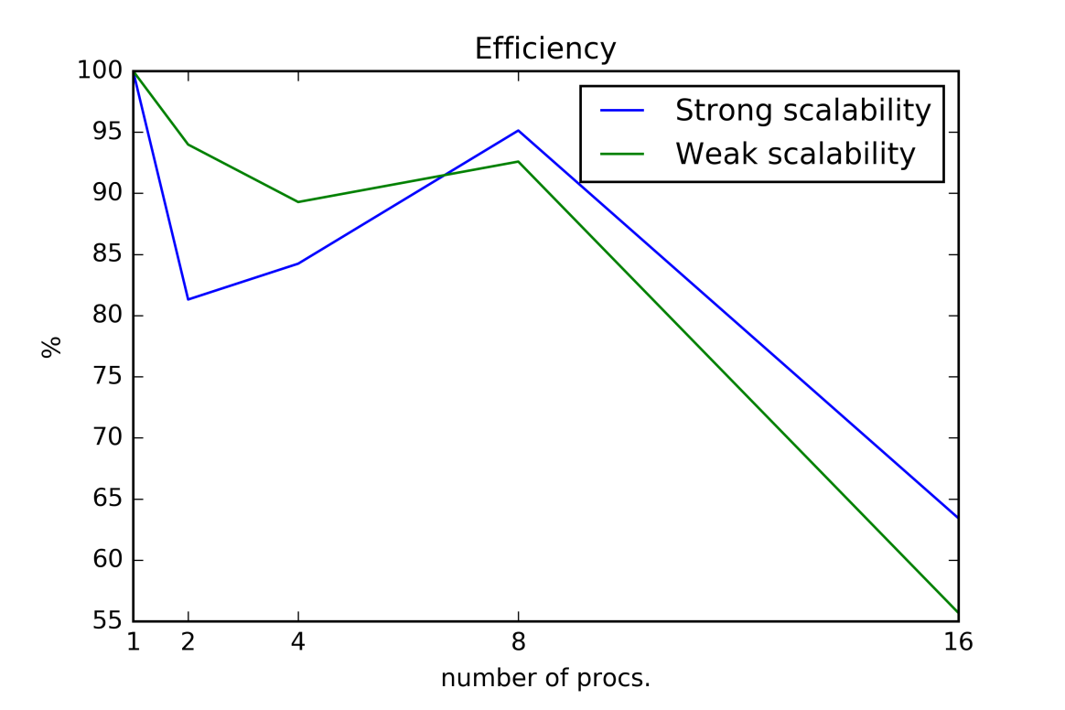
Performance modeling - Euler

Slide 16
Conclusions - Euler
CPU-bound
Good scalability in physical processors
Ideal simulation
Bottleneck: CPU
Suggestions:
Quicker CPUs
More CPUs (not always recommended)

Slide 17
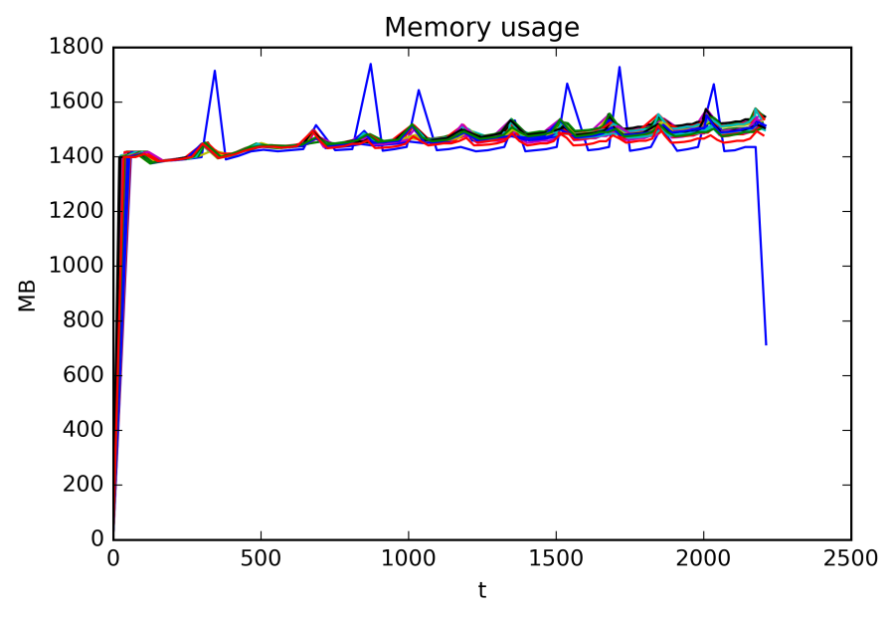
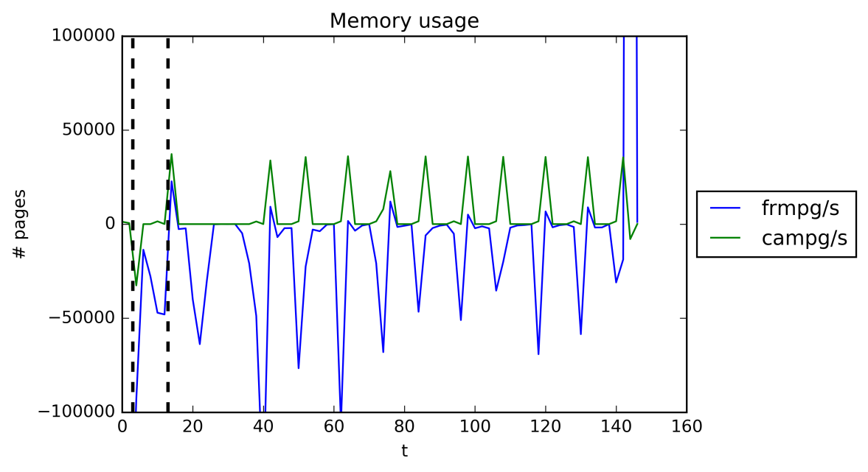
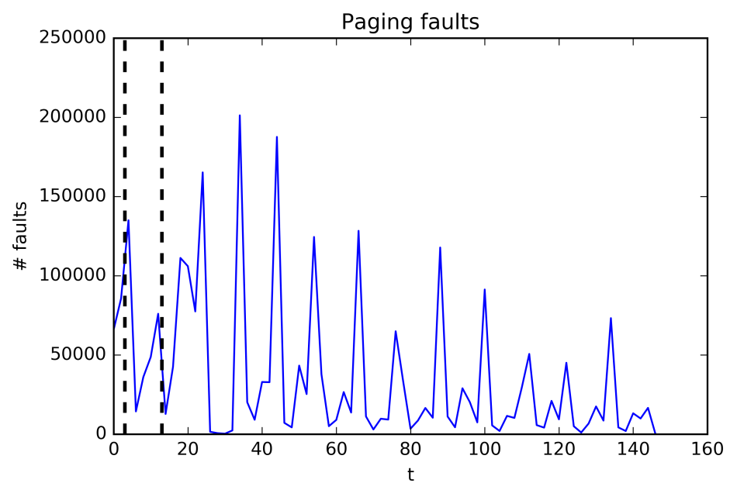
Performance characterization Cash and goods

Slide 18
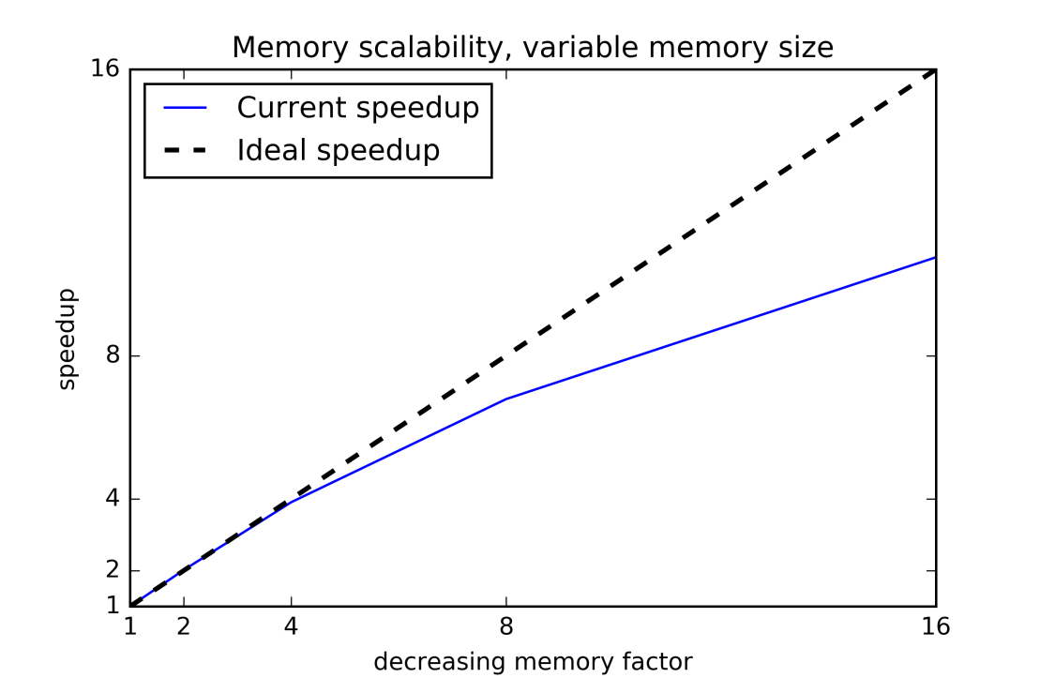
Performance modeling Cash and goods - Memory

Slide 19
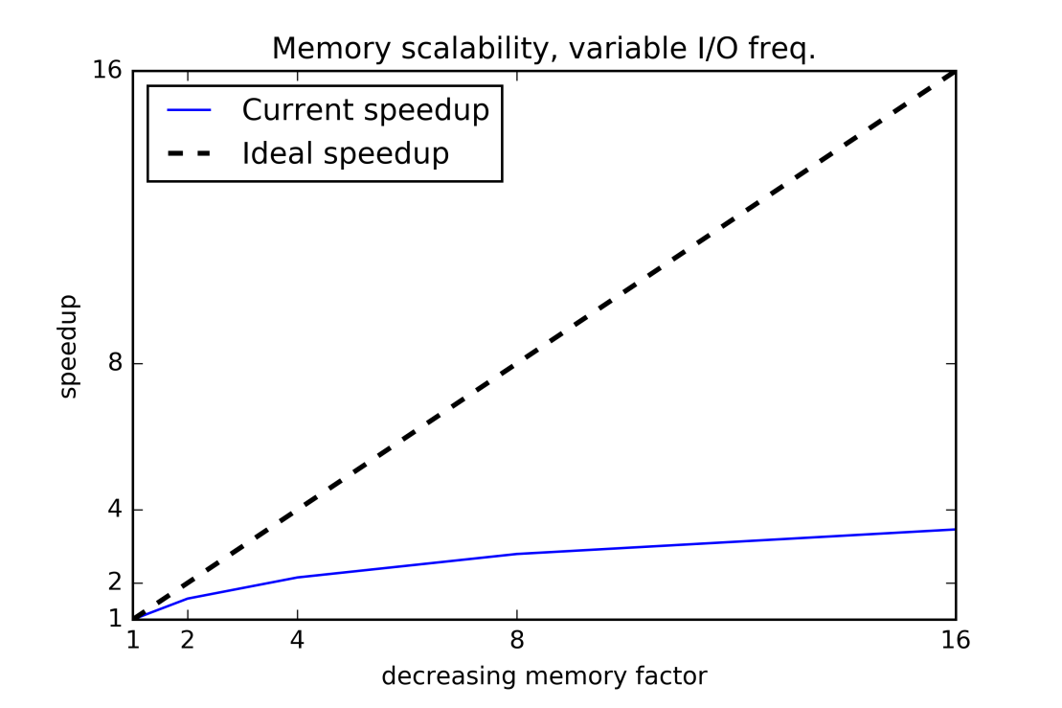
Performance modeling Cash and goods – I/O

Slide 20
Conclusions – Cash and goods
I/O-bound -> Memory-bound
Unbalanced behaviour for one process
Bottleneck: Memory access
Suggestions:
Quicker caches/memory access (hardware)
Distributed memory architecture
Balance output algorithm

Slide 21
Project conclusions – Metric researh
Metrics to cover all resources
Multiple tools:
Summary metrics
Temporal metrics
Consolidate conclusions
Metric granularity for parallel processes

Slide 22
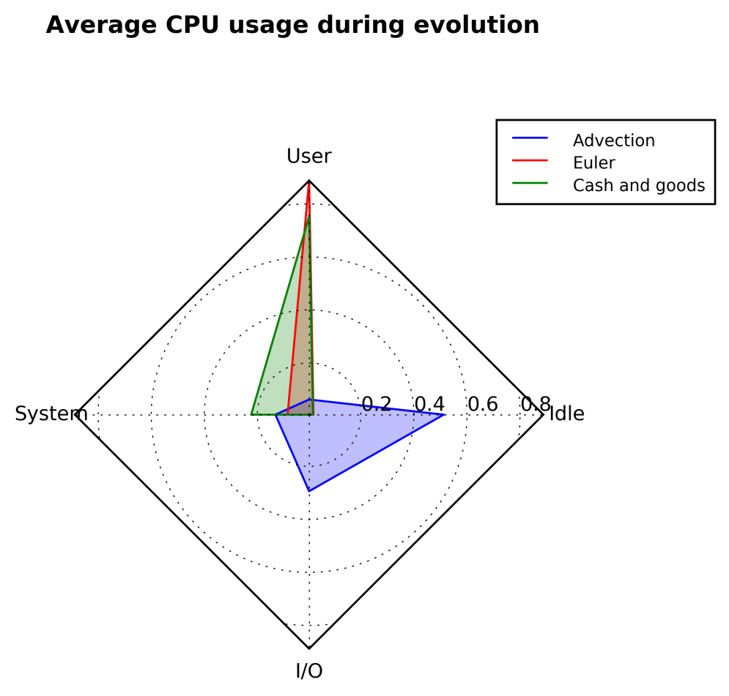
Project conclusions – Simulations
Unexpected bottlenecks
Modelization -> Scalability -> Speedup

Slide 23
Thank you for listening
Questions? / Comments?

