Slide 1
Redefining dropping out in online higher education: a case study from the UOC
Josep Grau-Valldosera, Julià Minguillón
Learning Analytics & Knowledge
February 27 - March 1, 2011
Notes:
Julià, professor computer science studies
Me, staff at the Market Research Department
We’ve collaborated this last years in projects concerning the dropout analysis in our university

Slide 2
Table of contents
Motivation and goals
Dropping-out definition
The Universitat Oberta de Catalunya (UOC)
Data and experiments
Enrolment and non-enrolment records
Results
Discussion
Conclusions and future work
Learning Analytics and Knowledge, Feb 27 – Mar 1, 2011, Banff, Canada
Notes:
The table of copntents of this presentation is as follows: (llegir)

Slide 3
Motivation
Dropping out has traditionally been a problem of brick-and-mortar universities
In Spain, the dropping-out ratio is 25,7 %
It is also a problem in distance and online universities
….acquiring even bigger dimensions
(38,9% for the UOC)
Learning Analytics and Knowledge, Feb 27 – Mar 1, 2011, Banff, Canada
Notes:
Dropping out has traditionally been a problem of brick-and-mortar universities.
- (already in 1975 Vincent Tinto established a doctrine of university dropout)
in Spain, the official dropping-out ratio is of 25,7 for HE institutions (afterwards we will see how this ratio is defined)
- It is also a problem in distance and online universities (acquiring even bigger dimensions -38,9% for the UOC-, also in the “official version”)
baixar-te uni española en cifras 2010
Docs suport:
UEC_2008.pdf Tasas_Abandono_09.ppt

Slide 4
Dropping out definitions (I)
Depending on the perspective adopted:
Not taking the final exam (course point of view)
Not taking any course in a certain (or consecutive) academic periods (degree point of view)
Not overcoming a fixed % of credits in a period of several semesters
Learning Analytics and Knowledge, Feb 27 – Mar 1, 2011, Banff, Canada
Notes:
Several dropping out definitions exists depeding on de perspective adopted
Not taking the final exam (course point of view)
Not taking any course in a certain (or consecutive) academic periods (degree point of view)
Not overcoming a fixed % of credits in a period of several semesters
Neither of them is more valid than the other, it depends on the objective and the “work settings” we have
From a “lAK point of view”, maybe the course point of view would be the “prefferred perspective”(?), although This paper focuses on the degree point of view
Anyway, these perpsectives are interrelated….the dropping-out from a degree would normally be rooted or originated in a “course dropping-out”
…no superant un % de credits en uns quants semestres

Slide 5
Dropping out definitions (II)
Example (Spain HE system):
“Percentage of students, with respect to the total of students enroled in these studies in the semester of beginning, that have not enroled in the theoretical academic year in which they should have finished the studies, or in the following year.”
Learning Analytics and Knowledge, Feb 27 – Mar 1, 2011, Banff, Canada
Notes:
As an example, here there is the “official” dropping out definition for HE institutions in Spain-> this definition applies indistinctly to brick-and-mortar and online universities
“Percentage of students, with respect to the total of students enroled in these studies in the semester of beginning, that have not enroled in the theoretical academic year in which they should have finished the studies, or in the following year.”

Slide 6
Goal
To find a realistic definition of dropping out based on reality (observed data)
This analysis is needed because the official dropping out definition doesn’t fit the peculiarities of UOC
Learning Analytics and Knowledge, Feb 27 – Mar 1, 2011, Banff, Canada
Notes:
Our goal would then be to find another definition for dropping-out, more realistic, based on reality, on observed data
(an exploratory analysis of historic enrolment data is done)
This analysis is needed because the official dropping out definition doesn’t fit the peculiarities of UOC, especially these concerning the non-obligatory enrollment, as we will see in the next slide

Slide 7
Universitat Oberta de Catalunya (UOC)
A 100 % virtual university, founded in 1994
With nearly 50,000 students:
Mainly adult learners
Work and family responsibilities:
90% have a part-time or full-time job
60% with previous HE record
19 degrees plus Masters and PhD Programme
Without obligatory enrolment (students can take breaks)
Learning Analytics and Knowledge, Feb 27 – Mar 1, 2011, Banff, Canada
Notes:
The UOC is a 100 % virtual university, founded in 1994.
Being a “internet based university” was quite an adventure those days!
With nearly 50,000 students, Mainly adult learners and with Work and family responsibilities:
90% have a part-time or full-time job aturats
60% with previous HE experience (half of them have finished their HE education)
The UOC offers 19 degrees plus Masters and Phd Programme
the most important characteristic of UOC “concerning” the dropping-out analysis is that enrolment is not obligatory: the existence of breaks that don’t imply the disruption of the studies mean a “new” dropping out definition is needed

Slide 8
UOC students’ profile
Learning Analytics and Knowledge, Feb 27 – Mar 1, 2011, Banff, Canada
Notes:
Here we can see the ages distribution: the major part of the sutdents has more than 30 years

Slide 9
UOC’s peculiarity
Official definitions are related to “obligatory” enrolment
Non-obligatory enrolment (i.e. breaks) makes such definitions unusable
This would be the case in many distance adult education institutions
Learning Analytics and Knowledge, Feb 27 – Mar 1, 2011, Banff, Canada
Notes:
Returning to the main UOC’s peculiarity, that is the non-obligatory enrolment, we’ve seen that official definitions in Spain are related to obligatory enrolment, while non-obligatory enrolment such as that of UOC makes such definitions unusable. It seems that this would be the case in many distance adult education institutions

Slide 10
UOC’s students enrolment behaviour
New student
Active
Break
Dropout-definition
Dropout first semester
Grade
Drop
out
Learning Analytics and Knowledge, Feb 27 – Mar 1, 2011, Banff, Canada
Notes:
This graph tries to represent the different stages on UOC’s students enrolment behaviour:
One student can remain active several semesters after her first enrolment in the university or, on the other side, drop out from the degree after the first semester.
This student can also take some break semesters (non-obligatory enrolment)..

Slide 11
Structure of data used
User ID | Sex | Date of birth | Enrolment period (semester) | Degree enrolled
529960 | F | 05-JAN-1983 | 2004 (2nd semester) | Law
529960 | F | 05-JAN-1983 | 2005 (1st) | Law
529960 | F | 05-JAN-1983 | 2005 (2nd) | Law
529960 | F | 05-JAN-1983 | 2006 (2nd) | Law
529960 | F | 05-JAN-1983 | 2007 (1st) | Law
529960 | F | 05-JAN-1983 | 2007 (2nd) | Law
529960 | F | 05-JAN-1983 | 2008 (1st) | Law
529960 | F | 05-JAN-1983 | 2008 (2nd) | Law
529960 | F | 05-JAN-1983 | 2009 (1st) | Law
529960 | F | 05-JAN-1983 | 2009 (2nd) | Law
Break (one semester)
Learning Analytics and Knowledge, Feb 27 – Mar 1, 2011, Banff, Canada
Notes:
AFEGIR UN BREAK
(example given for a specific student)
Dir que un registre es crea quan hi ha com a mínim una assignatura matriculada
De quants semestres-anys disposem d’informació històrica i de quants estudis
Dir quants registres s’han tractat

Slide 12
Enrolment / non-enrolment personal records
529960;1;1;1;0;1;1;1;1;1;1;1
A graduated one? It seems so…
20045;1;1;1
A graduated student? Maybe too early / not enough data
10104;1;1;1;0;1;0;0;0;0;0;0;0;0;0;0;0;0;0;0;0;0;0
A dropping out student? It seems so…
21129;1;1;1;1;1;1;1;1;0;0;0;…;0;X
A dropping out student?
Learning Analytics and Knowledge, Feb 27 – Mar 1, 2011, Banff, Canada
Notes:
QUE UN EXEMPLE SIGUI L’ANTERIOR
Dir que aquests records es construeixen a partir de les taules anteriors i dels graduats
Registres de longitud variable, alineats respecte el primer semestre de cada estudiant
Si la X es un zero, es mes probable que hagi abandonat; si la X es un 1 sabem que no ha abandonat

Slide 13
Analysis of long breaks
Goal: to minimize the error of affirming that someone drops out when it does not
P(X=“1” | N consecutive “0”) < ε
Experiments performed with ε = 0.05
Other ε (0.01, 0.1) have also been tested
Learning Analytics and Knowledge, Feb 27 – Mar 1, 2011, Banff, Canada
Notes:
Maximu error admitted = treshold error
Ojo, si fos al final 21129;1;1;1;1;1;1;1;1;0;0;0 ;0;0;0;0;1 no diríem que és dropout perque sabem que no ho és.
Només fem servir la infromació (“patterns”) del passat quan fem especulació sobre el futur (= afirmem que aquest estudiant és abandonador)

Slide 14
Result examples (I): Law Studies
Law degree
Number of semesters | Number of students | Percentage of students | Accumulated percentage
19 | 2 | 0.03 | 0.03
18 | 1 | 0.01 | 0.04
17 | 0 | 0 | 0.04
...
...
...
8 | 37 | 0.47 | 1.80
7 | 29 | 0.37 | 2.27
6 | 50 | 0.63 | 2.90
5 | 69 | 0.87 | 3.77 % (0.0377)
4 | 107 | 1.35 | 5.12
3 | 173 | 2.18 | 7.30
2 | 304 | 3.83 | 11.13
1 | 815 | 10.27 | 21.40
Notes:
These studies started nine and a half years ago
Deixar ben clar que 0.05 es el 5%
TREURE UN PARELL DE FILES (7, 8, …, 17)

Slide 15
Result examples (II): Marketing studies
Marketing degree
Number of semesters | Number of students | Percentage of students | Accumulated percentage
8 | 5 | 0.29 | 0.29
7 | 3 | 0.17 | 0.46
6 | 6 | 0.35 | 0.81
5 | 7 | 0.41 | 1.22
4 | 3 | 0.17 | 1.39
3 | 30 | 1.75 | 3.14 % (0,0314)
2 | 40 | 2.33 | 5.47
1 | 141 | 8.21 | 13.68
Learning Analytics and Knowledge, Feb 27 – Mar 1, 2011, Banff, Canada
Notes:
These studies started only four years ago

Slide 16
Results summary by degree and total of degrees
Degree | N | Error | Accredited | Dropping out
Business Sci. | 5 | 3,78% | 16.6% | 54.3%
Tech. Eng, in CS | 5 | 4,46% | 8.7% | 65.6%
Tourism | 3 | 3,38% | 9.6% | 49.7%
Catalan Language | 4 | 3,89% | 6.5% | 58.9%
Law | 5 | 3,78% | 10.2% | 54.0%
Psychology | 3 | 4,58% | 3.8% | 56.5%
Political Sci. | 3 | 4,27% | 21.7% | 49.5%
Market Res. & Tec. | 3 | 3,14% | 32.4% | 38.0%
Psychopedagogy | 4 | 4,86% | 25.4% | 54.2%
Computer Engineer. | 4 | 3,36% | 30.1% | 37.3%
TOTAL | 4 | 4,35% | 13.3% | 57.6%
Notes:
Accredited (repassar nombres baixos d’alguns programes!)
Dropping out (números espectaculars…relativitzar-los en funció de la definició donada?!-> dir que definició oficial és menys dura)
Les dades només són comparables amb altres institucions d’eduació no obligatòria que fessin el mateix exercici
Ojo…posem dada total?? Crec que pot liar.
Degree
N
Error
Accredited
Dropping out
Business Sci.
5
3,78%
16.6%
54.3%
Tech. Eng. in CM
5
4,11%
9.8%
66.8%
Tech. Eng, in CS
5
4,46%
8.7%
65.6%
Tourism
3
3,38%
9.6%
49.7%
Catalan Language
4
3,89%
6.5%
58.9%
Law
5
3,78%
10.2%
54.0%
Humanities
5
3,75%
7.4%
64.3%
Psychology
3
4,58%
3.8%
56.5%
Business Admin.
4
3,75%
38.2%
40.9%
Labour Sci.
4
2,82%
34.5%
44.8%
Political Sci.
3
4,27%
21.7%
49.5%
Audiovisual Comm.
3
2,67%
21.9%
43.7%
Documentation
3
4,48%
32.3%
50.3%
Market Res. & Tec.
3
3,14%
32.4%
38.0%
Psychopedagogy
4
4,86%
25.4%
54.2%
Computer Engineer.
4
3,36%
30.1%
37.3%
TOTAL
4
4,35%
13.3%
57.6%

Slide 17
Discussion
There exist differences between particular degrees → no “one-size-fits-all” definition
There seem not to exist differences between types of degree content (humanities vs cientific)
Short degrees (1st cycle) seem to have shorter break-up periods ending in dropout
Learning Analytics and Knowledge, Feb 27 – Mar 1, 2011, Banff, Canada
Notes:
Mostrar exemples de cada ítem (de les diferències)

Slide 18
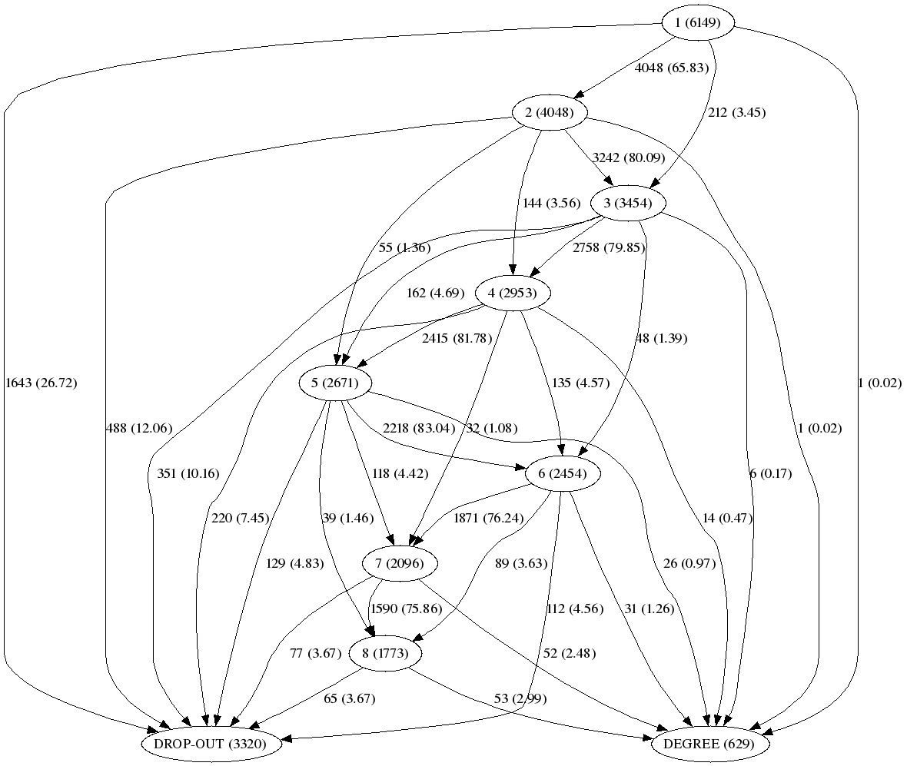
Enrolment behaviour graph (Law)
Notes:
We can see there are students that don’t fit either in the drop-out node or de degree node, because we don’t have enough historic information
It’ is something like a “limbo”

Slide 19
Importance of 1st semester dropout
Learning Analytics and Knowledge, Feb 27 – Mar 1, 2011, Banff, Canada
Notes:
the average of dropout in the first semester over the total dropout value, also for all the programmes considered, is as high as 0,48 (that is, almost half of all dropout would be caused in the first semester

Slide 20
Conclusions
Defining dropping out in distance HE needs to take into account differences:
Between individual degrees
Between degrees of different duration
The importance of 1st semester dropout has been confirmed
Learning Analytics and Knowledge, Feb 27 – Mar 1, 2011, Banff, Canada

Slide 21
Future work
Analysis of causes – predictive analysis of dropping out for “tagged” students:
Socio-demographic issues (gender, age, educational background…)
Institutional issues (mentoring of the 1st semester enrolment, tracking of student’s -learning analytics-,…)
Designing specific actions to reduce dropping out
Learning Analytics and Knowledge, Feb 27 – Mar 1, 2011, Banff, Canada
Notes:
Analitzar el dropping out del primer semestre vol dir fer un seguiment molt d’aprop de l’activitat dels estudiants perquè no sabem si abandonen el primer dia, la primera setmana, el primer mes, amb la primera activitat, etc.

Slide 22
Thank you for your attention! Josep Grau-Valldosera jgrauv@uoc.edu Julià Minguillón jminguillona@uoc.edu
Learning Analytics and Knowledge, Feb 27 – Mar 1, 2011, Banff, Canada

